Slide 1

Essex SEND Joint Commissioning Equipment Survey
Representing Parent and Carer Views on SEND across Essex
Essex Family Forum
July 2021

Slide 2
Purpose of the Survey
This survey was undertaken to address a weakness identified in the Written Statement of Action following the Local Area SEND Inspection in Essex in October 2019. It is being conducted by the Joint Commissioning Group, which is made up of key representatives across Education, Health, Social Care, and Essex Family Forum, which are responsible for SEND provision in Essex.
Parent/carer feedback is a fundamental part of this. The results presented within this report will aid the Joint Commissioning Group to better understand families’ experiences and will inform the provision of future services, meaning improved outcomes for children and young people and their families going forward.
For the purposes of this survey “Equipment” was deemed to include physical and medical equipment. Wheelchairs were excluded from this initial phase of the equipment project since they are a very clearly defined commodity, with clearly defined pathways and providers. Additionally, there is system wide review of wheelchair provision is being undertaken in Mid and South Essex. Therefore, the initial focus of this review is on adaptive or physical equipment rather than devices, i.e. orthotics, which come under “appliances”.
The survey was open from 27th April to 20th June 2021 and was promoted through Essex Family Forum’s network of Family Champions, social media and through education provisions by way of the Education Newsletter, asking settings to share the survey with their families.
Participants' comments included in the report are provided verbatim.

Slide 3
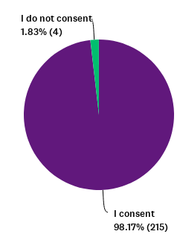
Consent and Participants
The survey was accessed by 219 participants, of which, 215 participants consented to sharing their data. The data from those participants who did not consent has therefore been removed.
A further 2 responses were discounted due to them being out of area. Furthermore, we found that 83 respondents “skipped” through the survey without providing any responses. Therefore, it would be fair to say that we had 130 valid contributions to the survey.
Respondents also had the option not to answer all questions, so the response rate varies dependent on the question, therefore, the number of participants answering each question will be clearly shown at each stage.

Slide 4
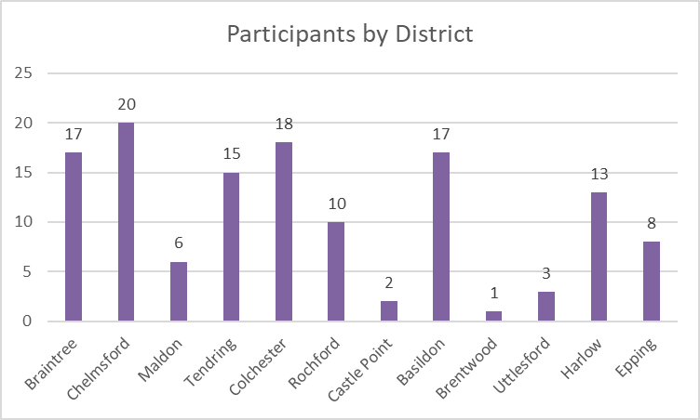
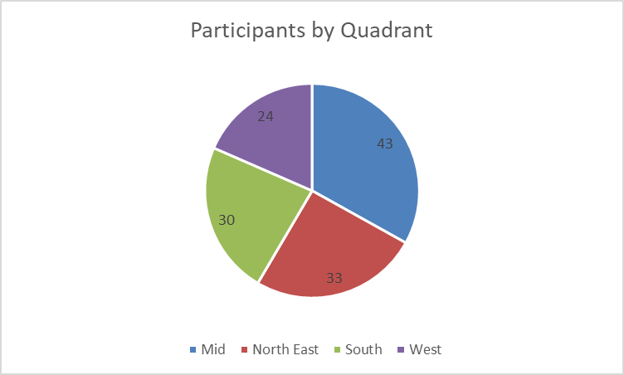
Geographical Response
Mid Essex provided the most feedback, with Chelmsford and Braintree featuring in the top 3 responses by district.
West Essex provided less feedback, with Uttlesford featuring in the bottom 3 districts, alongside Brentwood and Castle Point

Slide 5
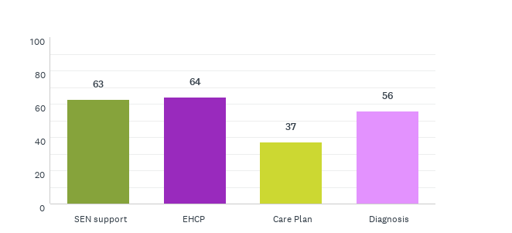
Type of Support
We asked what type of support their child or young person receives, and a total of 106 participants responded as follows:

Slide 6
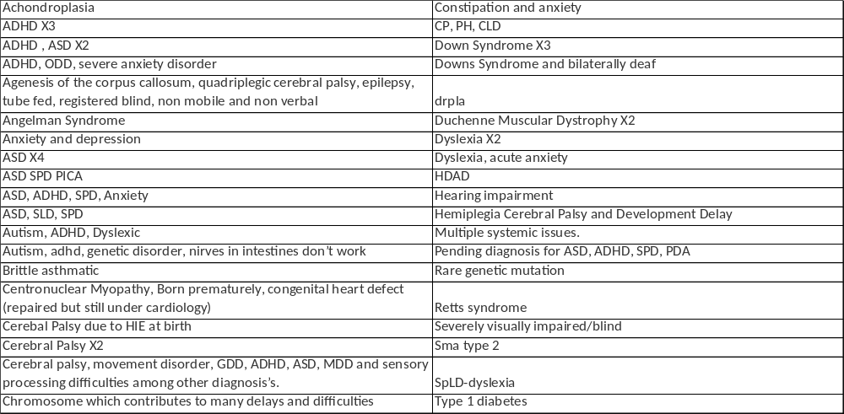
Type of Support
When we asked about the type of support participants were invited to provide diagnoses details of which 49 participants did.

Slide 7
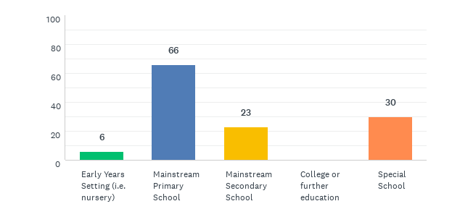
Educational Setting
We asked what type of education setting their child or young person attends, of which 94 participants responded as follows:
We had 5 “other” comments which included:
None yet. Starts nursery in September,
Thriftwoods
Attending an early years setting from September 2021
EOTAS
Currently attending 1.5 hours per week Majority homeschooling.

Slide 8
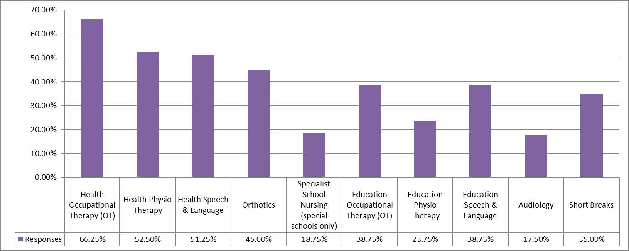
Provision and Service Access
We asked what services and teams their child or young person has access to. 80 participants responded providing 323 types of access, suggesting on average each participant accesses 4 types of provision of services.

Slide 9
Provision and Service Access
13 participants also provided open ended comments confirming the following:
Paediatric Community Nurses
We pay privately where we can as we are not Getty g enough support from the NHS
Ophthalmologist
Paediatrician, great Ormond Street
Ophthalmology
Play therapy
Type 1 Diabetic team
Ta for medical assistance
LA commissioned private sensory OT and SaLTs
Child and family worker
cannot access any service
None of the above
None

Slide 10
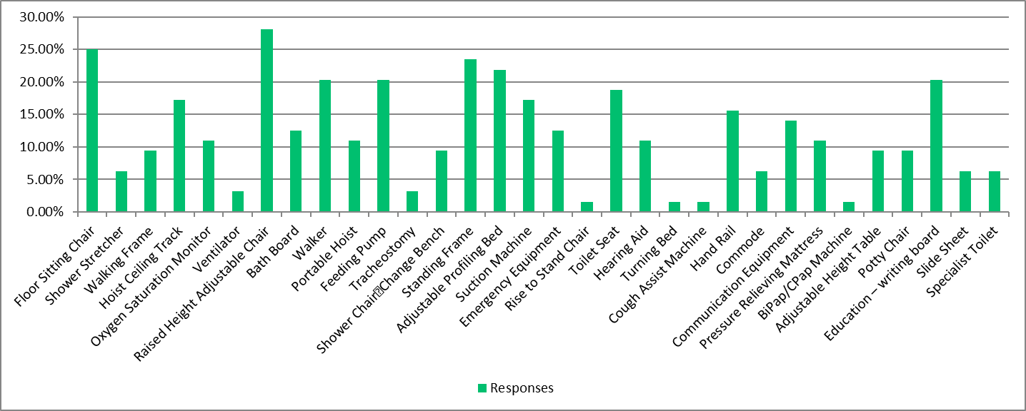
Equipment Use
We asked what equipment their child or young person regularly uses at home or in school, of which 64 participants responded, providing 274 types of equipment, suggesting on average each participants has 4.3 types of equipment

Slide 11
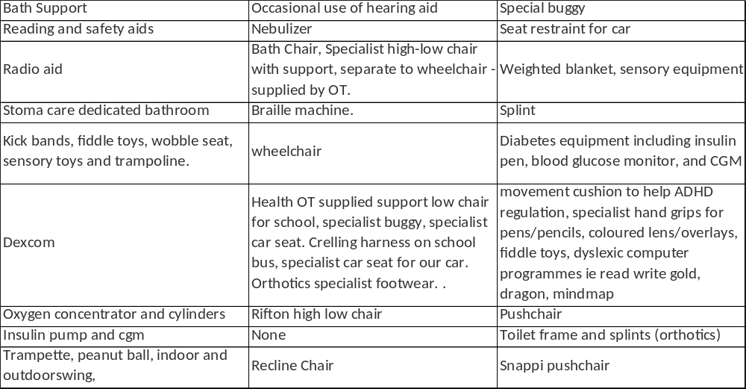
Equipment Use
27 participants also provided open ended comments confirming the following:

Slide 12
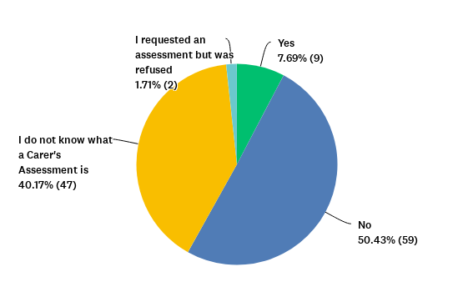
Carer's Assessment
We asked if the participants had been offered a Carers' Assessment, of which 117 participants responded.

Slide 13
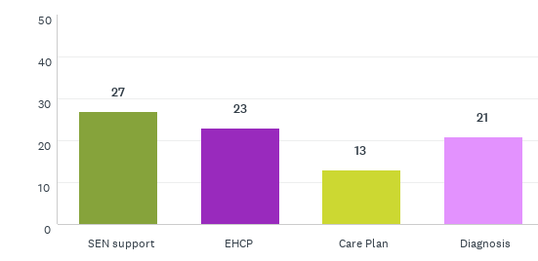
Carer's Assessment
Of the 59 participants that said no the type of support they listed is shown below, as well as some of the diagnosis details provided.
Duchenne Muscular Dystrophy
Sma type 2
Chromosome which contributes to many delays and difficulties
Downs Syndrome and bilaterally deaf
Dyslexia
SpLD-dyslexia
Brittle asthmatic
ADHD
ASD, ADHD, SPD, Anxiety
Retts syndrome
Constipation and anxiety
ASD,
Hearing impairment
Dyslexia, acute anxiety
ASD
Anxiety and depression
Agenesis of the corpus callosum, quadriplegic cerebral palsy, epilepsy, tube fed, registered blind, non mobile and non verbal
Achondroplasia
Autism, ADHD, Dyslexic
Dyslexia
Hemiplegia Cerebral Palsy and Development Delay

Slide 14
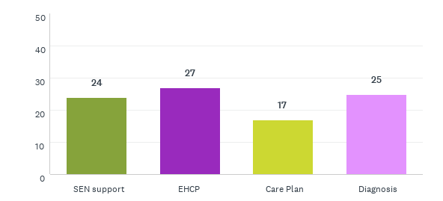
Carer's Assessment
Of the 47 participants that said that they did not know what a carers assessment is, the type of support they listed is as shown below, as well some of the diagnosis details provided.
duchenne muscular dystrophy
Cerebral Palsy
Multiple systemic issues.
Down Syndrome
Autism, adhd, genetic disorder, nirves in intestines don’t work
HDAD
Downes syndrome
ADHD, ODD, severe anxiety disorder
Down syndrome
ASD SPD PICA
Cerebral palsy, movement disorder, GDD, ADHD, ASD, MDD and sensory processing difficulties among other diagnosis’s.
Type 1 diabetes
Autism
ADHD
Severely visually impaired/blind
ASD
Pending diagnosis for ASD, ADHD, SPD, PDA
Cerebal Palsy due to HIE at birth
Cerebral palsy
drpla

Slide 15
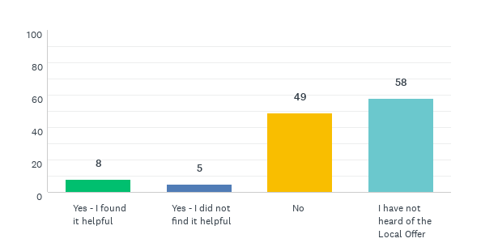
Local Offer
We asked participants if they had viewed the Local Offer for information on equipment, of which 116 participants provided a response.
Participants were invited to provide an open-ended comment, of which 3 did:
It's improved a great deal recently
It does not help people who are both working and are not eligible for benefits
Hard to navigate the website

Slide 16
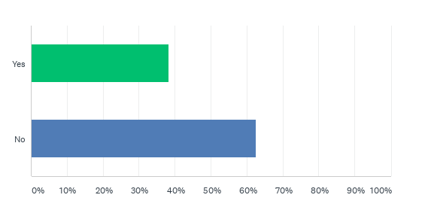
Equipment Access
We asked participants if they knew who to ask if their child or young person needed equipment, of which 115 participants responded.
Of the total number of Participants 26 futher indicated who they would ask. Their responses included:
Senco
PT
OT
Teacher of Deaf
ECC
School
Social Worker
Audiology
Diabetic Nursing Team (PAH)
Community Nurses
CCG
Provide

Slide 17
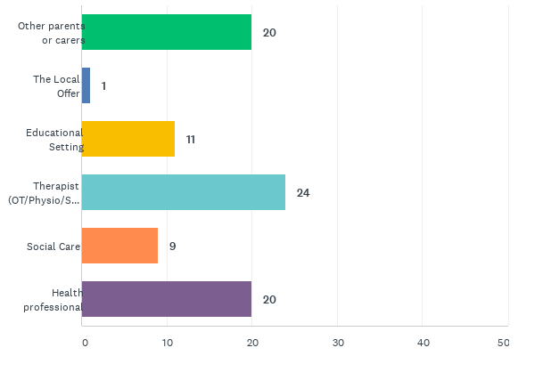
Equipment Access
We asked participants how they found out who to ask. 56 Participants responded.

Slide 18
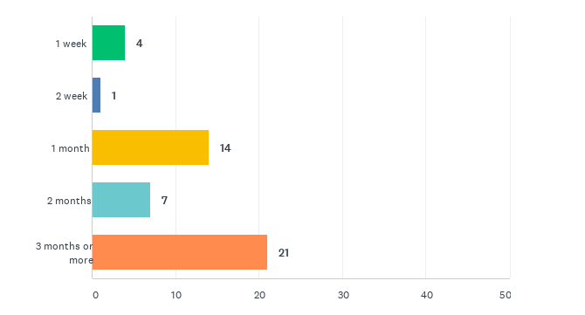
Assessment for Equipment
We asked participants how long did they wait for assessment for equipment (new or review)?

Slide 19
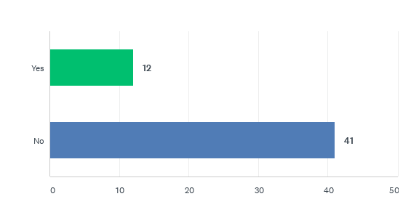
Assessment for Equipment
We asked participants if storage of equipment was taken into account, of which 53 participants responded.

Slide 20
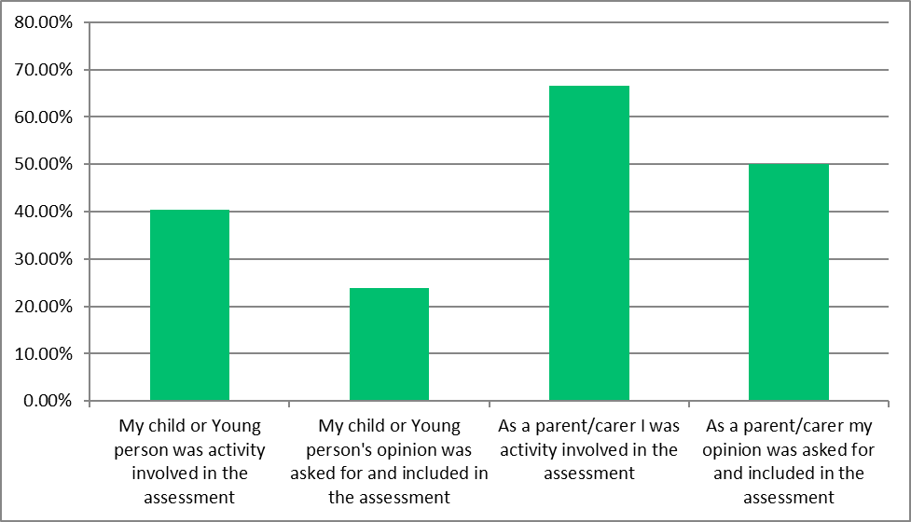
Assessment Views and Involvement
We asked participants if storage of equipment was taken into account, of which 42 participants responded.
Of the total number of Participants 12 provided further information:
No assessment
Have been told I need equipment but nhs and local council haven't provided. Been waiting since August 2020 at present with no help
I don't know
I haven’t had an assessment
Never had assessment from NHS
I don’t think either of our opinions were included or listened to.
None of the above
My views and knowledge of my child's needs was very much valued and respected. My child's own views were not included as he has no speech and SLD. Question above regarding how long did we wait for equipment to be supplied after assessment varied on the item.
I am not sure
We advised what we needed but spent almost a year being told what we should have (which was different to our requested item) after other trials were proven to be unsuitable we eventually got the original chair we requested about 2 years 4 months after our request.
was not asked and had to buy myself for my child for both home and school
Varies on different equipment/services

Slide 21
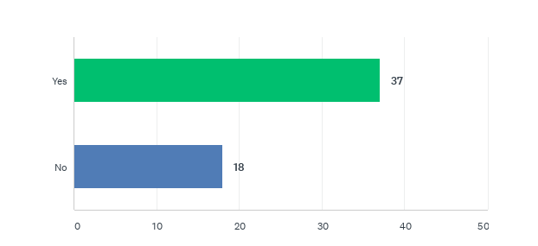
Future Needs
We asked participants if they felt that the future needs of their child or young person were considered in the assessment, for example; growth, progression, deterioration, or regression of condition and need. 55 participants responded.

Slide 22
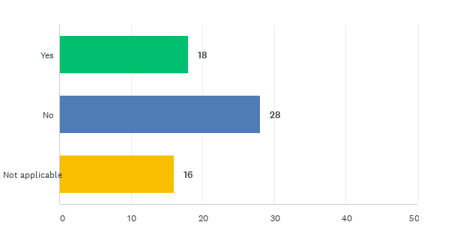
Future Needs
We asked participants if the therapist discussed what equipment might be needed in the future, of which 62 participants responded.

Slide 23
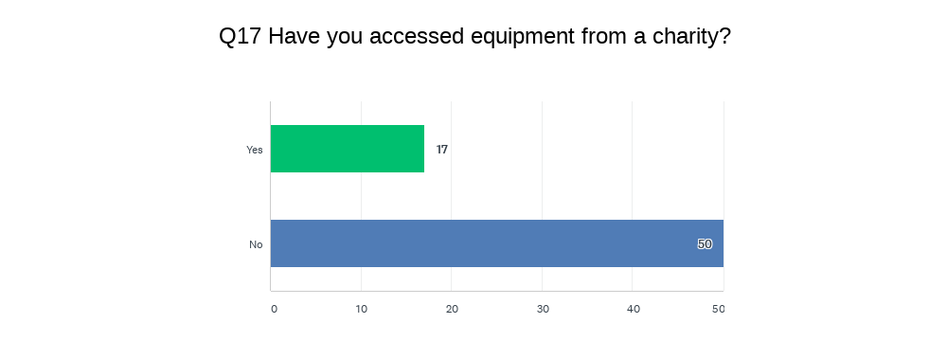
Equipment Access
We asked participants if they had accessed equipment from a charity. 67 Participants responded.
Of the total number of Participants 10 provided further information:
whizz kids for power chair risers
Designability and family fund
Trike and sleep system
New life
Emergency safety bed from Newlife Charity while working with SC OT
New Life
walking frame, no more tears
Wheelchair & been told to approach charity for portable coding movie hoist
Wheelchair/SEN buggy - Catalyst and Colchester Children's Charity
Floor sitter from wipe away those tears

Slide 24
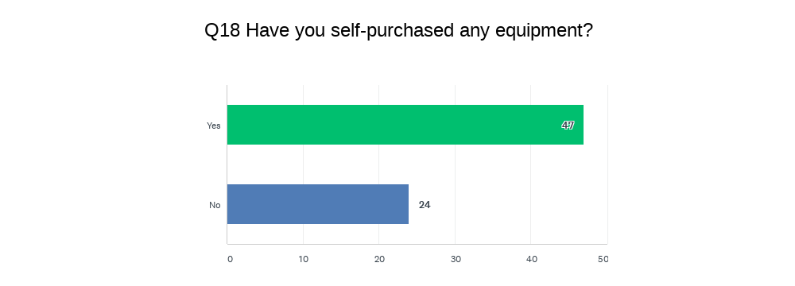
Equipment Access
We asked participants if they have self-purchased any equipment? 71 Participants responded.

Slide 25
Equipment Access
Of the 71 Participants who confirmed if they self-purchased any equipment, 37 of them provided open ended comments. A select of them are shown below:
A New more supportive Pushchair.
Continence equipment, communication tools, educational equipment, sensory room equipment suggested by the OT, cushions, books,
Wheelchair walker bath support
Pushchair and bed
Indoor chair, Outdoor 3 wheel jogger buggy, new mattress, height adjustable shower bench
Buggy - required due to safety from harm, emotional security and unable to walk distances. Knew we would not qualify for wheelchair services at that. Specialist car seat for our car,
Sensory equipment including, sensory wall, sensory garden and bed, trampoline.
wheelchair bycicle
Orthotics, chairs, stools, physio equipment

Slide 26
Equipment Access
We asked participants if there a is piece of equipment that is not currently funded by the NHS that would make a difference or impact on family life. 30 participants responded as selection are listed below.
Education and safety aids for children with neurological issues that cannot keep themselves safe and require monitoring
Renting Sensory equipment would be great as it’s so expensive and sensory needs change
Ppod chairs, being allowed a Walker at both home and school so the child benefits more from it.
Push chairs
a walking frame which my child can actually use; the one at school is not appropriate, ie he can't walk with it
Why does the NHS have to fit the bill - when in my case the ministry of Education should be fitting the bill for things such as specialist computer programmes/licences, pencil/pen grippers, coloured overlays
Yes. Dexcom CGM.
A specialised tryke would help him feel a bit more like the rest of his peers.
Special needs bicycle to be able to take my son out and get exercise and enjoy family time together
A bed for serverly austic children who have the senserory issue as she has been through 3 beds in 18mnths and the more sucure beds are about 1500 pounds
off road wheelchair
power assisted wheelchair
larger bed (myoclonus movements)
My son require special sleep suits that costs £85 because he tares his clothes.
Seating chair for eating, bath support, standing/walking frame & specialist buggy
Wizzybug

Slide 27
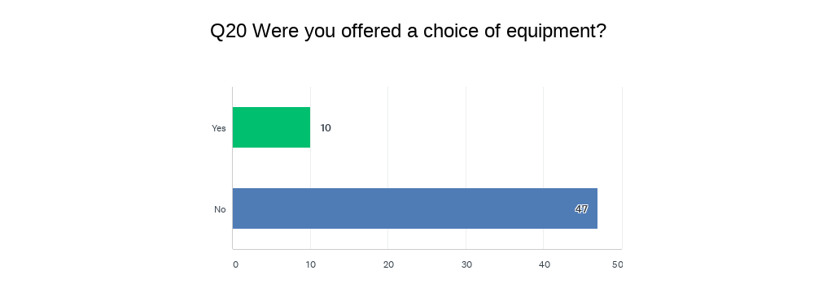
Equipment Choice
We asked participants if they were offered a choice of equipment. 57 Participants responded.

Slide 28
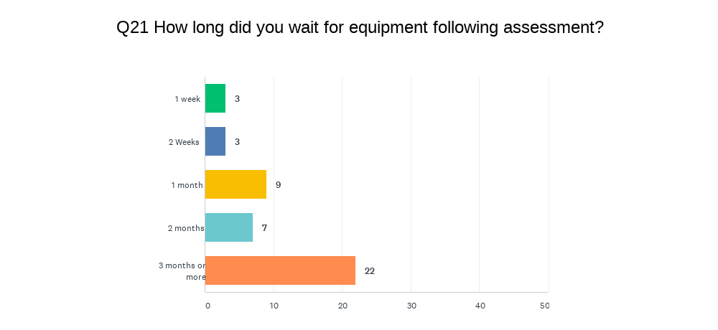
Equipment Wait
We asked participants long did they wait for equipment following assessment. 44 Participants responded.

Slide 29
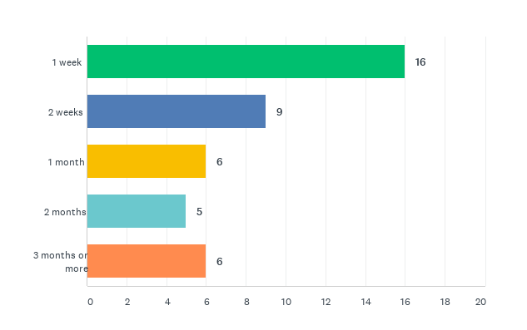
Equipment Set Up
We asked participants how long after delivery did, they wait for equipment to be set up. 42 Participants responded.

Slide 30
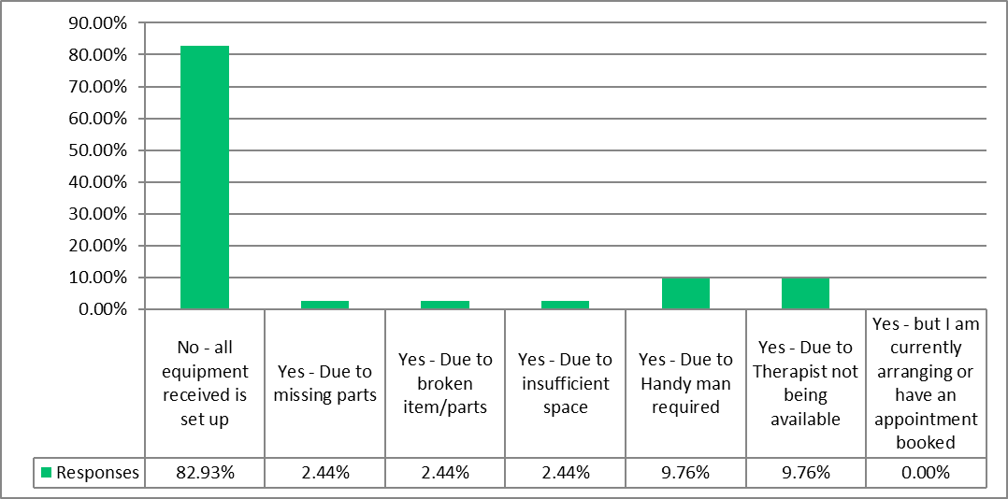
Equipment Set Up
We asked participants if they have received equipment that has not yet been set up. 41 Participants responded.
Of the total number of Participants 9 provided further information:
Breaks on walker been told to do it ourselves
Still waiting for equipment his O. T. said he needs
N/a
I have not received any equipment of any kind
Safety bed was set up on delivery
Not applicable
School wont install the dyslexic computer equipment as they do not have the resource or time to use it.
Item was eventually sent back as no one came to fit and 6 months later needs changed
We are currently having to take parts of our home high/low chair to fit onto nursery chair as the parts hadn't been ordered.

Slide 31
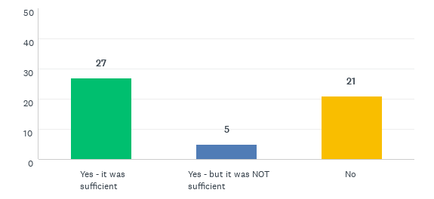
Equipment Training
We asked participants if they received training to use the equipment. 53 Participants responded
7 participants provided additional information:
It was a difficult time due to covid restrictions but the help was brillant
Nor has child with using wheelchair. Had accessed charity wheelchair skills which is crucial in accessing community safely
XXX has a special chair but this has been set up at school,not at home
Equipment needs a rep from the company
the school never said they could not use the equipment i sent in
Some things you get training for & others not. There’s also no training for parent carers lifting
Often we download the user manuals for equipment as it's quicker to make small adjustments ourselves as and when needed.

Slide 32
Equipment Training
Of the 21 participants that said they received no training for the equipment which they used is listed:
Adjustable Height Table
Adjustable Profiling Bed
Bath Board
Communication Equipment
Education – writing board
Emergency Equipment
Feeding Pump
Floor Sitting Chair
Hand Rail
Hearing Aid
Hoist Ceiling Track
Oxygen Saturation Monitor
Portable Hoist
Potty Chair
Pressure Relieving Mattress
Raised Height Adjustable Chair
Shower Chair Change Bench
Shower Stretcher
Slide Sheet
Specialist Toilet
Suction Machine
Toilet Seat
Walker
Walking Frame
Of the 5 participants that said the training was not sufficient, the equipment which they used is listed:
Adjustable Profiling Bed
Bath Board
BiPap/CPap Machin
Commode
Emergency Equipment
Feeding Pump
Floor Sitting Chair
Hand Rail
Hearing Aid
Oxygen Saturation Monitor
Raised Height Adjustable Chair
Standing Frame
Suction Machine
Toilet Seat
Tracheostomy
Ventilator
Walker
Walking Frame

Slide 33
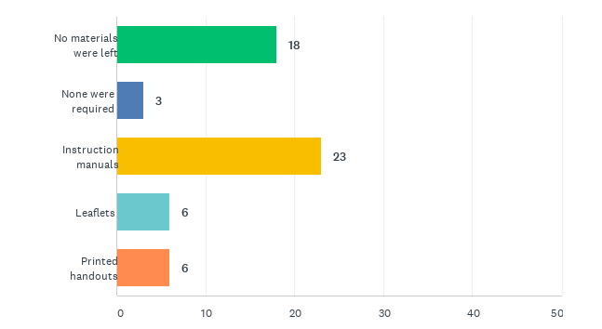
Equipment Training
We asked participants if training materials were left with them to read? 49 participants responded.

Slide 34
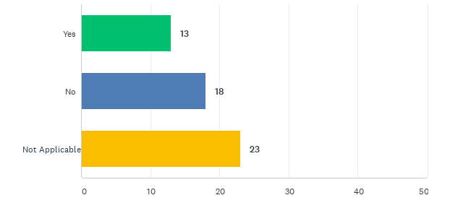
Equipment Manual Handling
We asked participants if their manual handling needs were considered? 54 participants responded.

Slide 35
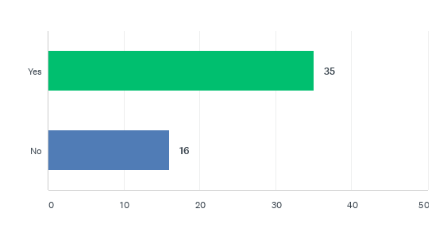
Does The Equipment Meet Need?
We asked participants if the equipment meets their child or young persons needs? 51 participants responded.

Slide 36
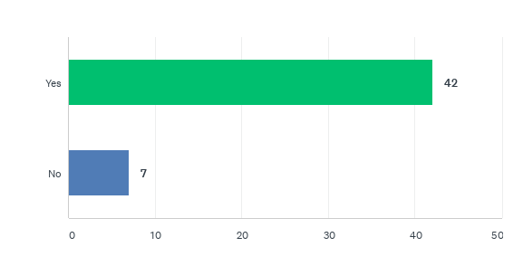
Does The Equipment Meet Need?
We asked participants if the equipment is child friendly or appropriate to their child or young person's age /need. 49 participants responded.
We look at the equipment they the 7 participants that stated the equipment did not meet the need, which is shown below:
Portable Hoist | Adjustable Profiling Bed
Potty Chair | Education – writing board
Pressure Relieving Mattress | Feeding Pump
Rise to Stand Chair | Floor Sitting Chair
Slide Sheet | Hand Rail
Specialist Toilet | Hearing Aid
Suction Machine | Hoist Ceiling Track
Toilet Seat | Oxygen Saturation Monitor
Walking Frame
6 of the 7 participants that said ‘No’, confirmed that the equipment provided did not meet their child or young person's needs.

Slide 37
Does The Equipment Meet Need?
15 participants provided additional information equipment meeting their child or young persons needs, a selection are shown below.
Because I have based on the basic's of what he might need at the moment not for the future
My child has grown we have waited over a year to have this sorted and we are still waiting
Need full sensory swing with different attachments
Bed, and chairs do but has outgrown buggy.
He was given specialist seating for school and home when he was 4 years old, he is now 7 so has outgrown this equipment but we haven’t been able to get him re assessed in school and at home a new chair was ordered but after 3 months still hasn’t arrived. In school he has no toilet facilities that he can use safely and appropriately. My son has been in this primary school for almost 2 years and no assessment for equipment has been done.
the special seating chair that was provided had to be adjusted for growth after approx 1 year, there was no one who would take this on and would not pay for the adjustments that were required, in the end as it sat unused for a second year we called Essex equipment service to remove it as we couldn't use it and they wouldn't pay to adjust it. We then bought our own chair from Leckey (what we requested in the first place) A lot of money was spent getting the chair the OT said we needed for postural support but no one followed up with the carved seating or paid for the reviews needed a total waste of money as it didn't meet our daughters needs for very long.
The Laptop is constantly changed, so he becomes obsessed with the laptop rather than the work
walker at school not appropriate; other equipment is fine
He has regressed in the past year, the therapists are aware.

Slide 38
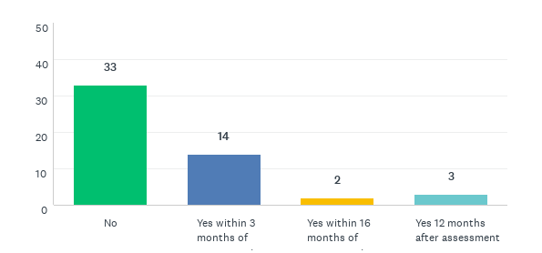
Equipment Review
We asked participants if they had an appointment with the OT/Therapist /Community Nurse/Dietician/Family Advice to review their child or young person's equipment needs. 52 Participant's responded.
6 participants, provided additional information.:
In waiting lists
We finally have a Pt and ot coming into school hopefully in the near future.
unable to access
I contact the therapist when equipment needs reviewing or adjusting.
I call relevant department to ask for assistance
I contact SC OT when I feel a review is required

Slide 39
Equipment Review
We asked participants if they know who to contact is they needed assistance with their equipment. 55 Participants responded.

Slide 40
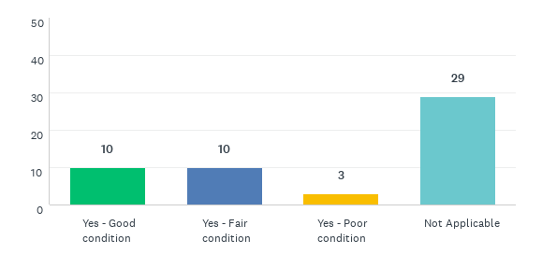
Recycled Equipment
We asked participants if they had received a piece of equipment that had been pre-used or recycled, and what condition it was in. 52 participants responded.

Slide 41
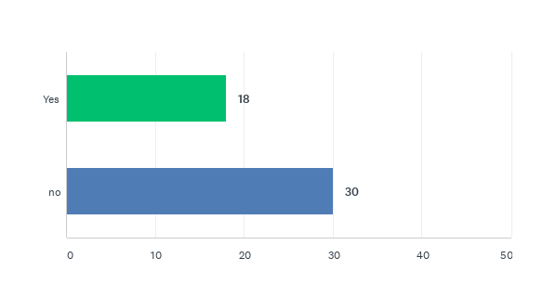
Equipment Servicing
We asked participants is their equipment required regular servicing? (i.e. moving, mechanical or electrical parts). 48 participants responded.

Slide 42
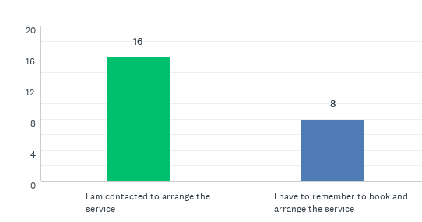
Equipment Servicing
We asked participants who arranges the service. 24 Participants responded.
9 Participants provided additional comments:
some call me other I have to remember to call them
No
I don't know
Don’t know who to contact
None
Tracking hoist service contact themselves
Never serviced - walking frame.
N/A
It varies depending on equipment item

Slide 43
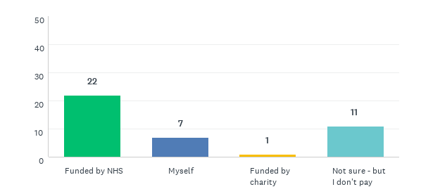
Equipment Servicing
We asked participants who pays for the service. 38 Participants responded.
4 Participants provided additional comments:
Me ans same time charity help
NA we have not been given any equipment at all and nothing I have bought requires specialist servicing
think the hoist is serviced by Essex equipment service
Never serviced

Slide 44
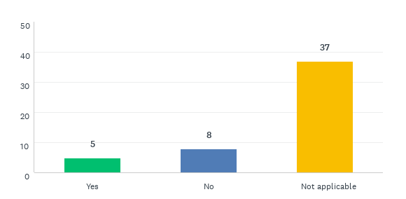
Equipment Servicing
We asked participants if their equipment has been taken away for servicing or to be repaired, were they offered a suitable alternative. 50 Participants responded.
For those that stated ‘No’, the equipment they listed they had access to is as follows:
Adjustable Height Table | Oxygen Saturation Monitor
Adjustable Profiling Bed | Portable Hoist
Bath Board | Potty Chair
Commode | Pressure Relieving Mattress
Communication Equipment | Raised Height Adjustable Chair
Education – writing board | Shower Chair Change Bench
Emergency Equipment | Slide Sheet
Feeding Pump | Specialist Toilet
Floor Sitting Chair | Standing Frame
Hand Rail | Toilet Seat
Hearing Aid | Walker
Hoist Ceiling Track

Slide 45
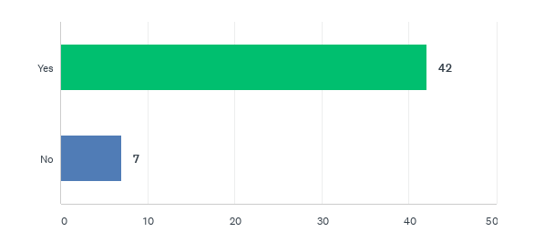
Equipment Servicing
We asked participants if it would be useful to have a sticker on the equipment stating a contact number for repair, a contact number for collection, a contact number for service, and a contact number for advice on how to use appropriately. 49 Participants responded.

Slide 46
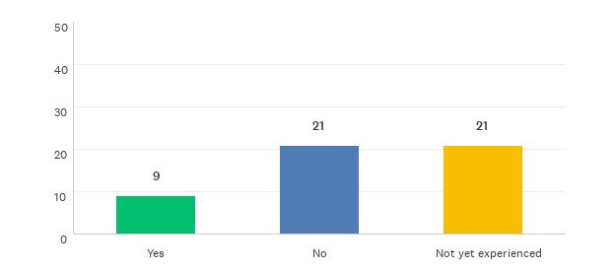
Equipment Collected
We asked participants if equipment collected quickly when no longer needed. 51 participants responded.

Slide 47
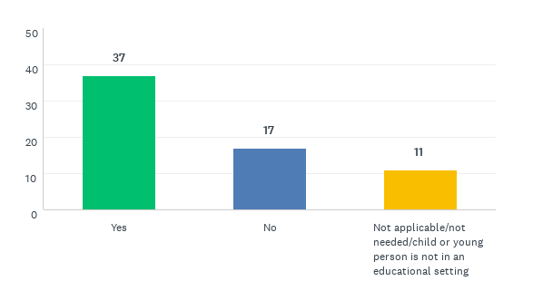
Equipment in an Educational Setting
We asked participants if their child has access to the right equipment at their educational setting. 65 participants responded.
For those participants that said ‘No', we looked at the information participants provided for diagnosis. Their responses are as follows:
duchenne muscular dystrophy
Chromosome which contributes to many delays and difficulties
ADHD, ODD, severe anxiety disorder
Cerebral palsy, movement disorder, GDD, ADHD, ASD, MDD and sensory processing difficulties among other diagnosis’s.
Dyslexia, acute anxiety
Cerebral palsy
Autism, ADHD, Dyslexic

Slide 48
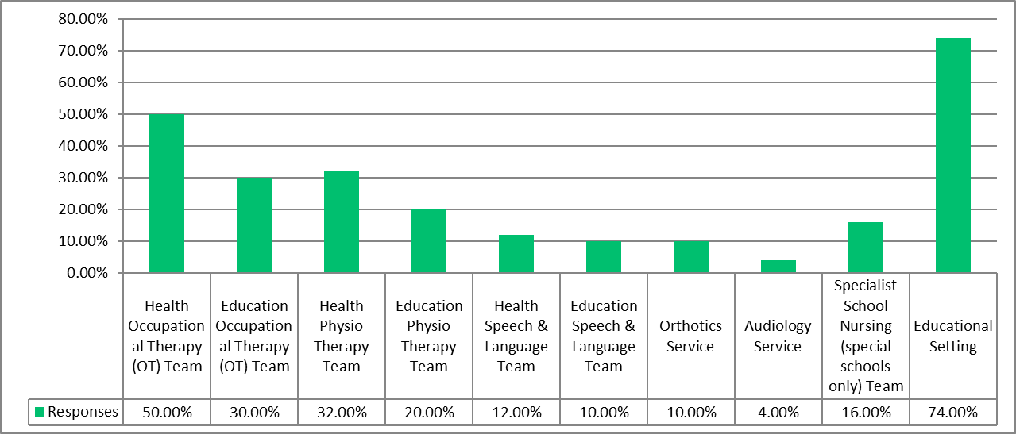
Equipment in an Educational Setting
We asked participants If they felt the appropriate equipment was not available in your children or young person's educational setting who would you raise this with. 50 participants responded.

Slide 49
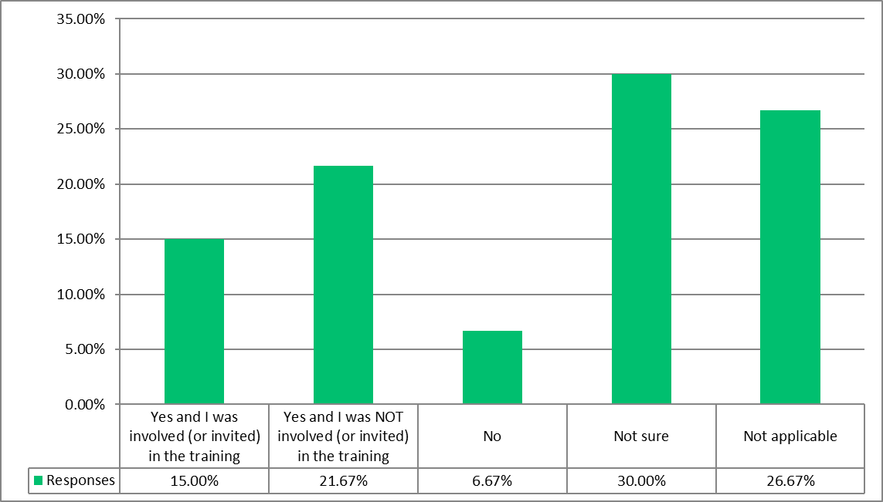
Equipment in an Educational Setting
We asked participants if their school setting received appropriate training to use the equipment effectively. 60 participants responded.

Slide 50
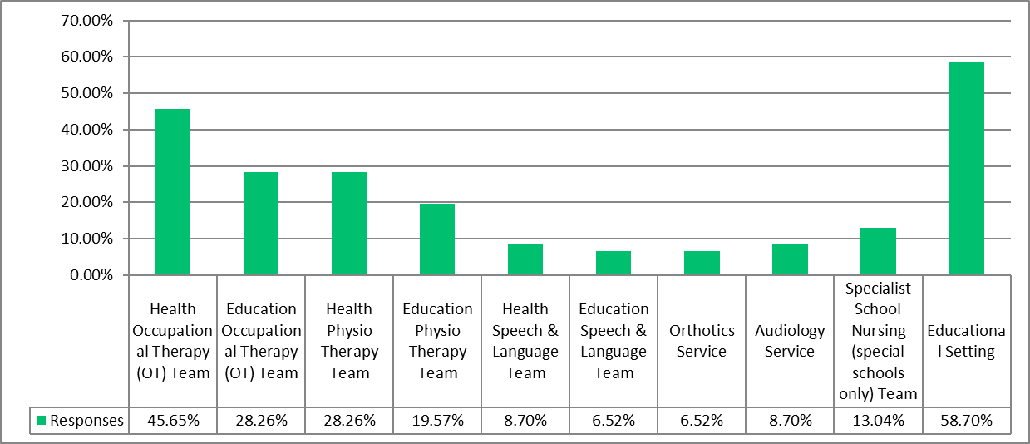
Equipment in an Educational Setting
We asked participants who would they ask for advice if they were worried that equipment in your child or young persons education setting was not being used safely or their child or young person was not comfortable. 46 Participants responded.

Slide 51
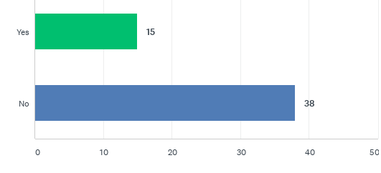
Equipment in an Educational Setting
We asked participants if they have to transport equipment to the school setting for your child to access? 53 participants responded.
13 participants provided additional information:
i prefer to do this
walker
Walker would be moved from home to preschool
Reading aids and sensory items
Hearing aids and microphone
He is attached to insulin pump and cgm so he goes with it everywhere
Suction and feeding pump
Major buggy
Ventilators, Suction Machine, Nebuliser.
ortheses
Wheelchair
Walking frame
Walker, floor sitter and currently high/low chair parts

Slide 52
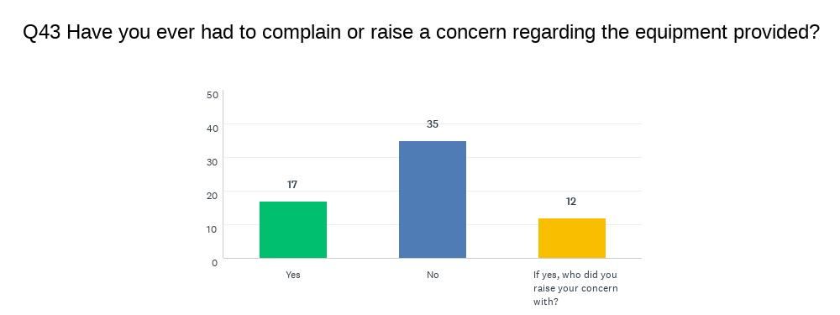
Equipment Complaints
We asked participants if they had ever had to complain or raise a concern regarding the equipment provided. 54 Participants responded.
Participants indicated that complaints were raised as followed:
Complained about lack of equipment to O. T. and PALS had no replies whatsoever
Not sure
I have raised my concern that we don’t have any appropriate equipment for my son in school with his OT, PT and PNI specialist teacher .
N/a
Physio or Occupational Therapist
Eaducation and health OT and nursing team
Community nurses or CCG
made formal complaint to the NHS trust; and sent a letter to headteacher at school
SC OT - told them the high safety chair at home was broken, was through ro7gh use and it was addressed very rapidly. 0
OT
head teacher, SEN teacher
OT & LA

Slide 53
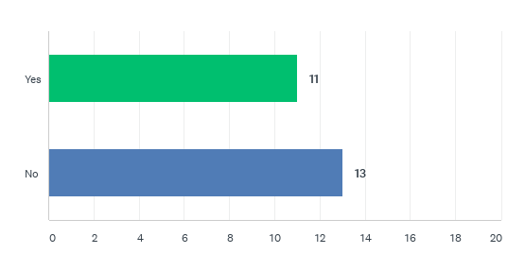
Equipment Complaints
We asked participants if the complaint they made was acted up. 24 Participants responded.
10 Participants provided additional information:
No complaints
Complained over 2 months ago and haven't even been acknowledged
Not sure
There still aren't left handed scissors in school
I am hoping it will be acted on soon.
N/a
They still brought same equipment back and wasn't helpful in finding a Alternative
only partially; the problem ocurred again, and nothing was done about it
It was a high low chair that was in a very dirty condition, We cleaned it ourselves
One currently outstanding

Slide 54
What is not working well?
We had 34 participants provide detailed reponses. A selection is listed below. The main themes are also provided.
Main Themes
Wait Time
Servicing
Restrictions on provision
Information
Choice
Cost
Accountability
Nappies
Assessments and Appointments
Communication and Access
The continence provision has been brilliant. But as our sons circumstances have changed the resources have not quite been able to meet his needs. He is now independently able to use the toilet for wees so needs a pull up so he is able to do this independently but is still soiling himself so needs the protection of a pull up to catch this and prevent spills. The provision are tab nappies and these he cannot manage independently. I appreciate the budget doesn’t reach this provision but it’s useful feedback I hope
As mentioned before a child is only able to receive one or the other wheelchair or walker but both may be required. I asked for social care assessment of the home but has been referred by the ecc hub to health ot who doesn’t deal with home equipment.
There’s no information for parents we have to do all the leg work always
Lack of contact with therapists, lack of contact numbers so we know who to ask for help.
Orders of consumables - too many people involved. If I could place an order direct with ECL it would be much easier than having a standing order, especially in circumstances where we may use less and storage becomes an issue.
The main issue has been the constant changing personnel, once you know the physio and OT names it seems they move on and it takes time for someone to get back in touch, or to meet the person that will take on the job.
Health Budget for equipment above £1k carne approved by OT area & goes to LA DFG area. Equipment refused based on current DFG separately underway.
It is hard to get assessment and appointments with the appropriate teams. It takes a long time to get the correct equipment and longer to then wait to get it set up. We have had equipment for 2 years on the school premises which has never been set up in that time and now my child has outgrown the equipment so now needs a new assessment and new equipment.
Information about available equipment, stock, collection of equipment no longer needed
They always want to give you the cheapest options first and not what's best for your child.

Slide 55
What is working well?
We had 30 participants provide detailed Reponses. A selection is listed below. The main themes are also provided.
Main Themes
Good Service
Helpful professionals
That most provision can be supplied by NHS
Child, young persona and parent carer views and needs considered
the professionals involved are competent and helpful
Friendly advice from the professional
OT us friendly and comes up with ideas to help
We are grateful for any and all resources. It’s incredibly expensive having a SEND child, so all support is helpful.
My daughter's OT (name removed) is amazing - for me it is her expertise and help that has made the equipment process positive.
We have a good relationship with our Physiotherapist and OT and they advise what they think she needs.
we have an exceptional ot, it depends on an individual rather than on procedure
Once appointment made the assessment does consider the child’s needs and parents views are considered however parents have to learn to not ask for much as are told about limitations snd budget cuts and are often referred to charities
Equipment is supplied and usually in a reasonable time or at least explained how long and why.
The professionals have all been fantastic, very knowledgeable, kind and caring.
wheelchair services and DGT are fabulous
That most can be supplied by the nhs
Community OT & Physio support what they can very well.
Great social ot who I can email
Nhs provide it

Slide 56
What can be done to improve?
We had 34 participants provide detailed Reponses. A selection is listed below. The main themes are also provided.
Main Themes
Efficient delivery
communication
communication
More choice
Manual handling help
Better information
Lease system
Reduce red tape
Suitability
Regular reviews
Improve wait times
"Less red tape in accessing equipment/consumables - too many people involved. We have to contact CCN, they contact Home Loans, HL contact ECL.
Ensure equipment is suitable for individual needs, don’t use a “one size fits all approach” for example; some suction machines are better for people with Tracheostomy’s than for those that need oral suction. Likewise, Nebuliser machines. We were only ever offered a static machine ( that has to be plugged into mains electric), we had to “fight” for a portable version that allowed us to go out for the day!
When assessments are made about equipment supplies, take into account storage within that person’s home - we have to store equipment in a shed due to lack of space within our home as we receive 2 months worth at a time!"
More efficient service from assessment to delivery of equipment
Consider wide spectrum of disability and don’t provide just the cheapest. Also wheelchair skills etc are required
It would be great if there was a lease system, we have been buying things in the second hand market whilst these are not always in great condition, sometimes you only require them for a short time.
Better communication with relevant departments and more information available about the help that is out there for those that may be struggling
For children to be provided with both a standing frame and Walker at home the same as at school. Currently my child is only allowed a standing frame at home as the nhs will not fund for both a standing frame and Walker at home even though she has both at school.
Info booklets for parents so we know who to contact and who to complain to
More advice for parents on what assessments and equipments are available. More available OTs and PTs to be able to do the assessments needed. Regular checks to see the equipment is still working and correct for the child. Better communication between NHS services and schools/parents.
"Parents need a point of contact. Parents need to know what equipment is available for their child.
Regular assessments are needed.
Regular servicing needed."
Keep doing what you're doing. Bless you all!
Better communication from equipment services

Slide 57

Disclaimer
The information and comments presented in this report are the views of the survey respondents and in no way, express or implied, should be construed to represent the views of Essex Family Forum CIC.
Essex Family Forum's purpose is established under the legal requirements of the Children and Families Act 2014. We therefore have a duty to faithfully relay the views and experiences of parents and carers of children and young people with SEND aged 0 – 25 years with regard to the services they use.
Essex Family Forum aims to work co-productively with services to improve the users’ experiences and to recognise good practices. Essex Family Forum accepts no legal liability for the personal accounts, views, or opinions that survey respondents shared.

