Slide 1

Mental health support survey summary report
The purpose of this survey was to identify gaps and unmet needs relating to mental health support in schools, uncover barriers to access, and gather feedback on support available both within and outside educational settings.
A total of 74 responses were collected, providing valuable insights into the lived experiences of families navigating mental health challenges within the education system.
This report presents the key findings from the survey, highlighting areas where support is lacking, current practices that contribute to unmet needs, and examples of both positive and ineffective interventions.

Slide 2
Mental Health Support Available in Schools
Only 10 out of 65 respondents (9 unresponsive) reported that their child's school had a Mental Health Support Team (MHST).
Only 12 out of 65 respondents (9 unresponsive) were aware of a designated mental health lead in the school.
Most families described minimal or absent support within the school setting, despite clear and ongoing needs.
Respondents reported receiving support from staff such as school nurses, pastoral teams, SENCos, safeguarding leads, and counsellors, but with varying levels of engagement and depth.
Support was often described as reactive rather than proactive and heavily dependent on individual staff capacity or persistence from parents.

Slide 3
Access and Barriers to School-Based Mental Health Support
Families reported that referrals and support often require severe escalation, such as self-harm, before interventions are considered.
Gatekeeping practices were identified, with support being denied until a crisis point was reached.
Masking, especially among autistic children, contributed to under-recognition of mental health needs because children's internal struggles were often not visible or acknowledged.
Teacher training gaps were reported, particularly around autism, anxiety, and sensory processing needs, leading to inconsistent support and misunderstanding of behaviours.

Slide 4
External Mental Health Support & Signposting
CAMHS was the most commonly referenced external service, but was frequently described as unhelpful, inaccessible, or dismissive. Some children were discharged without adequate support.
GP referrals were reported, often to explore SEN-related mental health needs or escalate cases where schools could not intervene.
The Wilderness Foundation emerged as a standout positive example of support, providing meaningful engagement and support where other services failed.
Families also accessed support through charities and specialist services such as Barnardo’s, Kids Inspire, Autism Outreach, SENDIASS, and MAZE.
Several respondents noted that they had to self-research and self-refer, describing a systemic lack of coordinated support.

Slide 5
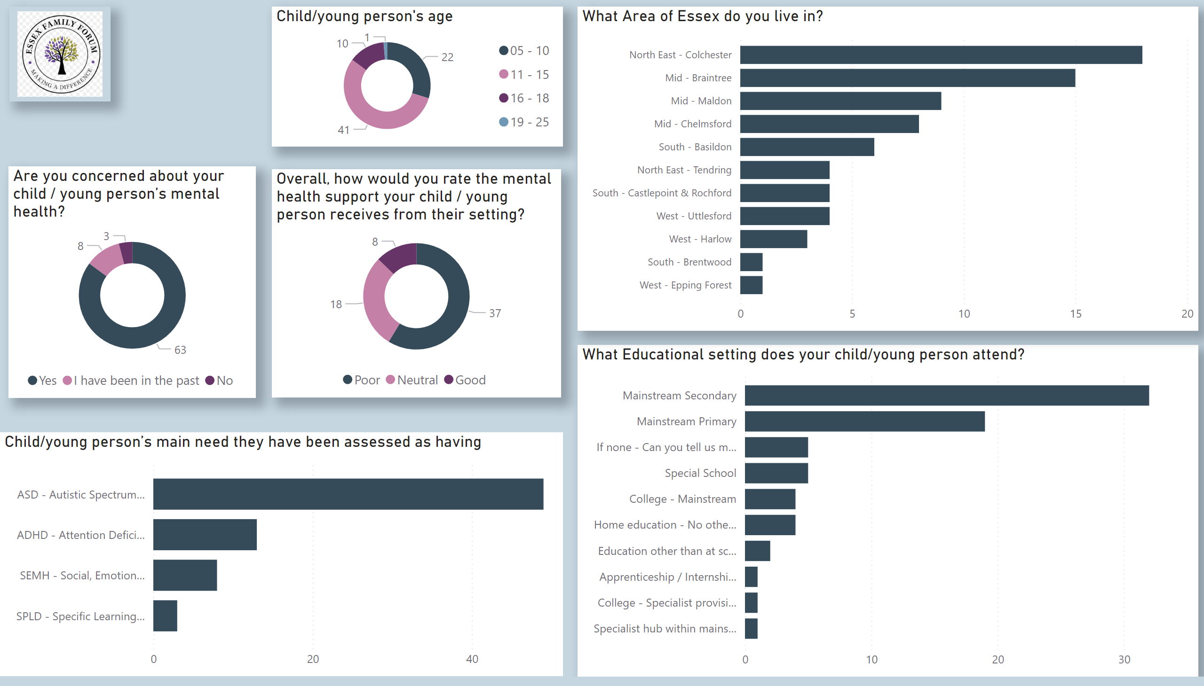
Demographics/ratings
Notes:
Are you concerned about your child / young person’s mental health?
No alt text provided
Overall, how would you rate the mental health support your child / young person receives from their setting?
No alt text provided
image
No alt text provided
Child/young person's age
No alt text provided
What Educational setting does your child/young person attend?
No alt text provided
What Area of Essex do you live in?
No alt text provided
Child/young person’s main need they have been assessed as having
No alt text provided

Slide 6
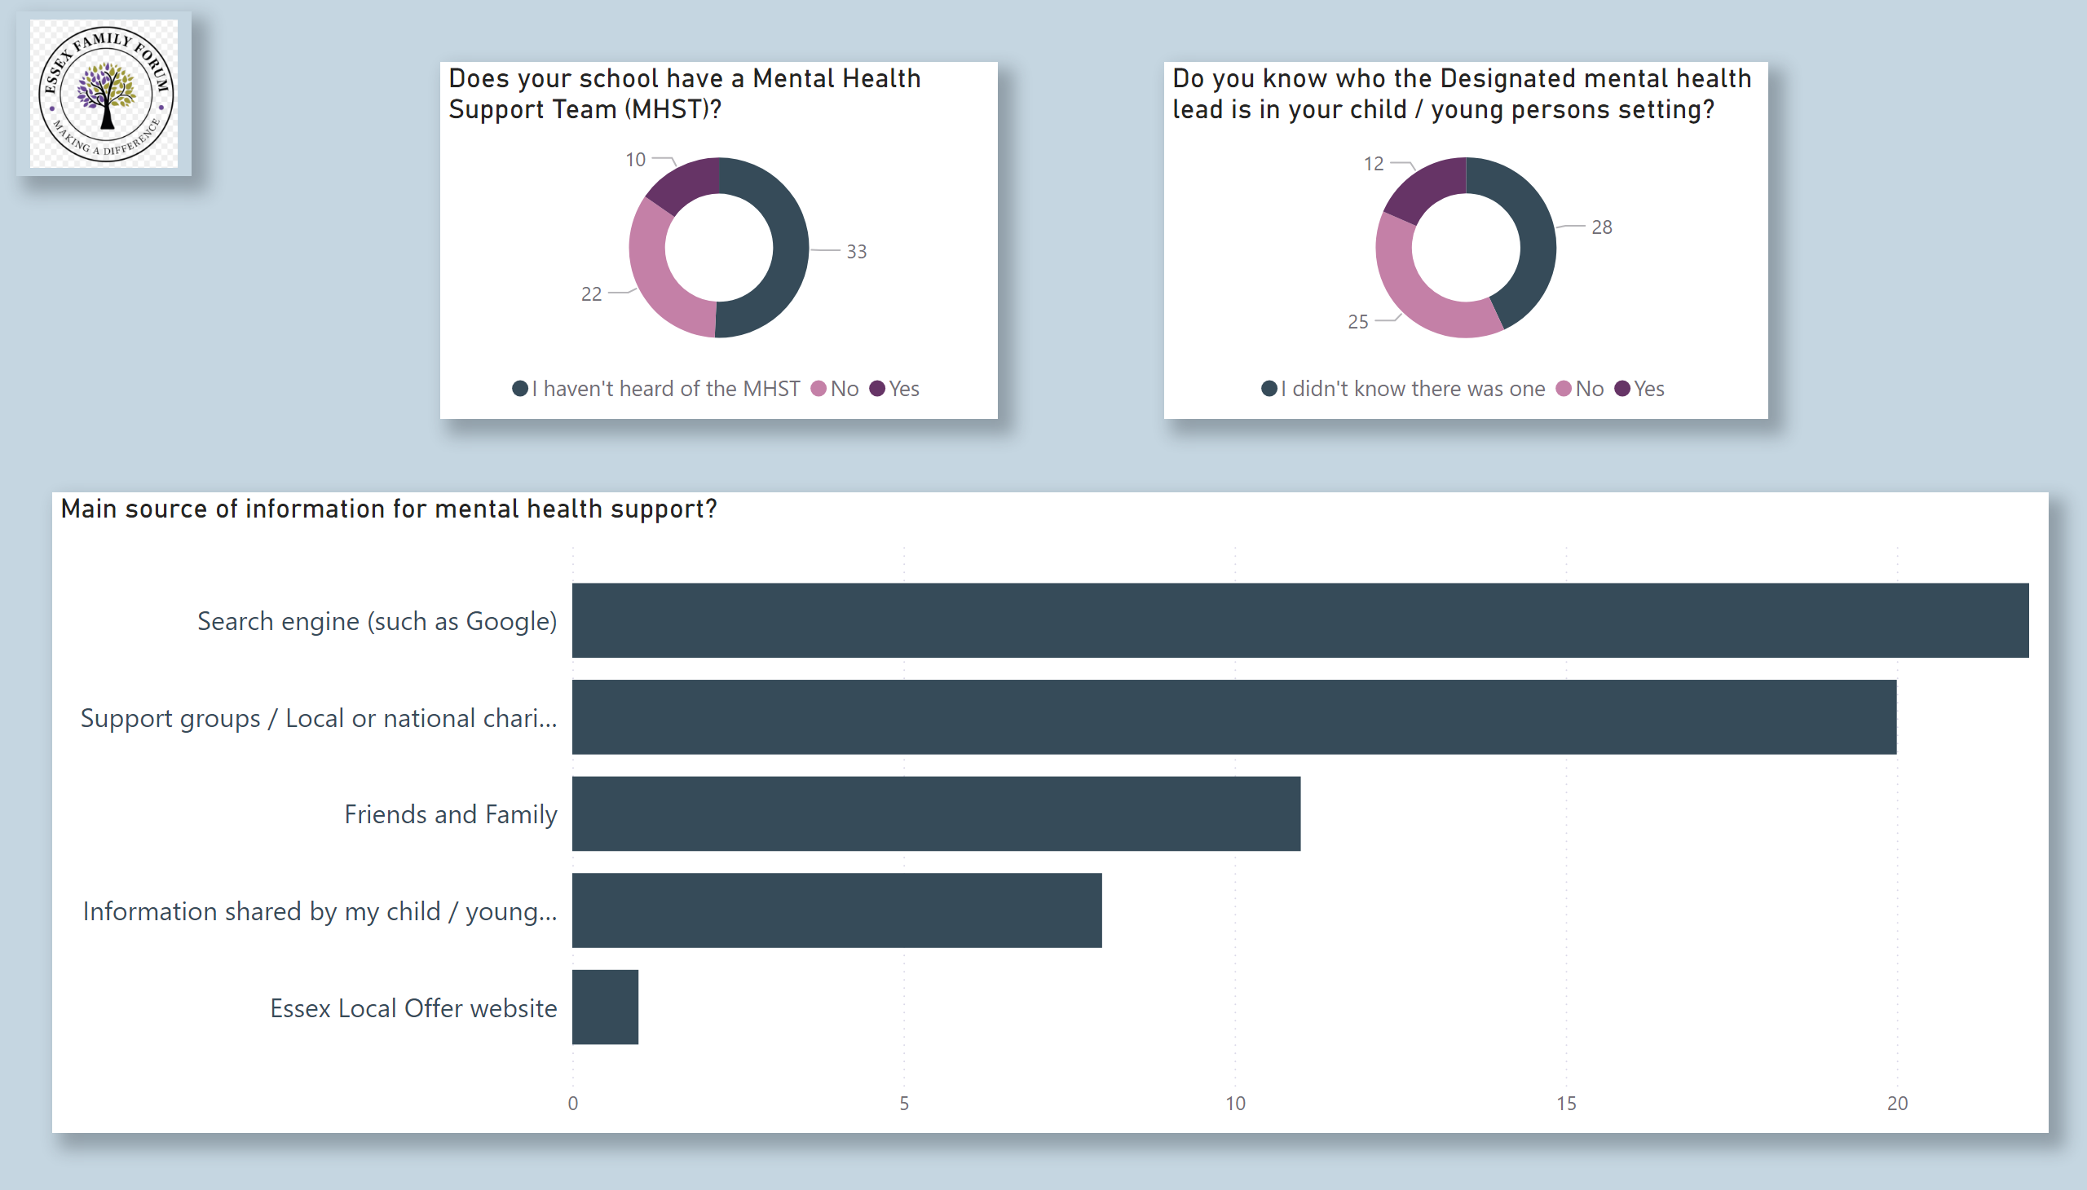
School support
Notes:
Main source of information for mental health support?
No alt text provided
Does your school have a Mental Health Support Team (MHST)?
No alt text provided
Do you know who the Designated mental health lead is in your child / young persons setting?
No alt text provided
image
No alt text provided

