Slide 1

665 parent carers responded across Essex
Children mainly aged 5–15 years
Most common needs: Autism (ASD), ADHD, SEMH and Speech, Language and communication needs
Majority of participants had children in mainstream settings
Family Impact Survey 2025/26 Communication
Notes:
The 2025 FIS received 665 responses from across Essex
This presentation looks to highlight the responses and data relating to North East Essex.
We received 130 responses from parents/carers from NEE
Respondents were evenly split between Tendring and Colchester
The majority of children and young people represented were aged 5-15
35% Female, 63% Male split remaining classified as other
Of those children that were represented in the survey 50 had an EHCP (50) 39 registered being on SEND support (for example One Plans) and 23 were undergoing assessment.

Slide 2
What is working well
Whilst many families report challenges with SEND communications, there are examples of positive practice across Essex. Communication is strongest where it is personal, consistent and relationship-based, particularly through education settings, SENDIASS, charities and trusted professionals.
Families also value Local Offer newsletters and events when they are aware of and able to access them.
"All my sons education settings have been very supportive and informative."
"DSR and SENDIASS have been amazing."

Slide 3
Key systemic challenges
Families consistently describe communication as delayed, unclear, inconsistent and often requiring them to repeatedly chase for updates.
The biggest concerns are around SEND Operations, EHCP processes, waiting periods, access to information, and knowing where to go for support.
Many parents feel information exists but is difficult to find, fragmented across services, and not communicated proactively.
"Absolutely disgraceful service .. no communication, no honesty, lack of scrutiny and transparency, no regard for the law, no care and compassion."
"Awful, lack of or no communication, painful, emotional, frustrating, system is not working, failing parents and children. It's a constant battle to get your child's needs met."

Slide 4
Quadrant Variation
Feedback suggests that challenges are experienced consistently across Essex, indicating a countywide systemic issue rather than isolated local problems.
Similarities across all quadrants
Delays in communication during EHCP and assessment processes.
Families struggling to find the right information and support.
Reliance on schools, charities, SENDIASS and other parents for advice.
Frustration with lack of updates and needing to chase services.
Emerging differences
Rural areas (particularly parts of West and North Essex) appear more likely to reference travel, accessibility and availability of local services through Local Offer comments.
Some variation exists based on individual teams or practitioners, with positive experiences often linked to specific workers rather than a consistent service model.

Slide 5
Next Steps
What we would like the SEND partnership to focus on:
1. Introduce proactive communication standards - Families should receive regular updates during assessments, waiting lists and EHCP processes, even when there is no change in status.
2. Improve information accessibility - Simplify signposting across SEND services, ensuring families can easily identify the right service and understand available support.
3. Review and improve the Local Offer - Improve searchability, navigation and awareness of the Local Offer, reducing the need for families to "know what they are looking for" before accessing support.
4. Develop a consistent countywide communication approach - Reduce variation between teams and services by establishing clear expectations, communication pathways and response standards.
5. Strengthen trusted communication channels - Work more closely with schools, SENDIASS, charities and parent networks, as these are the sources families report trusting most.
6. Co-produce communication improvements with families - Involve parent carers directly in designing communication standards, information resources and improvements to the family journey.

Slide 6
Appendix- Data from FIS 2025
The Below is the data that was used, along with individual comments to construct the summary report above.

Slide 7
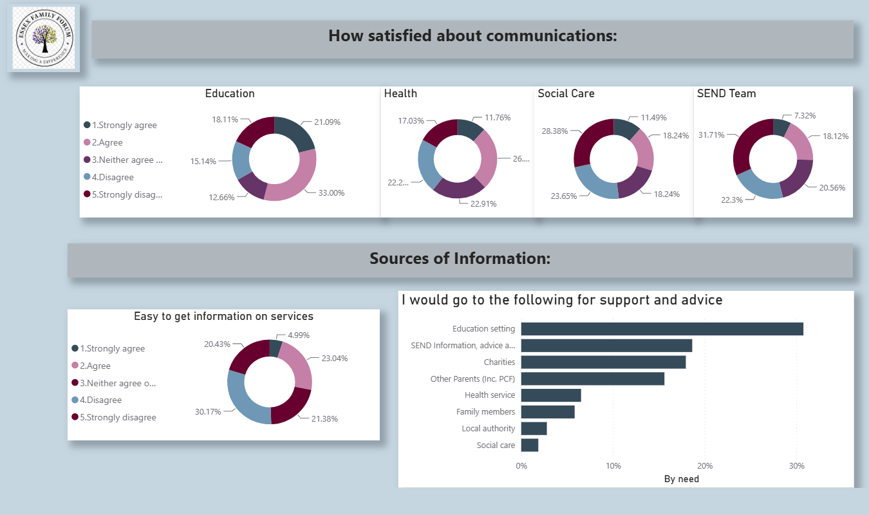

Slide 8
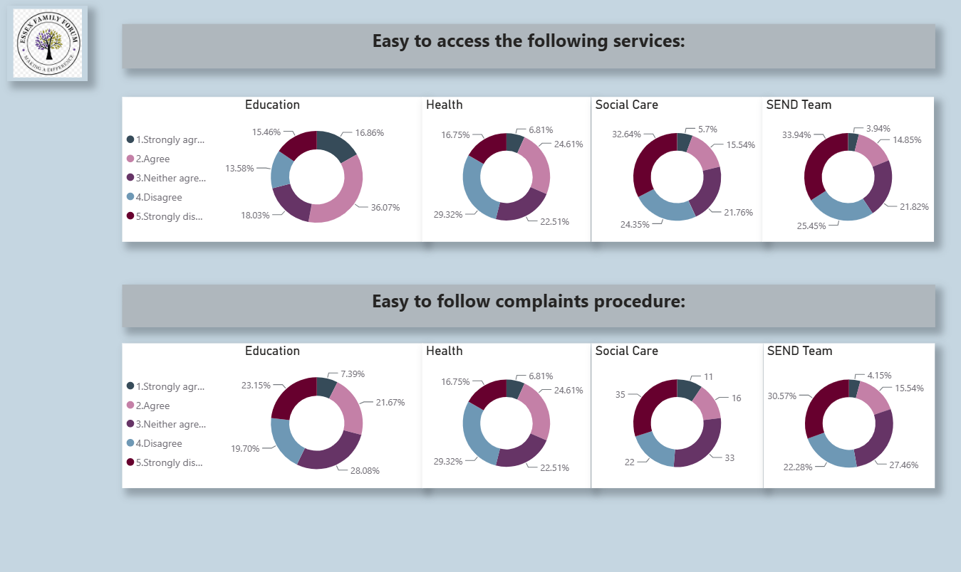

Slide 9
