Slide 1

452 families either had an EHCP or were currently going through EHCNA
Most common needs: Autism (ASD), ADHD, SEMH and Speech, Language and communication needs
Majority of participants had children in mainstream settings
262 - with EHCPs. 190 - going through EHCNA. 158 - been through EHCNA within the last 12 months.
Family Impact Survey 2025/26 Educational Health Care Needs Assessment (EHCNA) process.
Notes:
The 2025 FIS received 665 responses from across Essex
This presentation looks to highlight the responses and data relating to North East Essex.
We received 130 responses from parents/carers from NEE
Respondents were evenly split between Tendring and Colchester
The majority of children and young people represented were aged 5-15
35% Female, 63% Male split remaining classified as other
Of those children that were represented in the survey 50 had an EHCP (50) 39 registered being on SEND support (for example One Plans) and 23 were undergoing assessment.

Slide 2
What is working well
Many families reported positive outcomes once an EHCP was secured, particularly where children were placed in the right educational setting and support was delivered effectively. Parents valued supportive SEND professionals, schools, SENDIASS, and charities who helped them navigate the process and advocate for their child.
Key Statistics:
665 survey respondents identified as having SEND needs.
262 children and young people had an EHCP.
190 were going through an Education, Health and Care Needs Assessment (EHCNA).
"Education meets my sons needs and getting a place in the right setting has seen him thrive."
"Had a very positive experience with great oaks, and my case worker when going through the EHCP process."

Slide 3
Key systemic challenges
The EHCP process was one of the most significant areas of concern raised by families. Common themes included long delays, poor communication, missed statutory timescales, having to repeatedly chase for updates, and feeling they had to "fight" for support that should have been available.
Key Statistics
28.5% of families agreed that the EHCP NA was positive.
57.4% disagreed or strongly disagreed that the NA process was positive.
25.9% reported a positive experience of Annual Reviews with SEND Operations.
49.2% reported a negative experience of Annual Reviews with SEND Operations.
"The EHCPNA process is appalling given the delays and lack of visibility of timelines."
"The whole process has been so traumatic. My initial paperwork was lost and I had to redo the whole thing."

Slide 4
Quadrant Variation
Across all areas of Essex, families described very similar challenges around delays, communication and accessing support.
Common Themes Across All Quadrants
Delays in EHCNAs and EHCP reviews.
Poor communication from SEND Operations.
Lack of updates during assessment processes.
Families feeling they must challenge decisions to secure provision.
Concerns around Annual Reviews and EHCP implementation.
Positive Themes Across All Quadrants
Good experiences with individual SEND Officers, schools and SENCOs.
Strong support from charities and SENDIASS.
Better outcomes when children accessed the right educational placement.

Slide 5
Next Steps
Our Priorities for Improvement:
Reduce EHCP assessment delays and improve timeliness.
Provide regular updates throughout the EHCNA process.
Improve communication between families, SEND Ops and professionals.
Ensure Annual Reviews are completed on time and lead to meaningful action.
Increase transparency around decisions and thresholds.
Focus on getting the right provision first time, reducing the need for appeals and tribunals.

Slide 6
Appendix- Data from FIS 2025
The Below is the data that was used, along with individual comments to construct the summary report above.

Slide 7
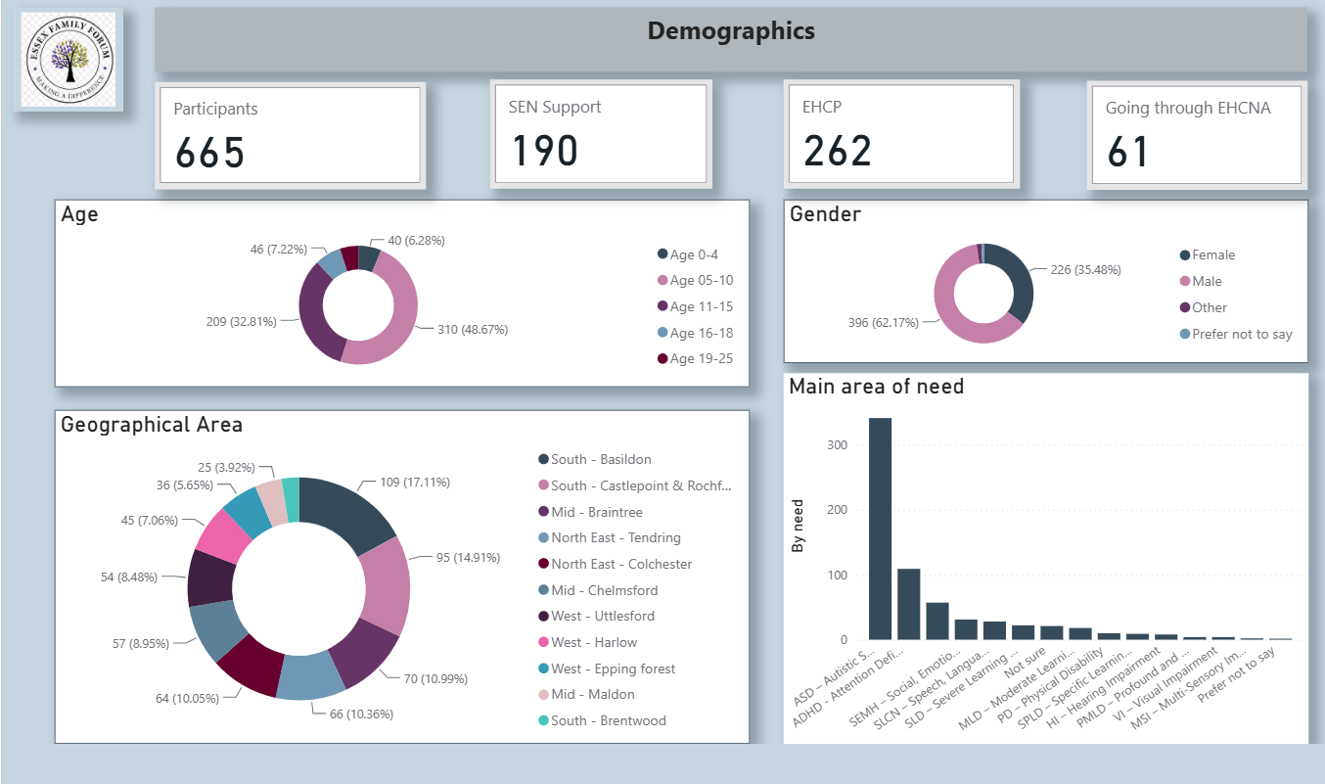

Slide 8
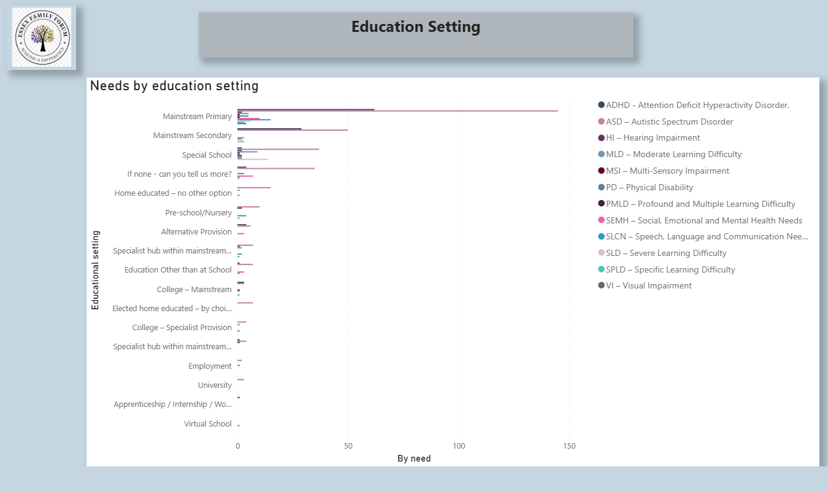

Slide 9
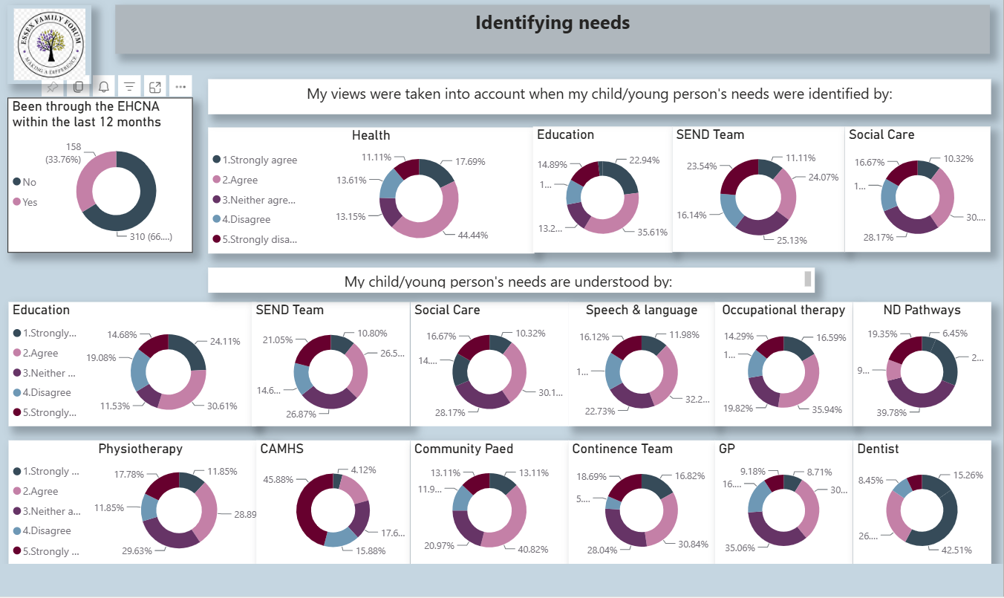

Slide 10
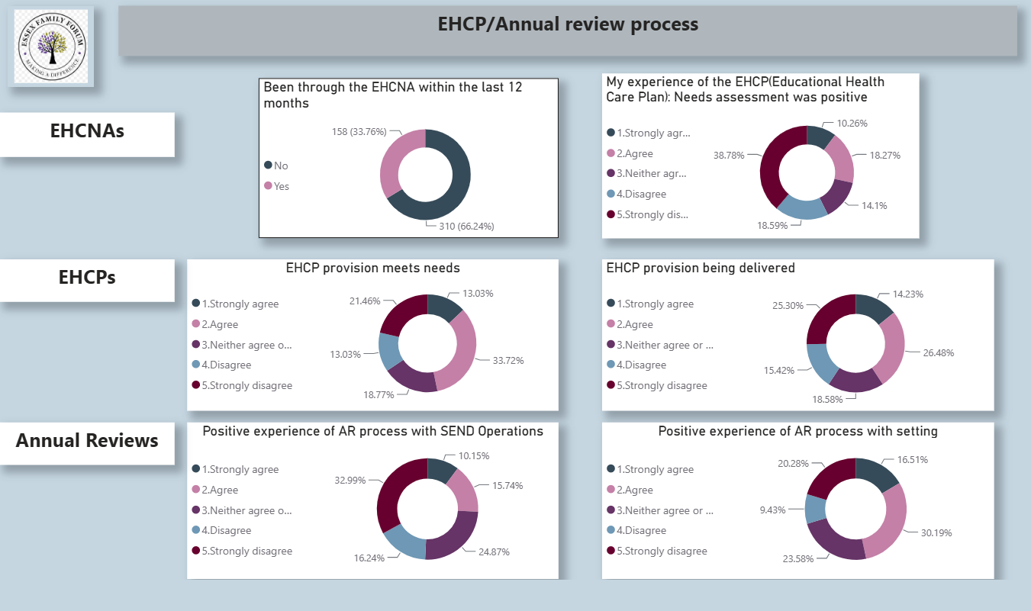

Slide 11
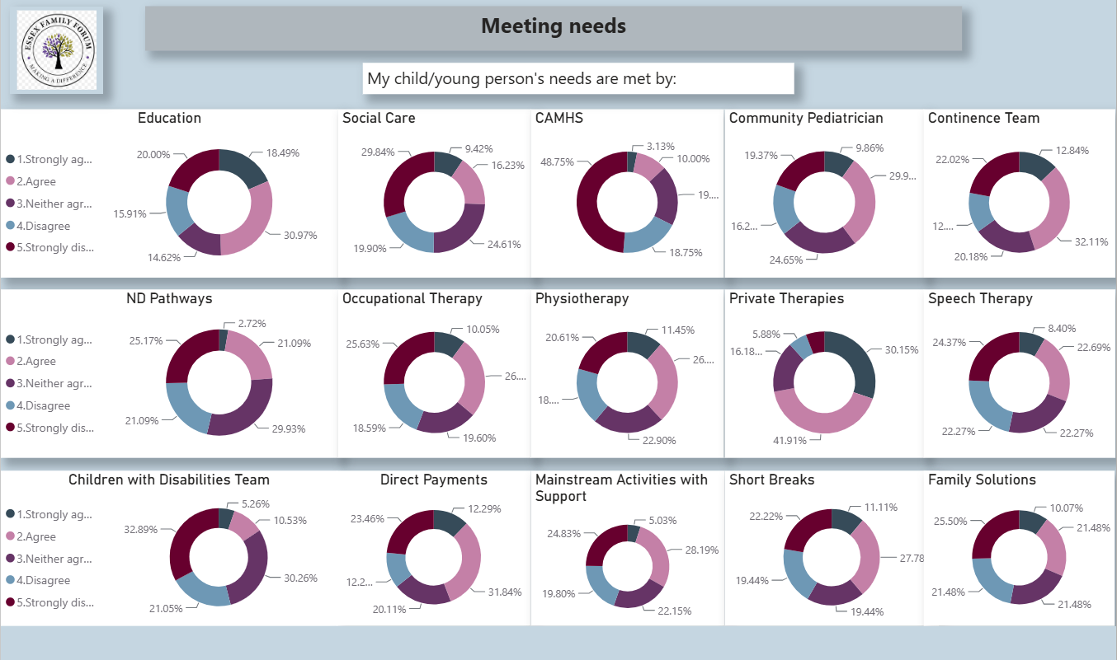

Slide 12
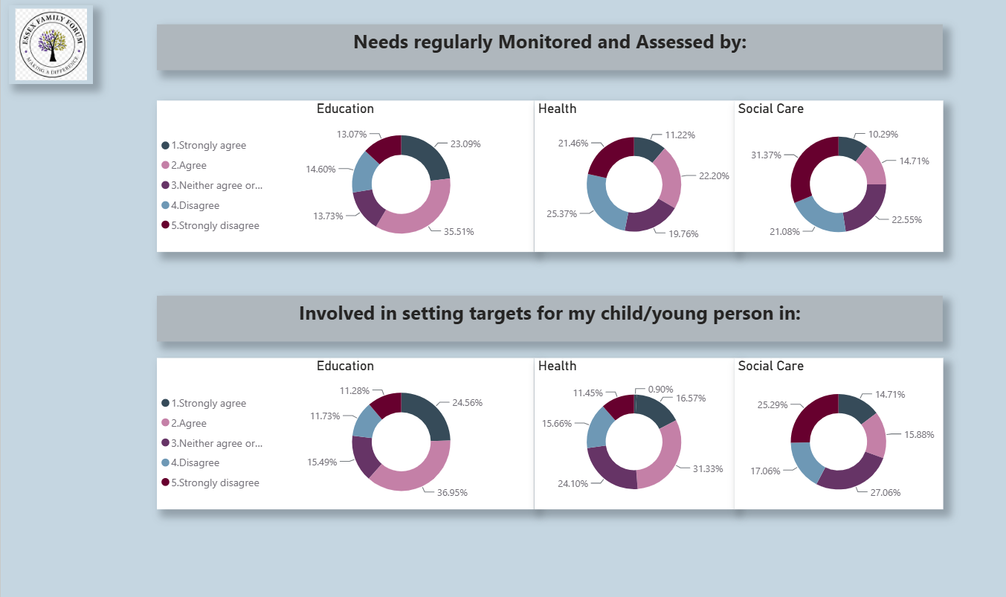

Slide 13
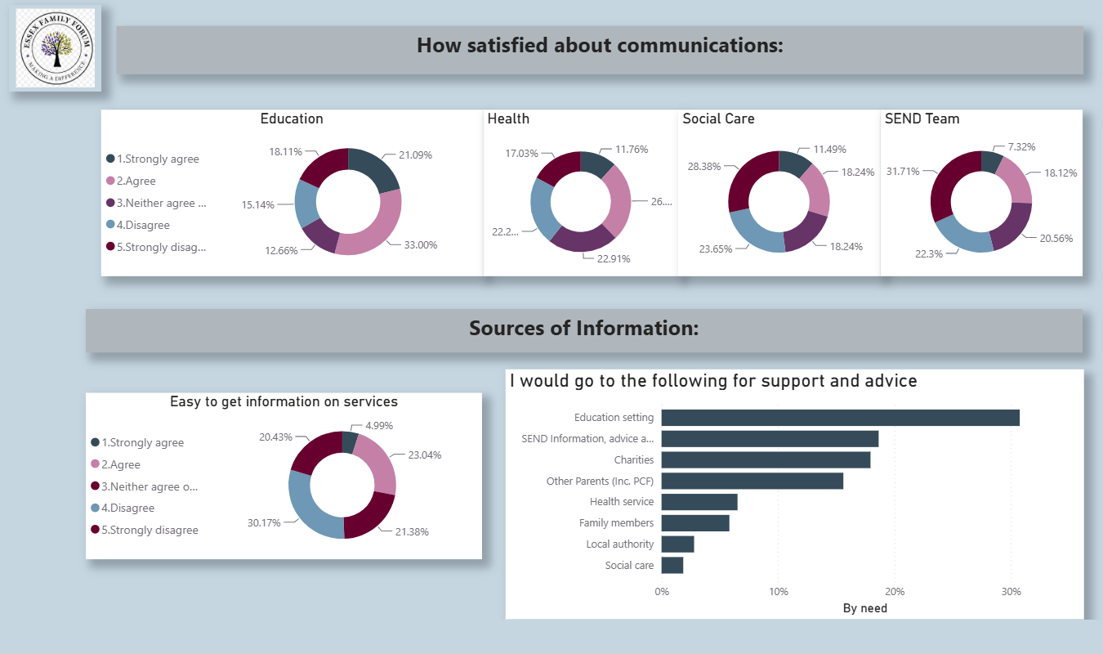

Slide 14
