Slide 1

665 parent carers responded across Essex
Children mainly aged 5–15 years
Most common needs: Autism (ASD), ADHD, SEMH and Speech, Language and communication needs
Majority of participants had children in mainstream settings
Family Impact Survey 2025/26
EOTAS/Attendance
Notes:
The 2025 FIS received 665 responses from across Essex
This presentation looks to highlight the responses and data relating to North East Essex.
We received 130 responses from parents/carers from NEE
Respondents were evenly split between Tendring and Colchester
The majority of children and young people represented were aged 5-15
35% Female, 63% Male split remaining classified as other
Of those children that were represented in the survey 50 had an EHCP (50) 39 registered being on SEND support (for example One Plans) and 23 were undergoing assessment.

Slide 2
What is working well
When children are placed in the right provision, particularly specialist settings, small group environments, or alternative provision, attendance, wellbeing and engagement improve significantly.
Flexible, person‑centred approaches (such as nurture groups, reduced timetables and therapeutic input) help children remain connected to education when implemented early and consistently.
Trusted relationships with individual professionals and support from the voluntary sector are also key strengths identified by families.
“Being in the right setting has made a huge difference in learning, safeguarding, social and emotional wellbeing.”
“Education meets my son’s needs and getting a place in the right setting has seen him thrive.”

Slide 3
Key systemic challenges
The data highlights significant systemic delays and gaps, resulting in many children being on roll but not attending school for extended periods, often without suitable alternative provision in place.
EBSA is frequently addressed too late, once children are already burnt out or traumatised, and EOTAS/EOTIS support is often reactive, delayed, or accessed only through tribunal.
Families report fragmented systems, inconsistent communication, and being forced to fill gaps through home education or private provision.
“Been left with no school for over a year despite constantly working with professionals.”
“SEND services only react when a child is out of school, but then it is too late.”

Slide 4
Quadrant Variation
Overall, the core issues are consistent across all four quadrants, with similar patterns of non‑attendance, EBSA, delays in provision, and reliance on home education as a last resort. While some local variation exists in the availability of specialist or alternative provision and access to support services, no quadrant is free from systemic challenges. This suggests countywide issues rather than isolated localised problems, with inequity driven more by service capacity than geography.

Slide 5
Next Steps
Based on the survey evidence, the following actions are recommended:
Strengthen early intervention for EBSA, recognising it as an anxiety‑based need rather than an attendance issue
Improve timely access to EOTAS/EOTIS and alternative provision, reducing reliance on crisis escalation and tribunal routes
Ensure Section 19 and EHCP provision is implemented consistently, not just agreed
Expand flexible and blended education pathways, including therapeutic and part‑time models
Improve joined‑up working across education, health and social care, with clearer ownership and accountability
Provide clearer support and guidance for families, particularly those home educating due to lack of suitable provision

Slide 6
Appendix- Data from FIS 2025
The Below is the data that was used, along with individual comments to construct the summary report above.

Slide 7
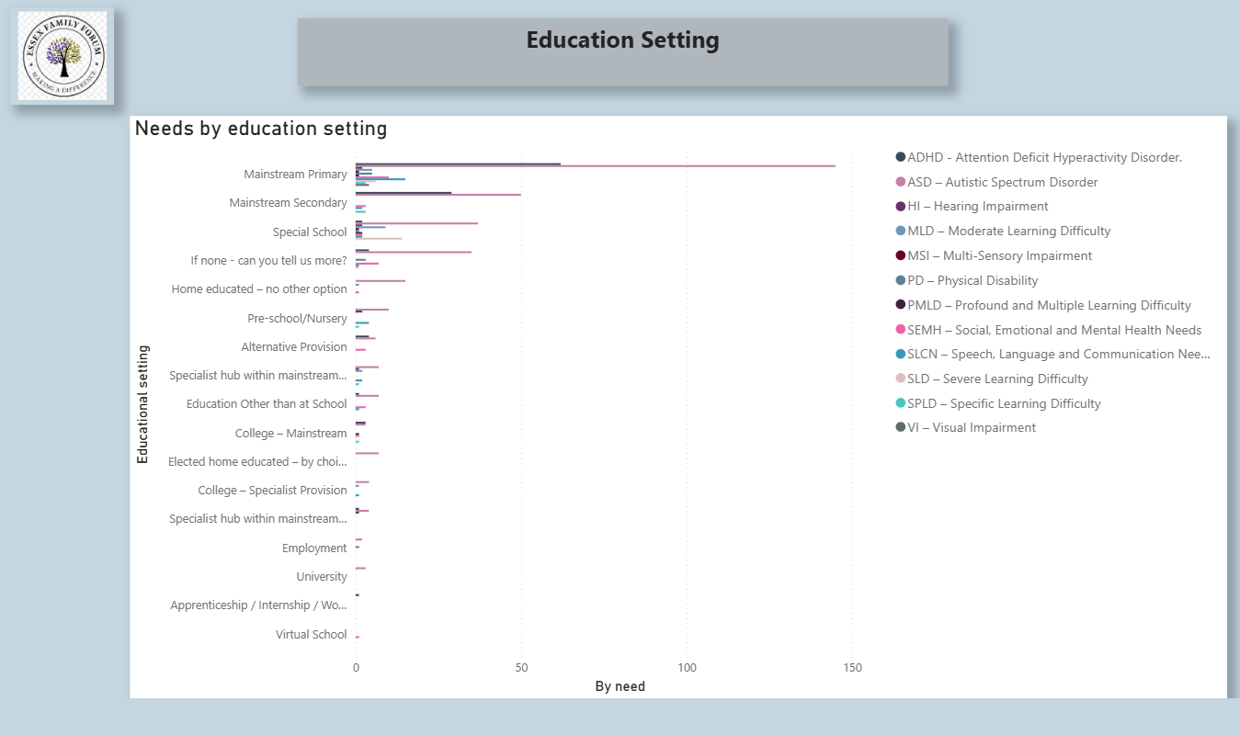

Slide 8
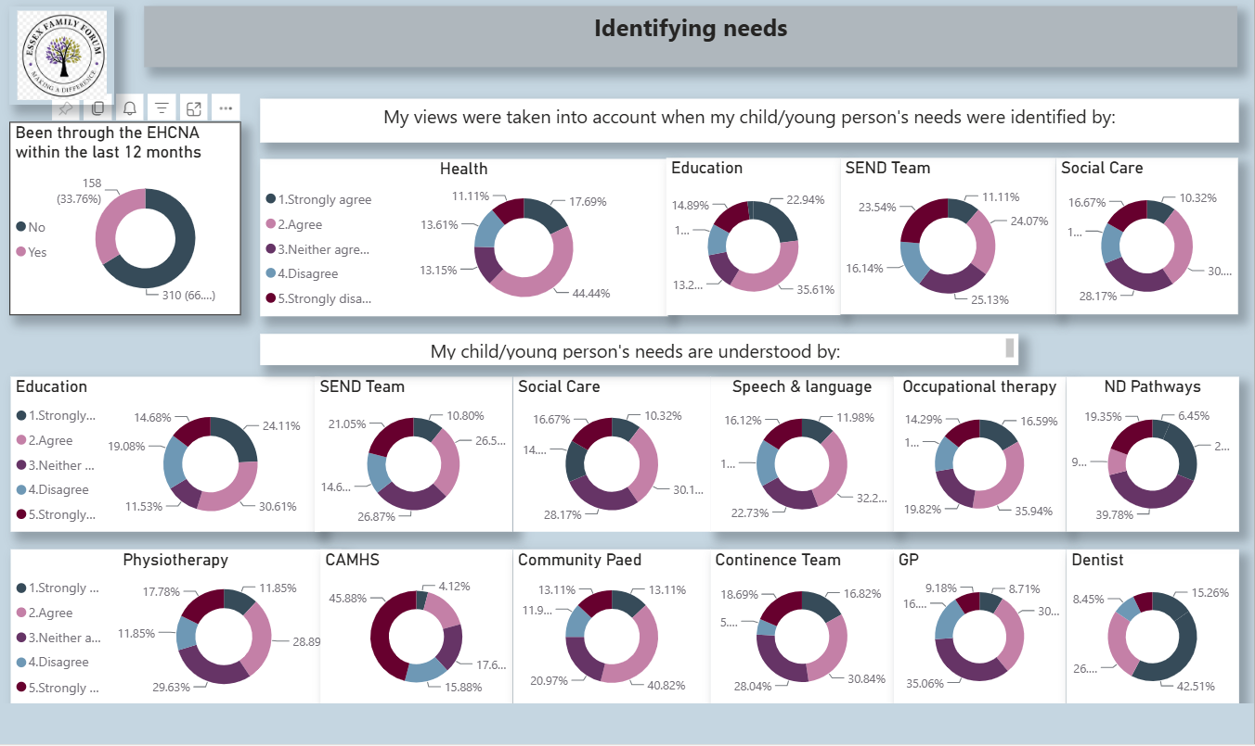

Slide 9
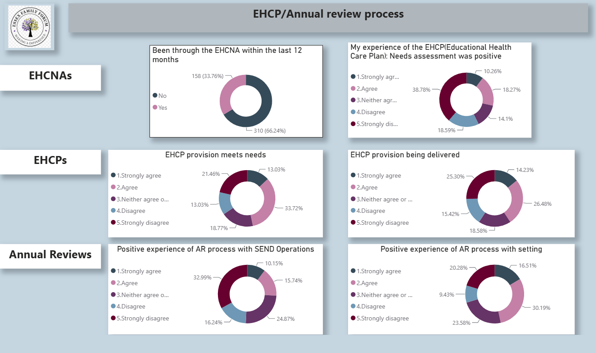

Slide 10
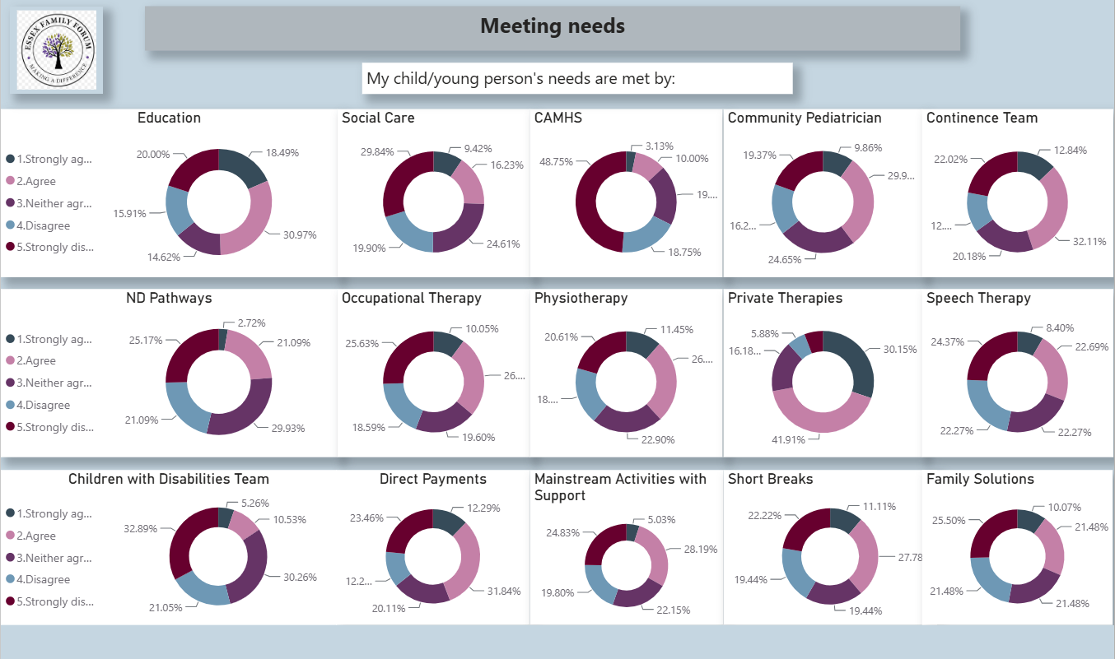

Slide 11
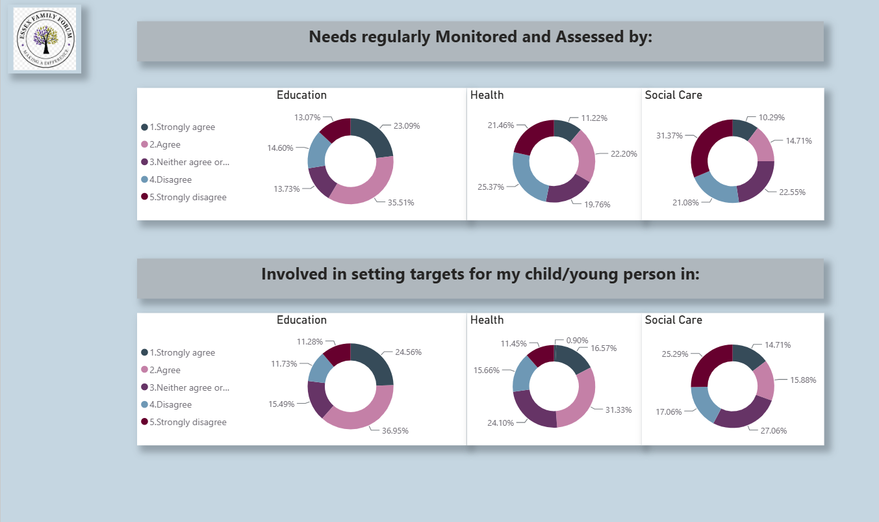

Slide 12
