Slide 1

Children mainly aged 0–4 years
Most common needs: Autism (ASD), ADHD, SEMH and Speech, Language and communication needs
Majority of participants had children in mainstream settings
40 children aged 0-4
Family Impact Survey 2025/26
Early Years
Notes:
The 2025 FIS received 665 responses from across Essex
This presentation looks to highlight the responses and data relating to North East Essex.
We received 130 responses from parents/carers from NEE
Respondents were evenly split between Tendring and Colchester
The majority of children and young people represented were aged 5-15
35% Female, 63% Male split remaining classified as other
Of those children that were represented in the survey 50 had an EHCP (50) 39 registered being on SEND support (for example One Plans) and 23 were undergoing assessment.

Slide 2
What is working well
Many families reported positive experiences when needs were identified early by health visitors, nurseries and preschool SENCOs.
Parents particularly valued professionals who listened to concerns, acted quickly and helped families access appropriate support and referrals.
"Health visitor has been fantastic and supported our referral. No one else took us seriously."
"Health visitor has been very supportive. Pre school was great at picking up needs early."

Slide 3
Key systemic challenges
Whilst some families benefited from early intervention, many others described delays in recognising needs, difficulties accessing referrals, and long waits for assessments.
Families often felt they had to repeatedly advocate for their child before concerns were taken seriously.
"GP and Children's Centre dismissed our concerns and we ended up having to take my child to a private doctor so that we could progress."
"Trying to get help desperately and no one wants to help."

Slide 4
Quadrant Variation
There was no strong evidence of significant quadrant differences regarding Early Years experiences. Positive and negative experiences were reported across Essex.
Common Themes Across All Quadrants
Similarities:
Health visitors frequently identified as a positive source of support.
Good preschool and nursery SENCOs made a significant difference.
Families valued early advice and signposting.
Challenges Across All Quadrants:
Delays accessing assessments.
Difficulties obtaining referrals.
Lack of support whilst waiting.
Families feeling they needed to "fight" to be heard.

Slide 5
Next Steps
Our Priorities for Improvement
Improve early identification of SEND needs.
Listen to and act on parental concerns earlier.
Reduce waiting times for assessment and diagnosis.
Provide clearer information and signposting at the start of the SEND journey.
Increase support while families are waiting for assessment outcomes.
Ensure consistent support across all Early Years settings.

Slide 6
Appendix- Data from FIS 2025
The Below is the data that was used, along with individual comments to construct the summary report above.

Slide 7
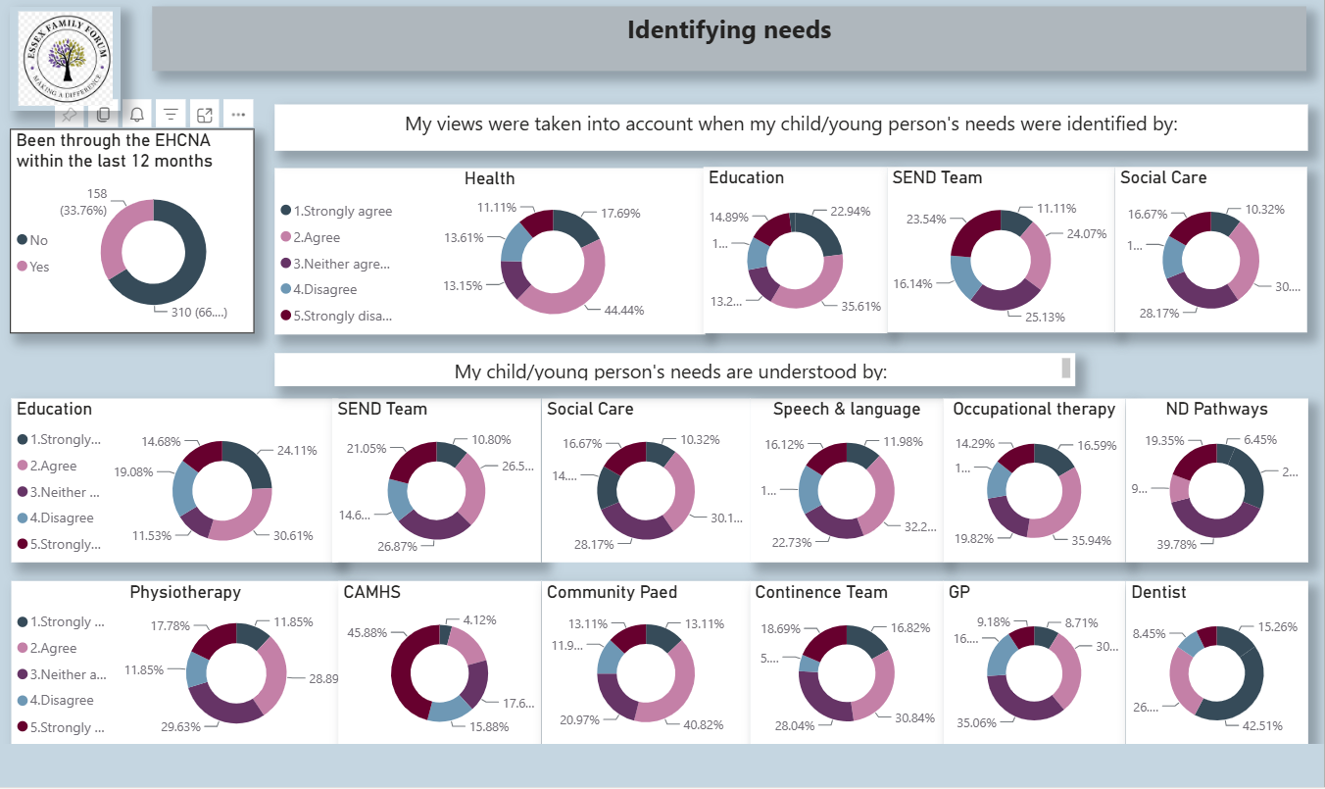

Slide 8
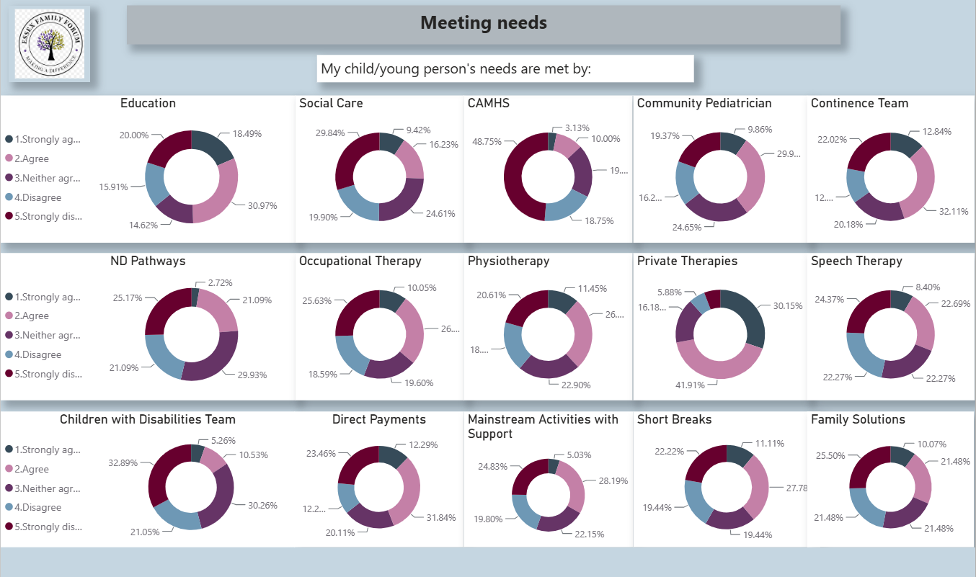

Slide 9
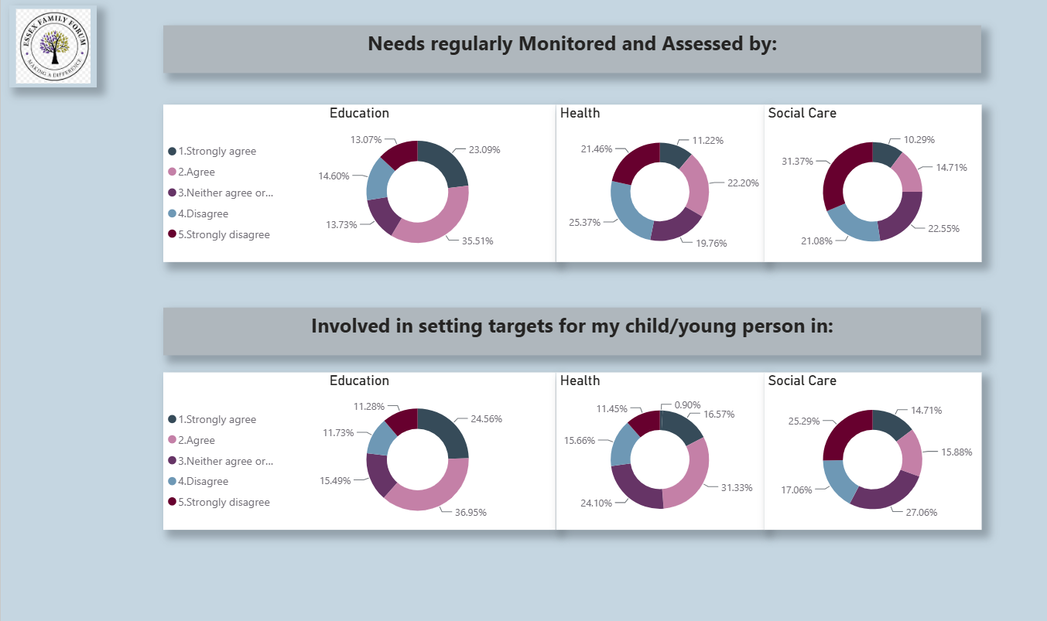

Slide 10
