Slide 1

665 parent carers responded across Essex
Children mainly aged 5–15 years
Most common needs: Autism (ASD), ADHD, SEMH and Speech, Language and communication needs
Majority of participants had children in mainstream settings
Family Impact Survey 2025/26 Family perspective on Education
Notes:
The 2025 FIS received 665 responses from across Essex
This presentation looks to highlight the responses and data relating to North East Essex.
We received 130 responses from parents/carers from NEE
Respondents were evenly split between Tendring and Colchester
The majority of children and young people represented were aged 5-15
35% Female, 63% Male split remaining classified as other
Of those children that were represented in the survey 50 had an EHCP (50) 39 registered being on SEND support (for example One Plans) and 23 were undergoing assessment.

Slide 2
What is working well
(Many families report that when children are in the right educational placement, with staff who understand SEND and are willing to make reasonable adjustments, children are able to thrive socially, emotionally and academically.) Remove – AI assumption?
Positive experiences are strongly linked to good SENCO leadership, effective communication, specialist hubs within mainstream schools, nurture provision, and schools working collaboratively with families.
Families also highlighted the value of schools that take a personalised approach, listen to parents, and focus on wellbeing as well as attainment.
“Mainstream school have been amazing & given all the support that is required. My child loves going to school & that's because she has the right support & her needs met."
“(Maylandsea) Primary school has been amazing... Being in a nurture class with children similar to him is just the best. Every school should have this!"

Slide 3
Key systemic challenges
While positive examples exist, parents consistently describe a system that often requires them to fight for support. The most common issues relating to education settings were:
Delays and difficulties accessing appropriate provision.
Schools not fully understanding neurodivergence, particularly masking, autism in girls and SEMH needs.
EHCP processes taking too long and provision not always being delivered.
Children experiencing EBSA, burnout and exclusion from education due to unmet needs.
Limited flexibility within mainstream settings.
Long periods without suitable education while awaiting specialist placement, AP or EOTAS
The survey contains numerous examples of children who were out of school for months or years, awaiting appropriate provision, EOTAS packages or specialist placements.
"The message is: if my child can't adapt to the school system, there is something wrong with my child, and they must change. The system cannot be wrong and cannot change."
“School did not really support our daughter leading to burnout, they need more training on autism in girls and masking."

Slide 4
Quadrant Variation
Overall, families reported more similarities than differences across Essex. The same core issues were raised in every quadrant;
Access to the right provision; EHCP delays and communication; EBSA and unmet mental health needs; Difficulty securing specialist support; Better outcomes when schools are flexible and SEND-informed
Notable differences:
West Essex - More concerns about limited local SEND provision and long travel distances for support.
South Essex - More comments relating to transitions and mainstream schools struggling to meet complex needs.
North East Essex - More references to positive specialist and alternative provision experiences, alongside concerns about availability.
Mid Essex - Similar experiences to the wider county, particularly around communication and EHCP processes.
Key Message: Families consistently reported positive experiences where schools listened, understood SEND and adapted provision to meet need.

Slide 5
Next Steps
What we would like education settings to focus on:
1. Understand EBSA and school trauma - Move away from attendance-focused responses and towards understanding the unmet needs, anxiety and burnout that sit behind EBSA. Many families described children becoming emotionally unsafe before support was put in place.
2. Listen to parents earlier - Parents repeatedly told us they felt unheard and had to fight for support. Families are experts in their child and should be treated as equal partners.
3. Improve SEND understanding in mainstream settings - Increase training around: Autism in girls; Masking; Demand avoidance; SEMH needs; Neurodivergent communication styles. (These themes featured heavily throughout family feedback)
4. Be flexible before crisis point - Use reduced timetables, nurture provision, sensory adaptations, quiet spaces, hybrid learning and personalised approaches before children disengage from education.
5. Focus on outcomes, not processes - Families want support that works, not endless meetings, referrals and paperwork. Review whether provision is making a real difference to the child's experience.
6. Ensure no child is left without education - The survey contained multiple examples of children waiting months or years for suitable placements, AP, specialist provision or EOTAS. Early intervention and timely planning are essential to prevent children becoming NEET or disconnected from education.

Slide 6
Appendix- Data from FIS 2025
The Below is the data that was used, along with individual comments to construct the summary report above.

Slide 7
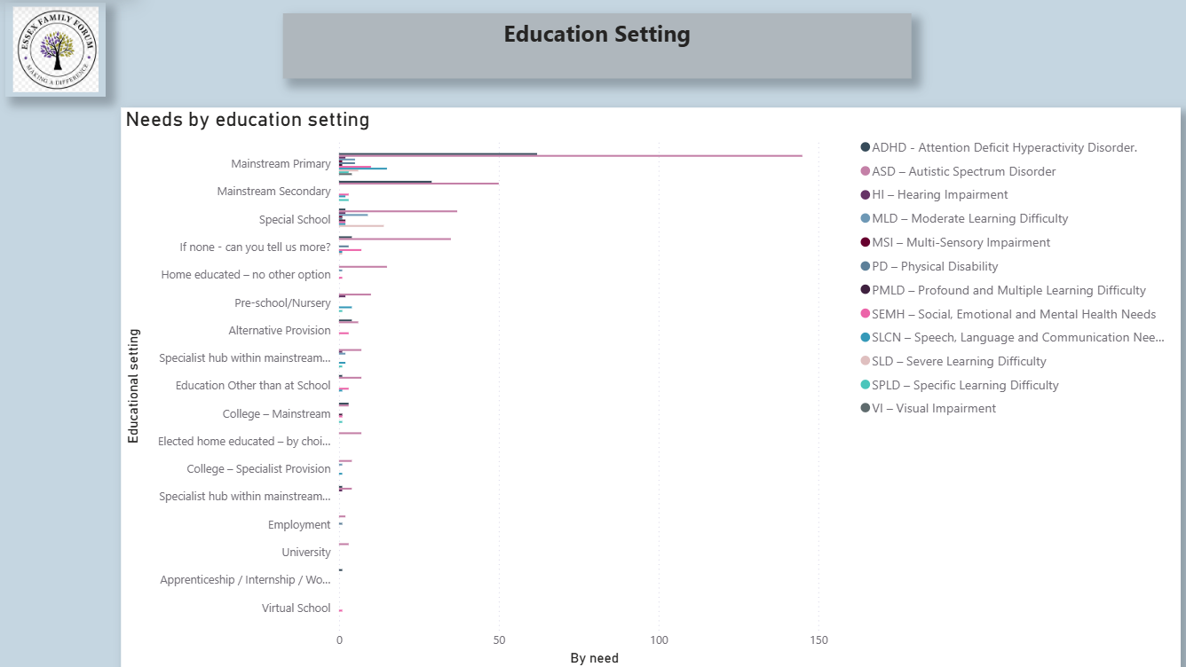

Slide 8
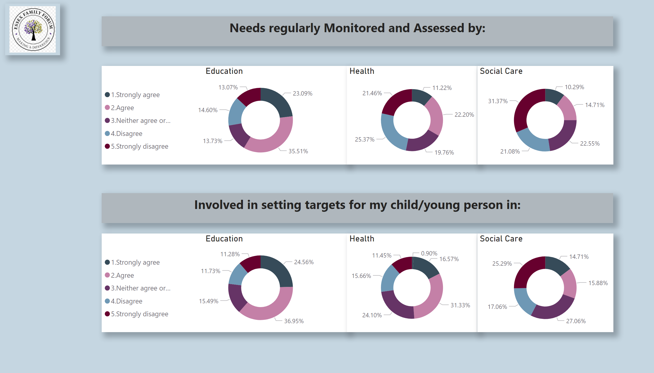
Monitoring/Targets
Notes:
Education
No alt text provided
image
No alt text provided
Health
No alt text provided
Social Care
No alt text provided
Education
No alt text provided
Health
No alt text provided
Social Care
No alt text provided
textbox
No alt text provided
textbox
No alt text provided

Slide 9
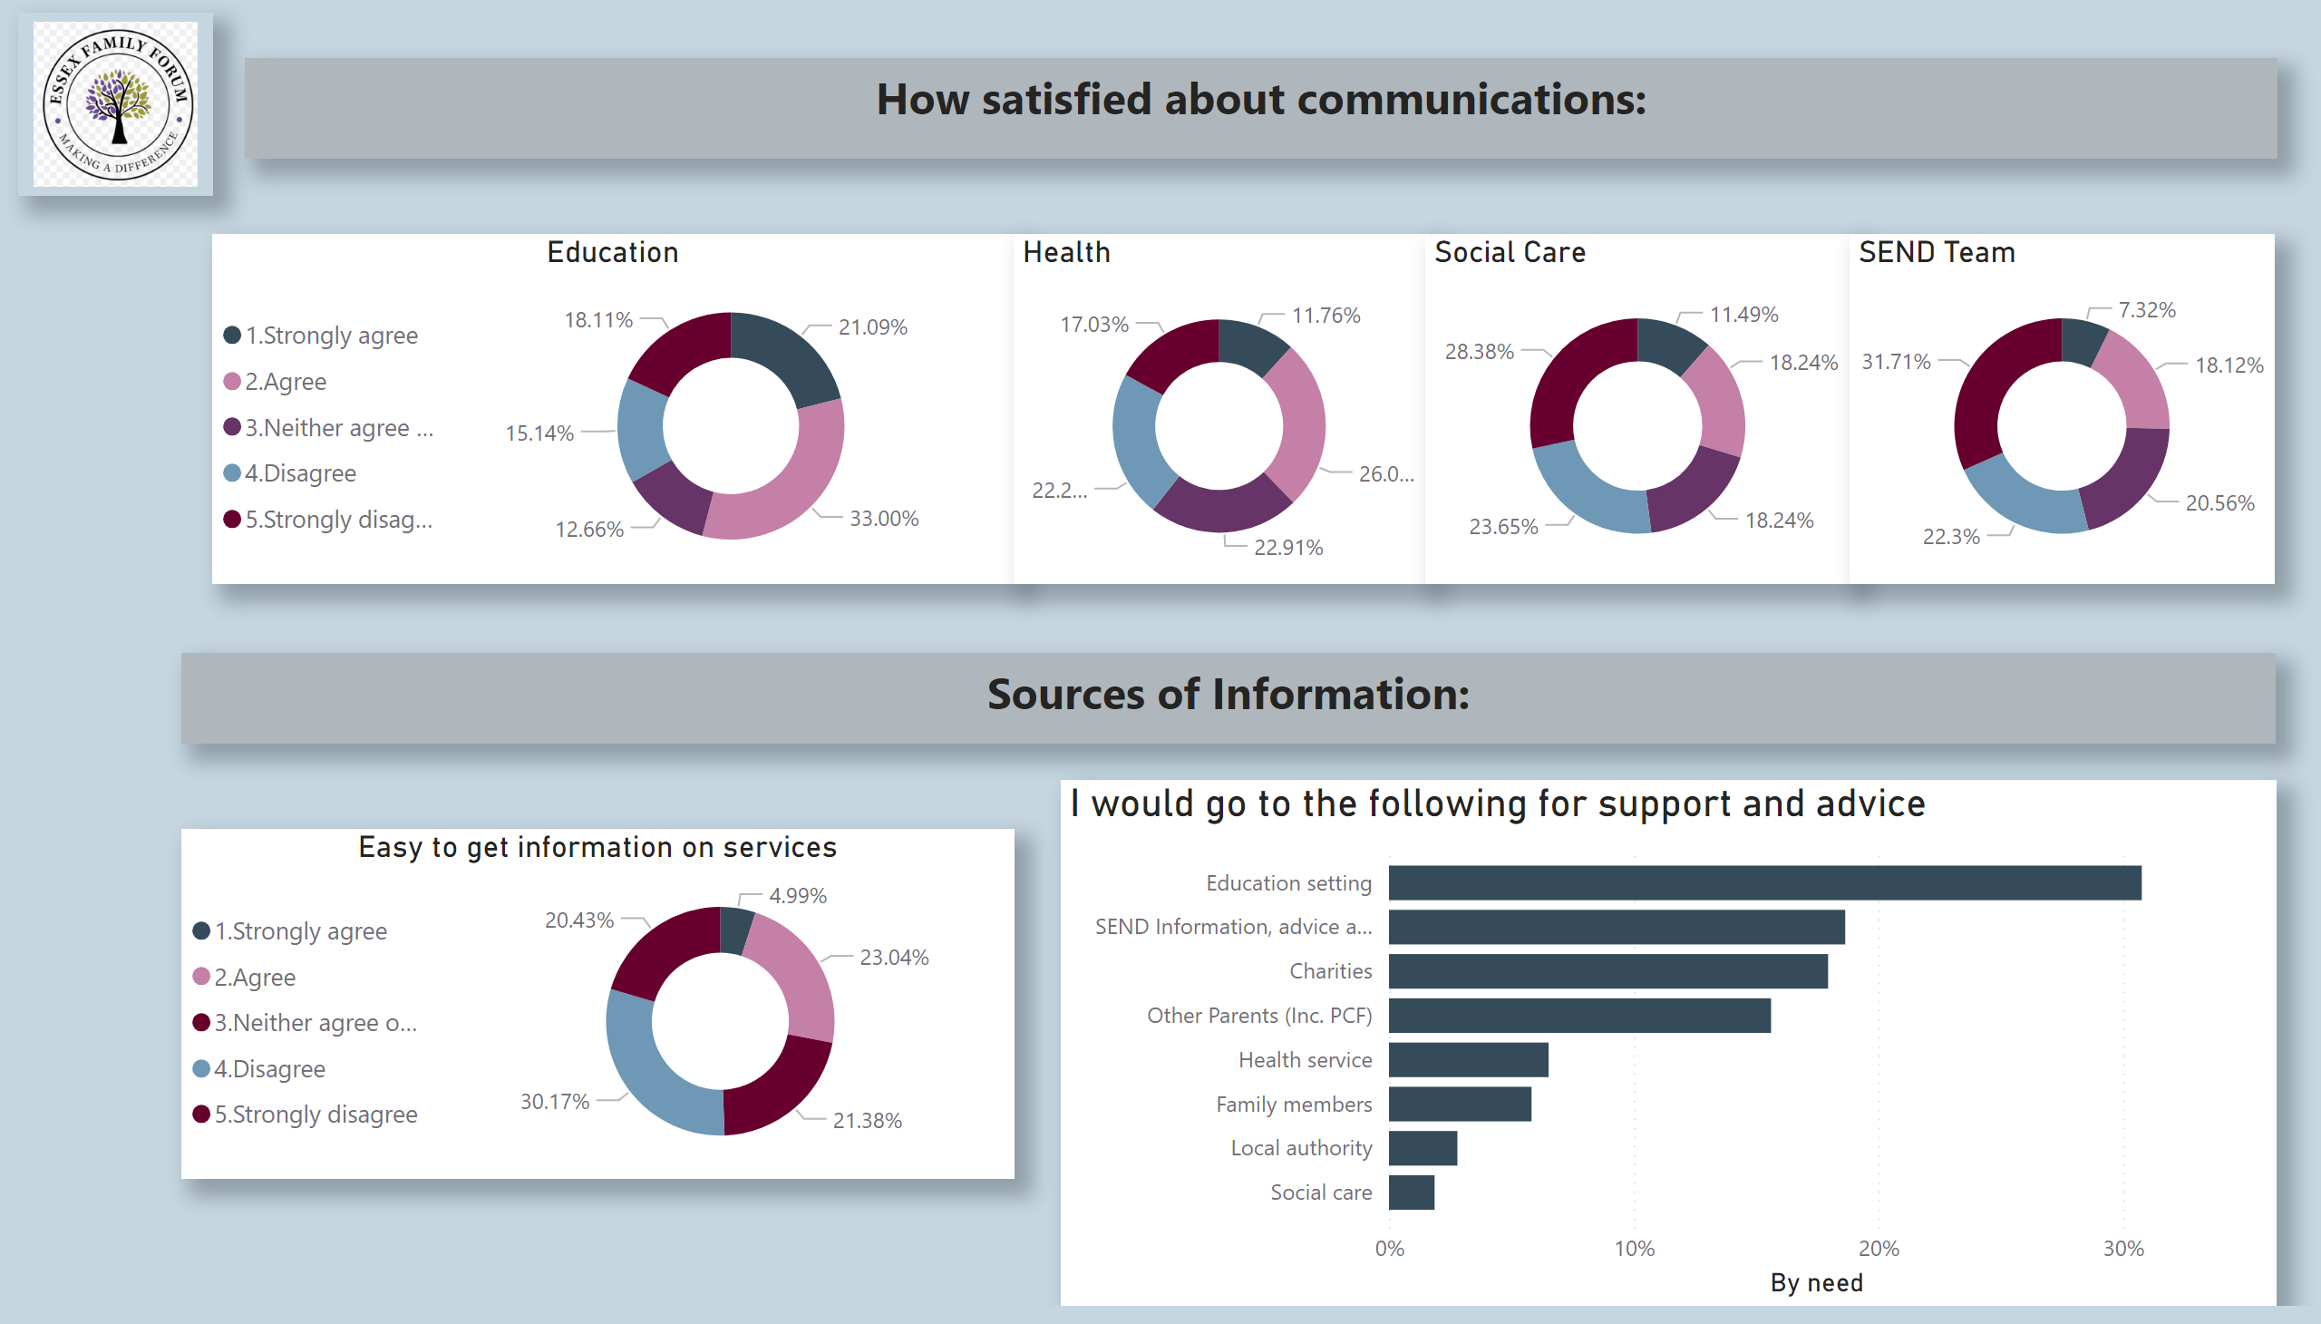
Comms/Info
Notes:
Education
No alt text provided
image
No alt text provided
Health
No alt text provided
Social Care
No alt text provided
Easy to get information on services
No alt text provided
textbox
No alt text provided
textbox
No alt text provided
SEND Team
No alt text provided
I would go to the following for support and advice
No alt text provided

