Slide 1

Family Impact Survey 2025/26 Overview
This Survey summarises feedback from 665 participants (parents, carers) about their experiences with SEND services across education, health, and social care.
The findings present a mixed but consistent picture: while many families experience commitment, care and good practice from individual professionals and settings. System pressures, delays and fragmentation are significantly affecting outcomes, increasing need and eroding trust.
This summary highlights key themes relevant to system leadership and partnership working, rather than individual service performance.

Slide 2

665 parent carers responded across Essex
Children mainly aged 5–15 years
Most common needs: Autism (ASD), ADHD, SEMH and Speech, Language and communication needs
Majority of participants had children in mainstream settings
Survey
Overview​
Notes:
The 2025 FIS received 665 responses from across Essex
This presentation looks to highlight the responses and data relating to North East Essex.
We received 130 responses from parents/carers from NEE
Respondents were evenly split between Tendring and Colchester
The majority of children and young people represented were aged 5-15
35% Female, 63% Male split remaining classified as other
Of those children that were represented in the survey 50 had an EHCP (50) 39 registered being on SEND support (for example One Plans) and 23 were undergoing assessment.

Slide 3
What is working well
Families consistently report positive experiences where support is relational, consistent and personalised. In particular:
Individual schools, SENCOs, specialist settings and hubs that understand the child and adapt provision
Being in the right setting, described as critical to wellbeing, attendance and progress
The role of charities, SENDIASS and parent networks, often filling gaps in statutory provision
Individual health and social care staff who listen, communicate clearly and stay involved
“Being in the right setting has made a huge difference in learning, safeguarding and emotional wellbeing.”
“Charities are a lifeline – without them I wouldn’t know where to turn.”
These examples show what is possible when systems work around the child rather than the process.

Slide 4
Key systemic challenges
Alongside these positives, families report persistent system‑level issues, particularly:
Long waiting times for assessment, diagnosis, therapy and EHCP processes
Poor communication and lack of continuity, with families often chasing updates
EHCP processes experienced as adversarial, complex and emotionally draining
Provision written into plans not consistently delivered
Families required to appeal, escalate or go to tribunal to access statutory entitlements
“It shouldn’t take a tribunal for the law to be followed.”
“Everything feels like a constant fight, and it’s exhausting.”
These pressures are described as escalating need rather than managing it early.

Slide 5
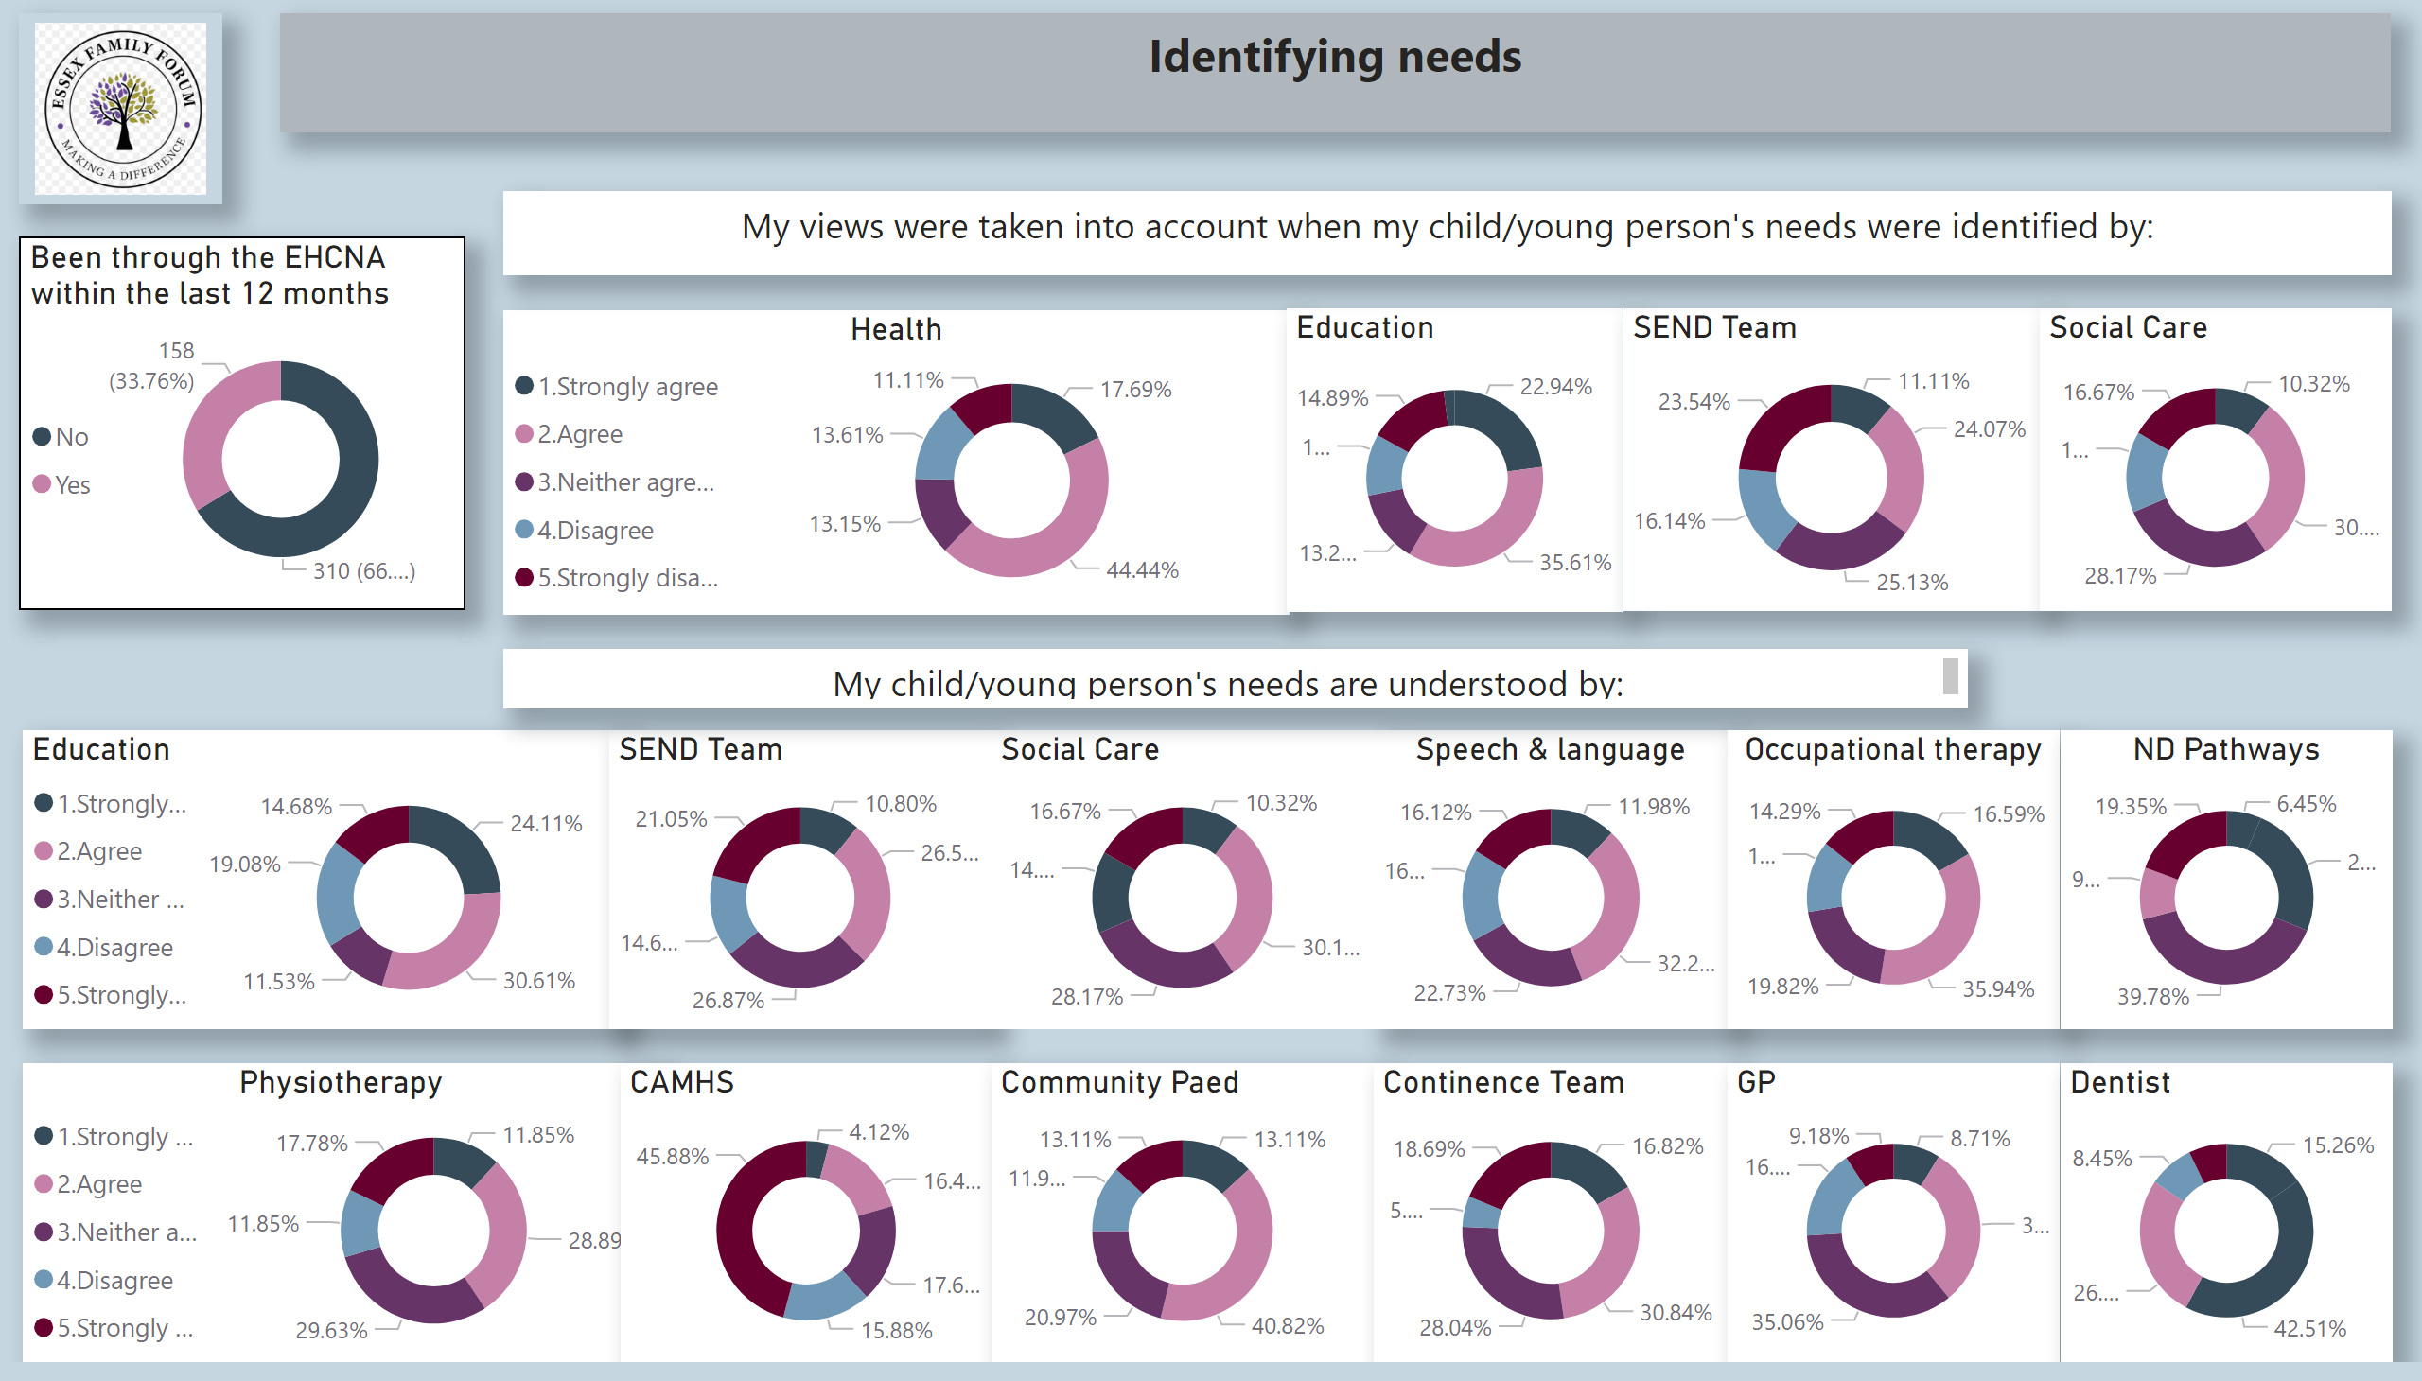
Identifying Needs
Identifying Needs
The majority of families felt their views were taken into account
They also felt their needs were understood by the various teams. However, this does not seem to translate in the provision within EHCPs and needs being met (see data below).
Notes:
Been through the EHCNA within the last 12 months
No alt text provided
textbox
No alt text provided
Health
No alt text provided
image
No alt text provided
Education
No alt text provided
SEND Team
No alt text provided
Social Care
No alt text provided
textbox
No alt text provided
Speech & language
No alt text provided
Education
No alt text provided
SEND Team
No alt text provided
Social Care
No alt text provided
textbox
No alt text provided
Occupational therapy
No alt text provided
Physiotherapy
No alt text provided
CAMHS
No alt text provided
Community Paed
No alt text provided
Continence Team
No alt text provided
GP
No alt text provided
Dentist
No alt text provided
ND Pathways
No alt text provided

Slide 6
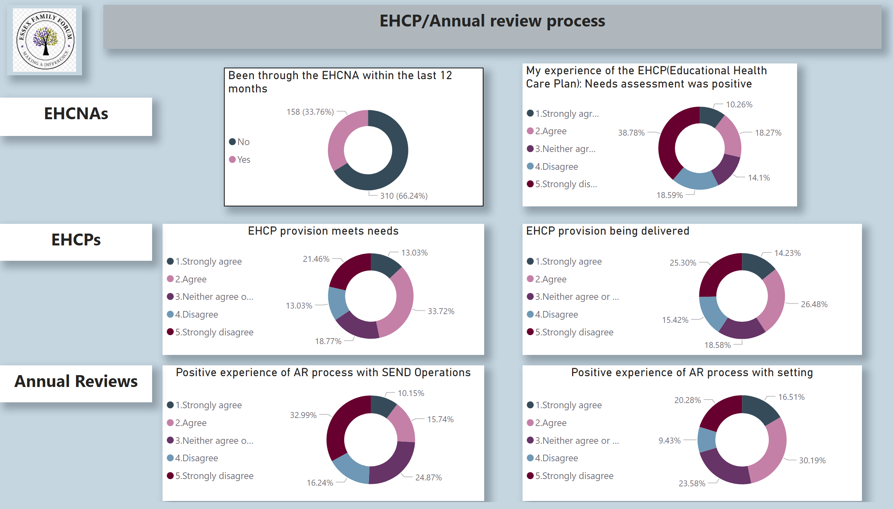
EHCP process
EHCP/Annual Review Process
The majority of families reported a poor experience of the EHCNA process
Less than 50% of respondants felt the EHCP provision met their CYP needs or was being delivered.
Notes:
Been through the EHCNA within the last 12 months
No alt text provided
My experience of the EHCP(Educational Health Care Plan): Needs assessment was positive
No alt text provided
textbox
No alt text provided
EHCP provision meets needs
No alt text provided
image
No alt text provided
EHCP provision being delivered
No alt text provided
textbox
No alt text provided
Positive experience of AR process with SEND Operations
No alt text provided
textbox
No alt text provided
Positive experience of AR process with setting
No alt text provided
textbox
No alt text provided

Slide 7
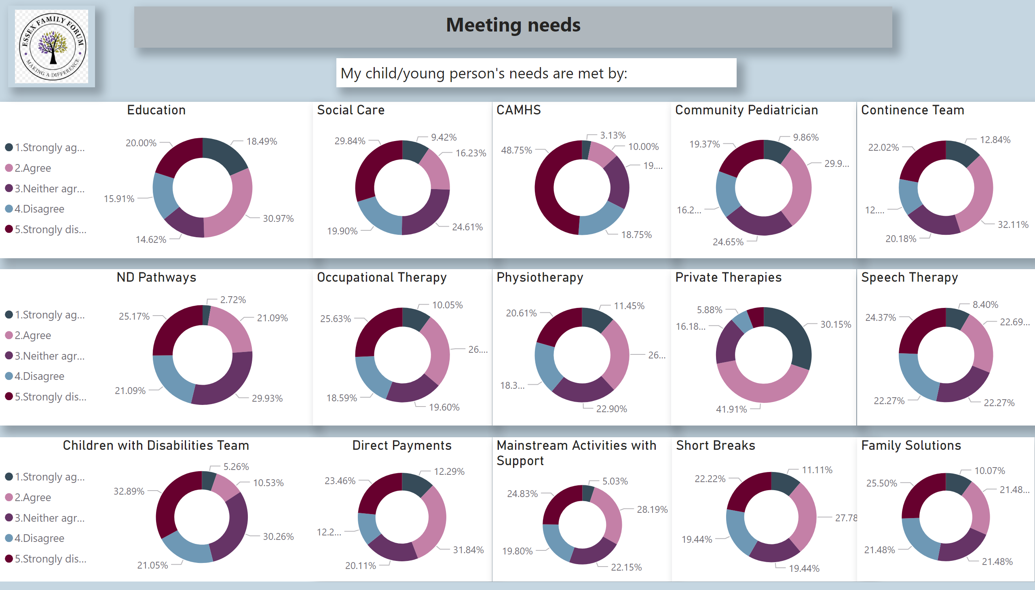
Meeting needs
Notes:
Education
No alt text provided
image
No alt text provided
Social Care
No alt text provided
CAMHS
No alt text provided
Community Pediatrician
No alt text provided
Continence Team
No alt text provided
ND Pathways
No alt text provided
Occupational Therapy
No alt text provided
Physiotherapy
No alt text provided
Private Therapies
No alt text provided
Speech Therapy
No alt text provided
textbox
No alt text provided
Direct Payments
No alt text provided
Mainstream Activities with Support
No alt text provided
Short Breaks
No alt text provided
textbox
No alt text provided
Children with Disabilities Team
No alt text provided
Family Solutions
No alt text provided

Slide 8
Health and Mental Health Themes
Health services – particularly CAMHS and neurodevelopmental pathways – are frequently referenced as a point of strain:
Difficulty accessing support before crisis
Limited post‑diagnosis interventions
Families turning to private services due to long waits, creating inequality based on income
Lack of joined‑up working with education during periods of distress
“We got the diagnosis, then we were left on our own.”
“CAMHS only stepped in once we reached breaking point.”
This has significant implications for prevention, school attendance and family resilience.

Slide 9
Education and Transitions
Many families value schools’ efforts but report that mainstream settings are under pressure, particularly when:
Children mask difficulties or are academically able
Needs are primarily emotional, sensory or related to anxiety
Flexibility is needed during distress or change
Transitions, especially secondary transfer and post‑16, are repeatedly described as high‑risk points.
“Everything fell apart during transition – that’s when we lost all support.”

Slide 10
Impact on Families
The cumulative impact across services is severe:
Parental burnout and declining mental and physical health
Periods of reduced or no education for children
Increased family conflict and isolation
Loss of trust in statutory systems
“Navigating SEND feels like a full‑time job, on top of caring for your child.”

Slide 11
Strategic messages from Families
Families are not asking for unrealistic solutions. The messages are consistent and focused on system improvement:
Earlier, proactive support before crisis
Transparent communication and realistic timescales
Greater consistency in case ownership
Better joined‑up working across education, health and social care
A culture of partnership rather than conflict
“We don’t want to fight the system – we want to work with it.”

Slide 12
Strategic Implications
The survey suggests that:
Delay increases cost, complexity and risk
Crisis‑led systems are replacing prevention
The voluntary sector is carrying unmet statutory demand
Communication, continuity and trust are as critical as funding
Addressing these issues at system level offers the opportunity to improve outcomes, reduce escalation and rebuild confidence.

Slide 13
Quadrant Variation
While families across Essex report similar systemic challenges, the survey highlights areas where pressures are more pronounced by quadrant.
North East: Families are more likely to say EHCPs reflect their child’s needs, but also report high levels of non‑delivery in practice, alongside particularly low confidence in complaints and transitions.
Mid: Relatively stronger experiences of access to education services and transport, with slightly fewer concerns about EHCP delivery, suggesting operational strengths that may offer learning.
West: Stronger concerns around health services, especially CAMHS, and more strained relationships with SEND operations, alongside lower transport satisfaction.
South: Larger response base shows some slightly less negative experiences in assessment and relationships with settings, but transition confidence remains low.
Overall message: Core issues are consistent countywide, but how and where families experience pressure varies, highlighting the importance of combining countywide system improvement with place‑based responses.

Slide 14
Appendix- Data from
Family Impact Survey 2025
The Below is the data that was used along with individual comments to construct the summary report above.
We will use this data to produce varying reports focusing on different elements, for different teams.
We will be presenting the results at the relevant LA/ICB (local authority/ Integrated Care Board) workstreams to ensure maximum impact.
In addition, we are ensuring your responses feed through to Local Area Partnership Action plans as well as responses to the SEND Reforms.

Slide 15
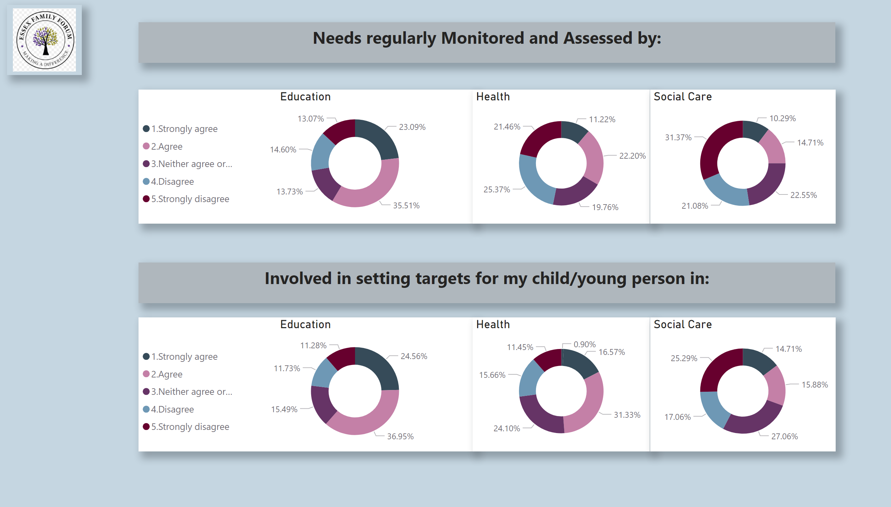
Monitoring/Targets
Notes:
Education
No alt text provided
image
No alt text provided
Health
No alt text provided
Social Care
No alt text provided
Education
No alt text provided
Health
No alt text provided
Social Care
No alt text provided
textbox
No alt text provided
textbox
No alt text provided

Slide 16
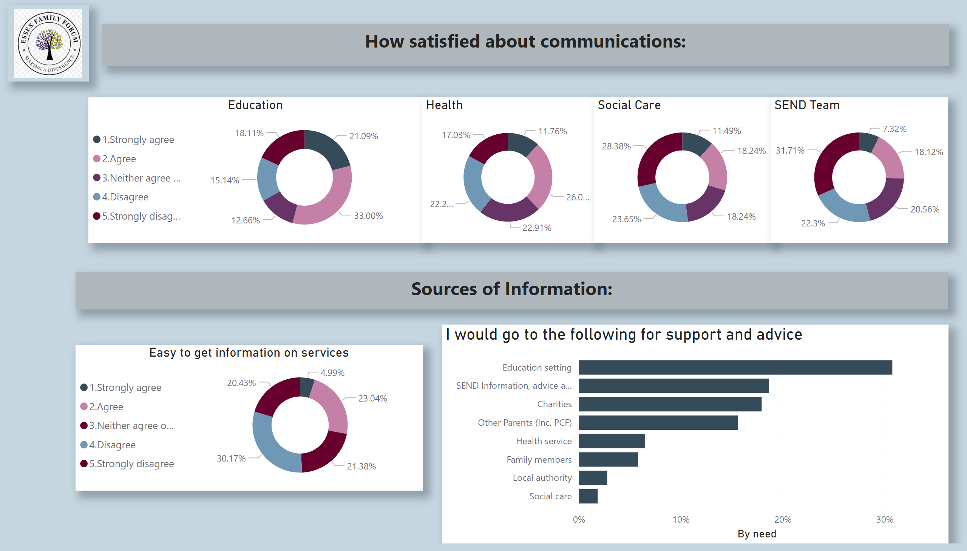
Comms/Info
Notes:
Education
No alt text provided
image
No alt text provided
Health
No alt text provided
Social Care
No alt text provided
Easy to get information on services
No alt text provided
textbox
No alt text provided
textbox
No alt text provided
SEND Team
No alt text provided
I would go to the following for support and advice
No alt text provided

Slide 17
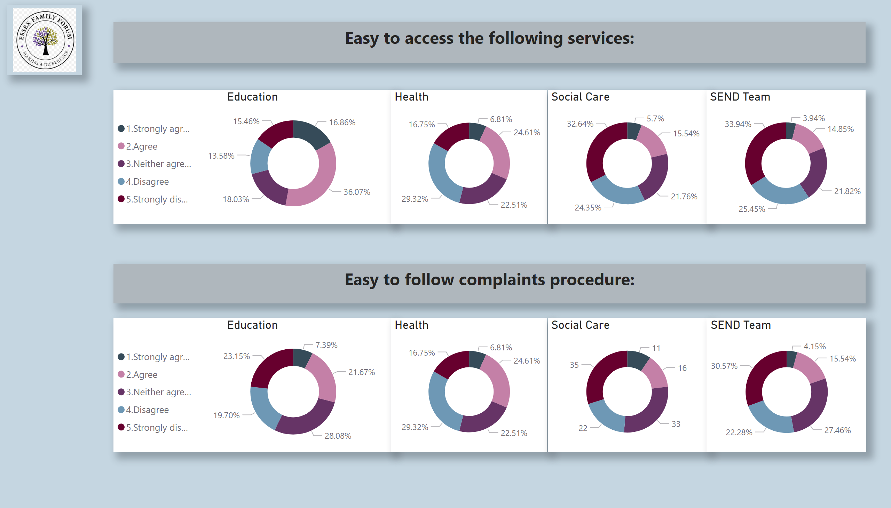
Access/complaints
Notes:
Education
No alt text provided
image
No alt text provided
Health
No alt text provided
Social Care
No alt text provided
Education
No alt text provided
Health
No alt text provided
Social Care
No alt text provided
textbox
No alt text provided
textbox
No alt text provided
SEND Team
No alt text provided
SEND Team
No alt text provided

Slide 18
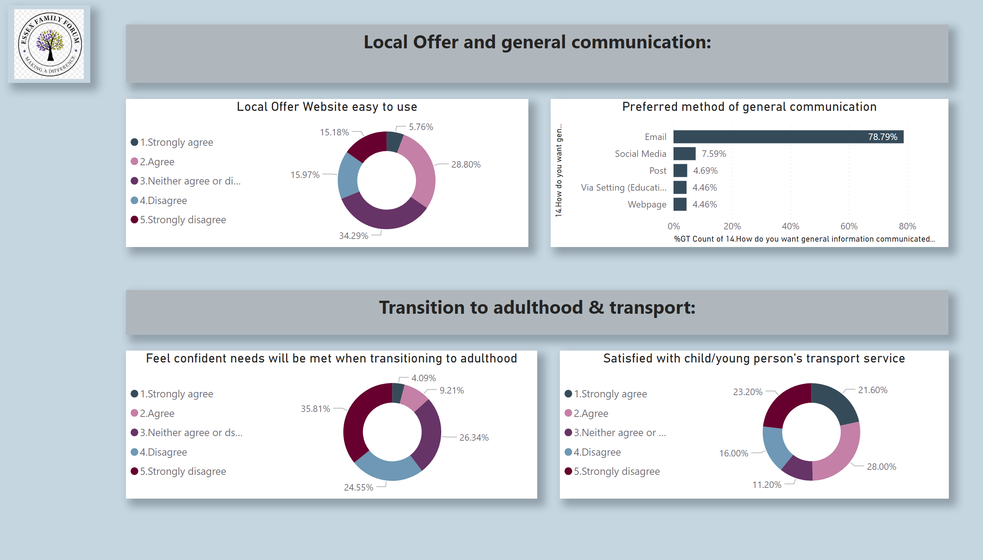
Local Offer/Transport/PfA
Notes:
Local Offer Website easy to use
No alt text provided
image
No alt text provided
Feel confident needs will be met when transitioning to adulthood
No alt text provided
textbox
No alt text provided
textbox
No alt text provided
Preferred method of general communication
No alt text provided
Satisfied with child/young person's transport service
No alt text provided

