Slide 1

665 parent carers responded across Essex
Children mainly aged 5–15 years
Most common needs: Autism (ASD), ADHD, SEMH and Speech, Language and communication needs
Majority of participants had children in mainstream settings
Family Impact Survey 2025/26 Mental Health
Notes:
The 2025 FIS received 665 responses from across Essex
This presentation looks to highlight the responses and data relating to North East Essex.
We received 130 responses from parents/carers from NEE
Respondents were evenly split between Tendring and Colchester
The majority of children and young people represented were aged 5-15
35% Female, 63% Male split remaining classified as other
Of those children that were represented in the survey 50 had an EHCP (50) 39 registered being on SEND support (for example One Plans) and 23 were undergoing assessment.

Slide 2
What is working well
Families reported the most positive mental health outcomes when children accessed the right educational setting, had supportive relationships with professionals, and could participate in SEND-friendly activities and support groups.
Parents described children becoming happier, more confident, less anxious and more engaged when their needs were understood and supported.
"Education meets my sons needs and getting a place in the right setting has seen him thrive."
"My son hated school, started adult services at the Essex Skipper, has been amazing for him. He is confident, happy and enthusiastic to go every time."

Slide 3
Key systemic challenges
Families frequently described the emotional impact of delayed support, unmet needs and long waiting lists. Many felt their child's mental health deteriorated whilst waiting for assessments, EHCP decisions or appropriate interventions. CAMHS was one of the most commonly cited areas of dissatisfaction.
"It feels non existent for ASD children in mainstream. She struggled greatly showing suicidal ideation from primary school. We tried every avenue and couldn't get support."
"Social Care and CAMHS rejected support... even though he is self harming, hitting others, feels bad about himself and has daily meltdowns."

Slide 4
Quadrant Variation
Families across Essex consistently reported similar concerns about access to support, long waiting times, school-related anxiety, and challenges accessing CAMHS.
Similarities Across All Quadrants:
Long waiting times for mental health assessments and support.
Difficulties accessing CAMHS and specialist services.
Anxiety linked to unmet SEND needs and unsuitable educational provision.
Parents reporting deterioration in mental health whilst waiting for support.
Positive impact when children access the right school, activities and trusted professionals.
Areas Where Local Differences May Exist:
Families living in more rural areas reported concerns about the availability and accessibility of local services and support opportunities.
Some families highlighted postcode variation in access to activities, support groups and community-based provision.
Positive Themes Across All Quadrants:
Supportive schools and SEND provisions were frequently linked to improved confidence, wellbeing and school engagement.
Charities, support groups and SEND-focused activities were consistently highlighted as helping reduce isolation and improve mental wellbeing.
Trusted professionals who listened and acted early had a significant positive impact on family wellbeing.

Slide 5
Next Steps
Our Priorities for Improvement:
Improve access to mental health support for CYP with SEND.
Reduce waiting times for assessment and intervention.
Provide support whilst families wait for diagnosis or services.
Increase understanding of neurodivergence across services.
Strengthen early intervention and prevention.
Expand opportunities for social connection, inclusion and peer support.

Slide 6
Appendix- Data from FIS 2025
The Below is the data that was used, along with individual comments to construct the summary report above.

Slide 7
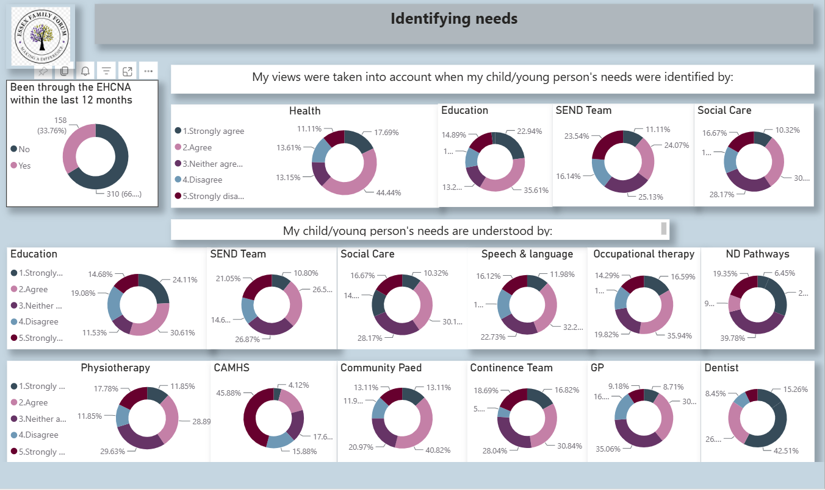

Slide 8
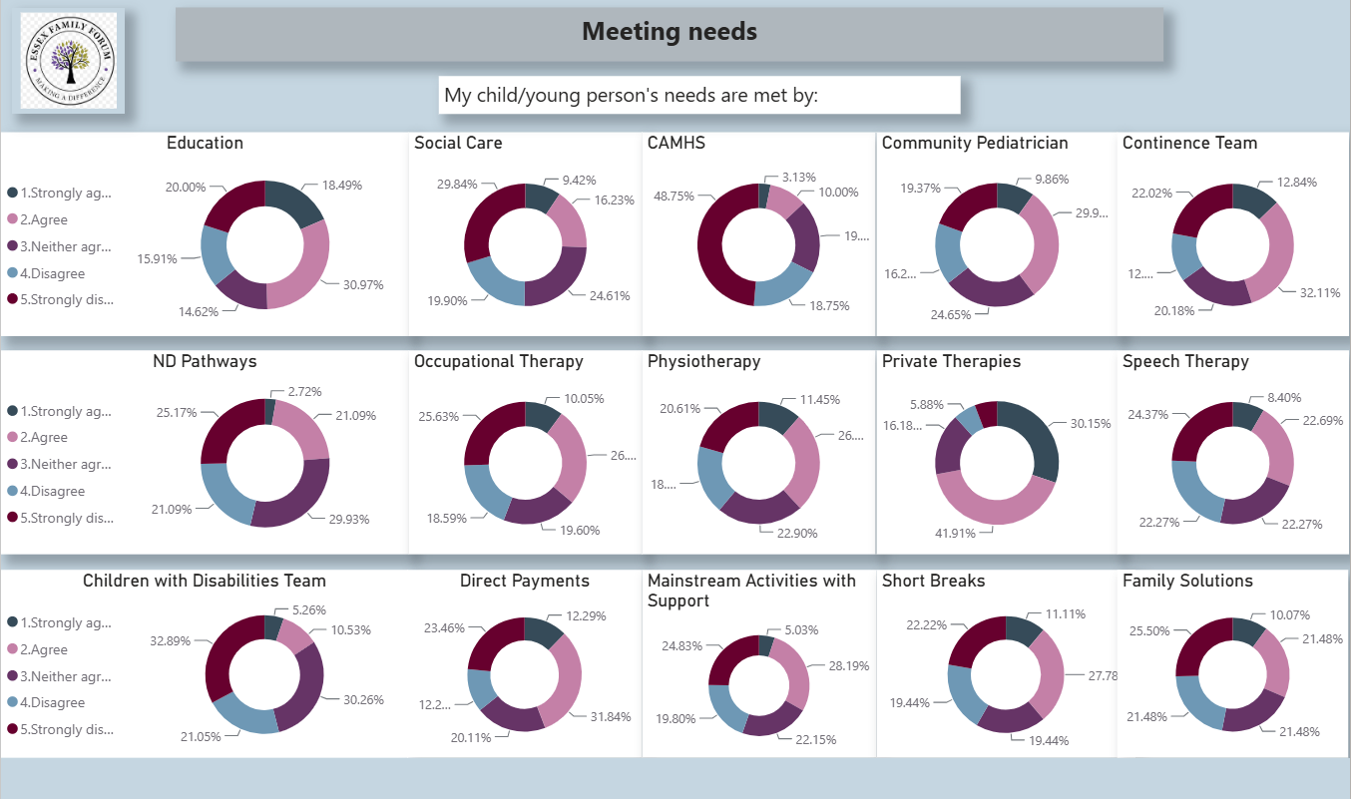

Slide 9
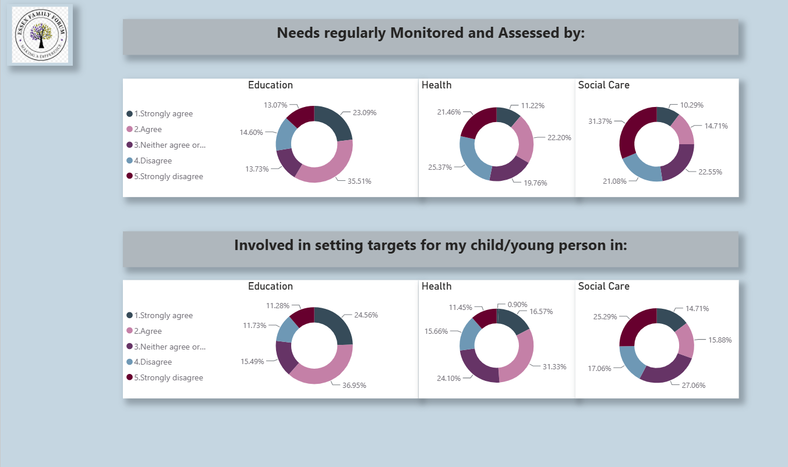

Slide 10
