Slide 1

665 parent carers responded across Essex
Children mainly aged 5–15 years
Most common needs: Autism (ASD), ADHD, SEMH and Speech, Language and communication needs
Majority of participants had children in mainstream settings
Family Impact Survey 2025/26
ND Pathways
Notes:
The 2025 FIS received 665 responses from across Essex
This presentation looks to highlight the responses and data relating to North East Essex.
We received 130 responses from parents/carers from NEE
Respondents were evenly split between Tendring and Colchester
The majority of children and young people represented were aged 5-15
35% Female, 63% Male split remaining classified as other
Of those children that were represented in the survey 50 had an EHCP (50) 39 registered being on SEND support (for example One Plans) and 23 were undergoing assessment.

Slide 2
What is working well
Where families were able to access assessment and diagnostic services, many described feeling listened to and gaining a better understanding of their child's needs.
Receiving a diagnosis often helped families access support, make informed decisions and advocate more effectively for their child.
"The ASD assessor's were amazing."
"The right to choose initiative helped with getting a quick diagnosis."

Slide 3
Key systemic challenges
Families consistently reported lengthy waiting times for ASD and ADHD assessments, poor communication whilst waiting, and a lack of support before diagnosis.
Many described feeling left to manage escalating needs without appropriate guidance or intervention.
Key Challenges
Long waits for ASD and ADHD assessments.
Limited communication regarding waiting lists and progress.
Referrals declined or delayed.
Lack of support while awaiting diagnosis.
Families feeling they must repeatedly chase services for updates.
"Been waiting since September 2024."
"The wait time for assessment is a joke."

Slide 4
Quadrant Variation
Families across Essex reported similar experiences and challenges accessing assessment, diagnosis and follow-up support.
Similarities Across All Quadrants:
Long waits for ASD and ADHD assessments.
Lack of updates during the assessment process.
Difficulties accessing support whilst awaiting diagnosis.
Parents feeling they need to repeatedly advocate for their child.
Concerns about increasing demand and limited capacity within services.
Areas Where Local Differences May Exist:
Some families reported needing to travel outside their immediate area to access support.
Awareness and access to local support groups and services appeared to vary between communities.
Positive Themes Across All Quadrants:
Positive experiences with individual clinicians and assessment teams.
Appreciation for Right to Choose pathways where accessible.
Families valued assessments that took time to listen and understand their child.

Slide 5
Next Steps
Our Priorities for Improvement:
Reduce waiting times for ASD and ADHD assessments.
Improve communication during the assessment process.
Provide support while families wait for diagnosis.
Increase awareness of available support and pathways.
Improve post-diagnosis support and follow-up.
Ensure consistent access across all areas of Essex.

Slide 6
Appendix- Data from FIS 2025
The Below is the data that was used, along with individual comments to construct the summary report above.

Slide 7
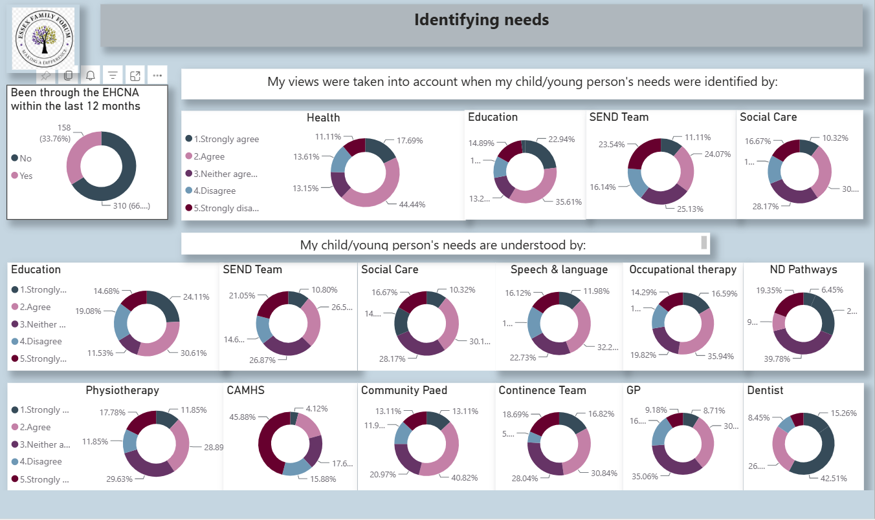

Slide 8
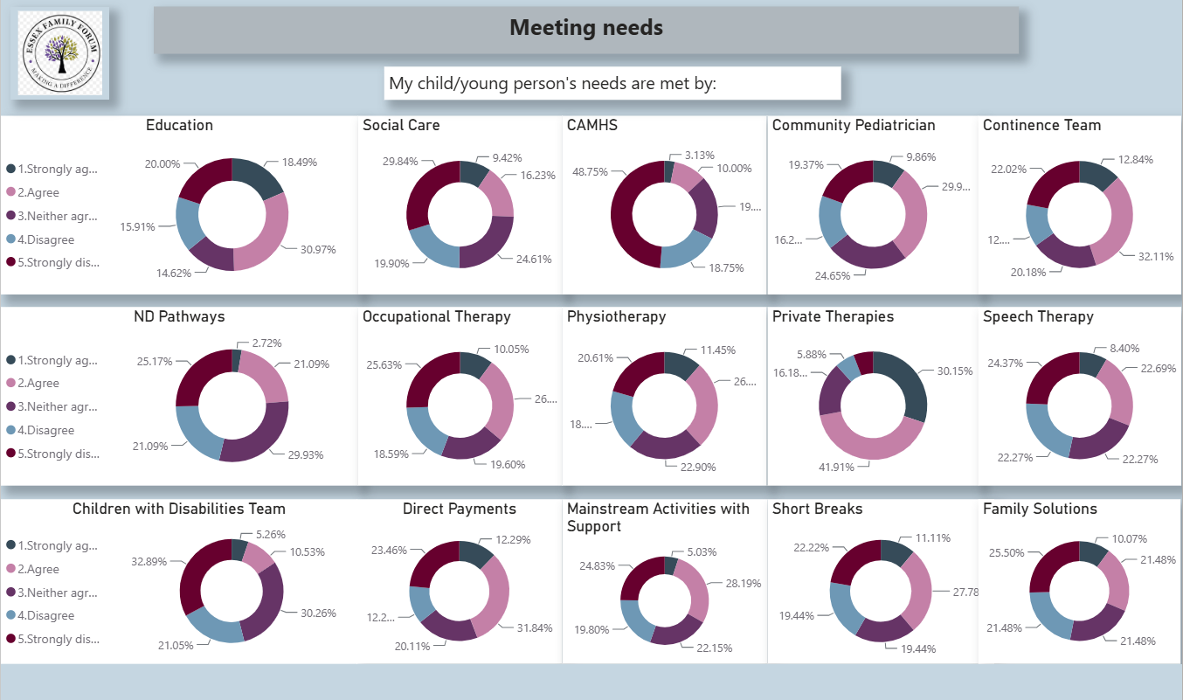

Slide 9
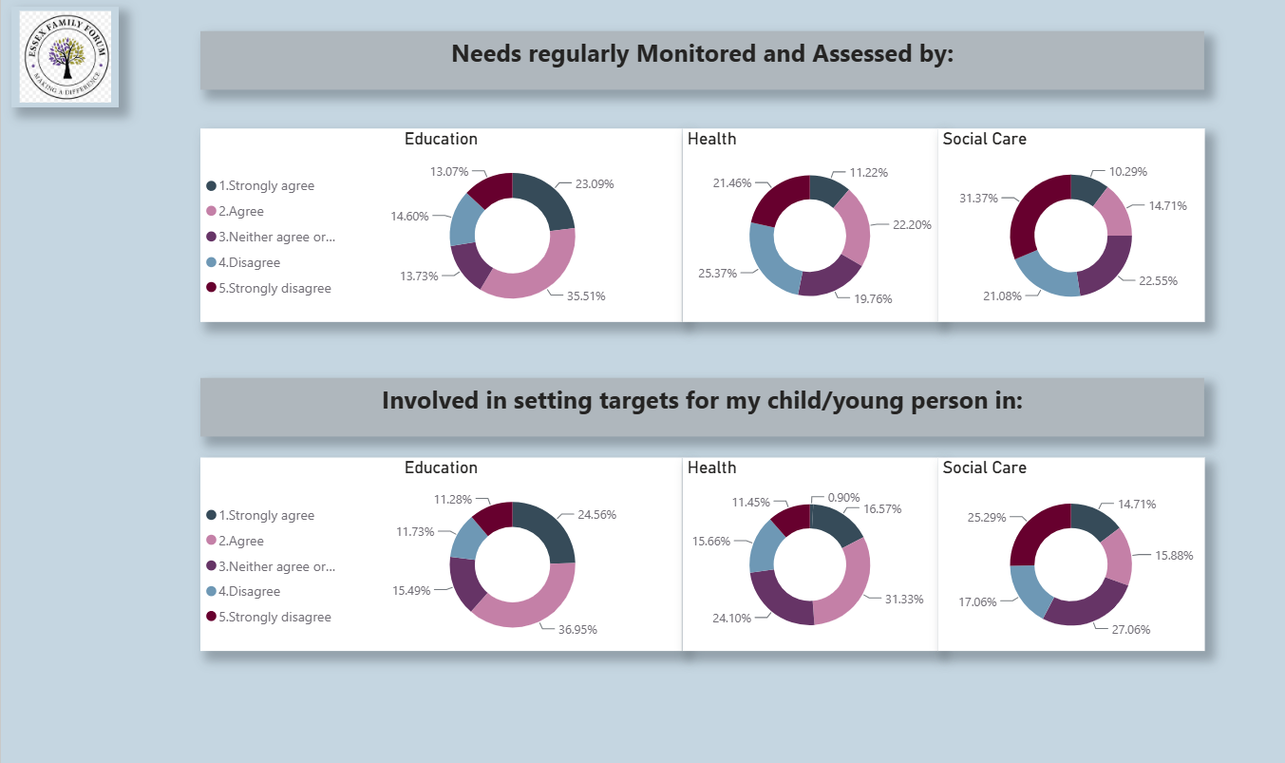

Slide 10
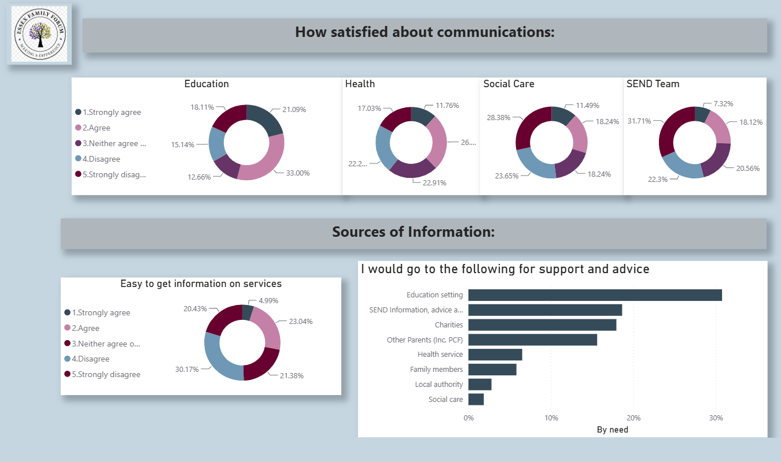

Slide 11
