Slide 1

This theme is informed primarily by approximately 77 families of young people aged 16-25
Most common needs: Autism (ASD), ADHD, SEMH and Speech, Language and communication needs
Majority of participants had children in mainstream settings
16-18 = 46 respondents. 19-25 = 31 respondents.
Family Impact Survey 2025/26 Preparing for Adulthood (PFA)
Notes:
The 2025 FIS received 665 responses from across Essex
This presentation looks to highlight the responses and data relating to North East Essex.
We received 130 responses from parents/carers from NEE
Respondents were evenly split between Tendring and Colchester
The majority of children and young people represented were aged 5-15
35% Female, 63% Male split remaining classified as other
Of those children that were represented in the survey 50 had an EHCP (50) 39 registered being on SEND support (for example One Plans) and 23 were undergoing assessment.

Slide 2
What is working well
Many families report positive experiences where they have access to the right education setting, supportive professionals, charities and peer support networks.
When support is tailored and relationships are consistent, children and young people are more likely to thrive socially, emotionally and educationally.
“Being the in right setting has made a huge difference in learning, safe guarding, social, emotional.”
“Children with disabilities team have been incredibly helpful. Our social worker has been a consistent support and helped my Son get the support he needs.”

Slide 3
Key systemic challenges
Families describe Preparing for Adulthood as a significant area of concern. Confidence that needs will be met in adulthood is very low, with around 60% of respondents disagreeing or strongly disagreeing that they feel confident about transition to adulthood.
Families frequently describe a "cliff edge" between children's and adult services, particularly around mental health support, employment pathways and ongoing care.
“As a neurodivergent adult, with neurodivergent family, I strongly believe that there will little to no support. Unless something drastically changes then we are left to work it out.”
“The biggest area of failure is adult mental health.”

Slide 4
Quadrant Variation
The survey data does not show substantial differences in PfA experiences between the four quadrants. Feedback from families across Essex was remarkably consistent, with the same themes appearing repeatedly regardless of location.
Similarities Across All Quadrants
Low confidence about transition to adulthood. Concerns about adult mental health provision. Difficulties accessing information and navigating services. Anxiety about education, employment and future support. Reliance on charities and parental advocacy to secure support.
Emerging Differences
West and Mid Essex - Slightly higher response volumes, resulting in more examples being received from those areas.
Rural areas - highlighted travel and transport concerns more frequently.
Urban areas - appeared to report more concerns relating to waiting times and service demand.

Slide 5
Next Steps
What Families Are Telling Us Needs to Change:
1. Improve communication and transparency - Regular updates for families. Clear points of contact. Better information about waiting times and progress.
2. Reduce delays - Faster EHCNA and EHCP processes. Improved access to diagnosis, therapies and specialist support.
3. Strengthen accountability - Ensure EHCP provision is delivered consistently. Improve monitoring of statutory timescales and outcomes.
4. Invest in early intervention - Earlier support before crisis point. Better support for children who are masking or do not fit traditional thresholds.
5. Learn from what already works - Build on successful practice in schools, SENDIASS, charities, support groups and specialist settings. Replicate examples of good partnership working across Essex.
6. Improve preparation for adulthood - Clearer pathways into adulthood, employment, independence and social care. Greater confidence that support will continue beyond school.

Slide 6
Appendix- Data from FIS 2025
The Below is the data that was used, along with individual comments to construct the summary report above.

Slide 7
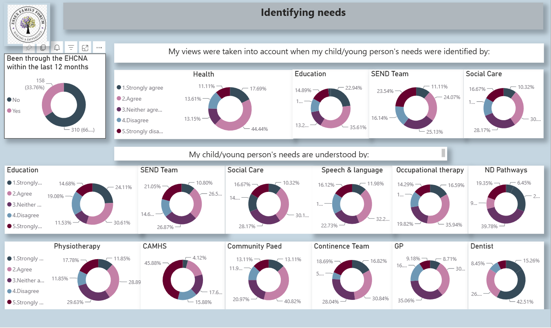

Slide 8
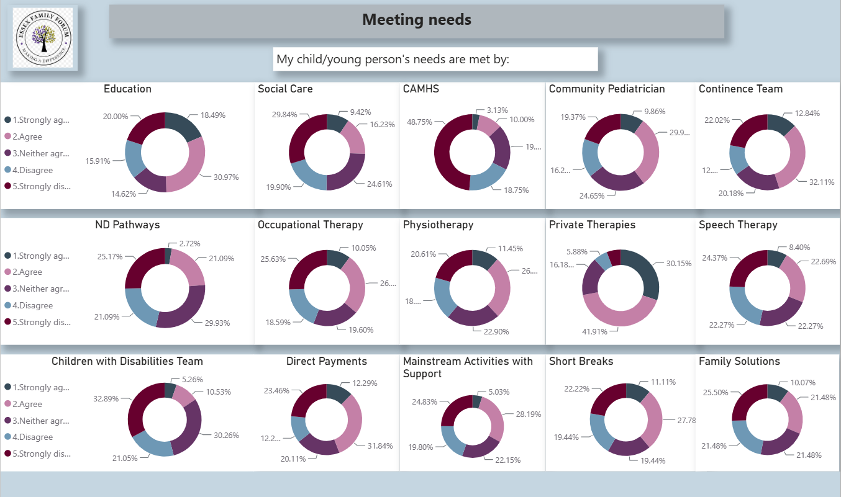

Slide 9
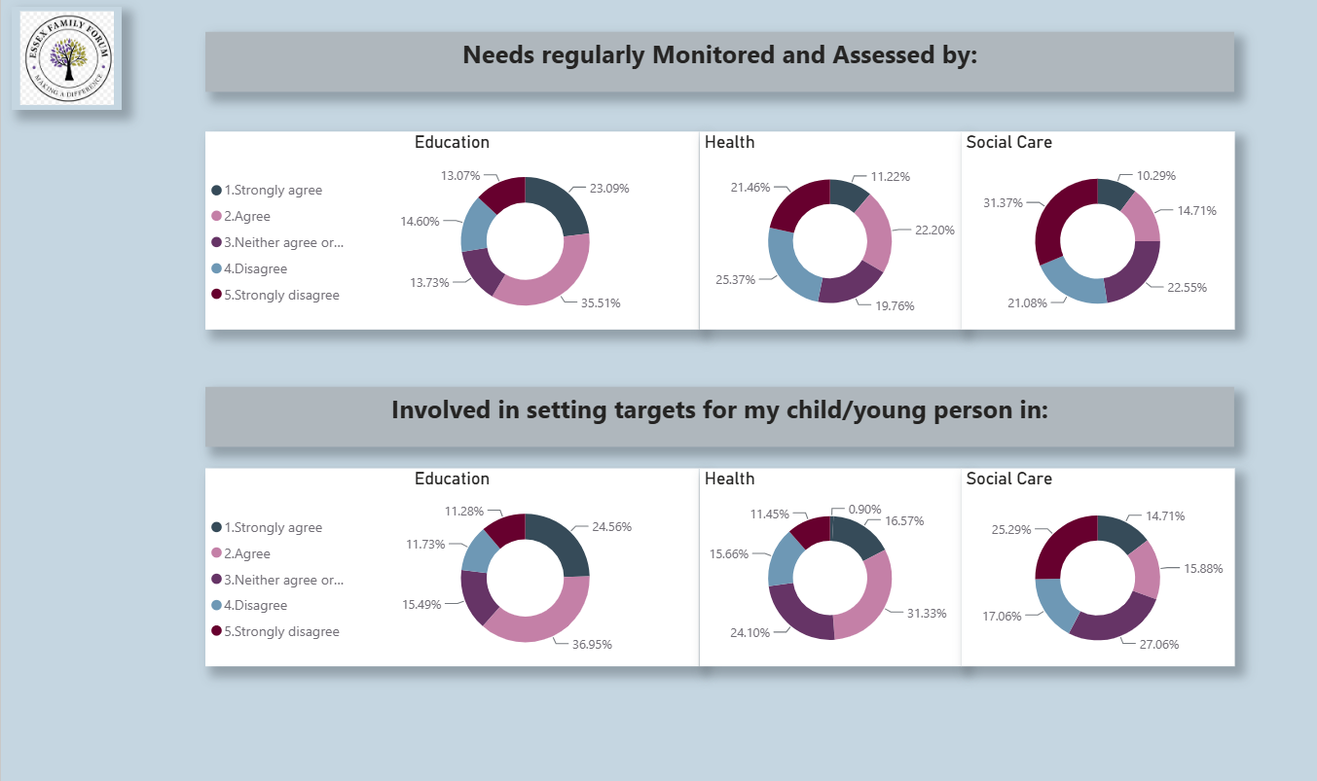

Slide 10
