Slide 1

665 parent carers responded across Essex
Children mainly aged 5–15 years
Most common needs: Autism (ASD), ADHD, SEMH and Speech, Language and communication needs
Majority of participants had children in mainstream settings
Family Impact Survey 2025/26 SEND Support
Notes:
The 2025 FIS received 665 responses from across Essex
This presentation looks to highlight the responses and data relating to North East Essex.
We received 130 responses from parents/carers from NEE
Respondents were evenly split between Tendring and Colchester
The majority of children and young people represented were aged 5-15
35% Female, 63% Male split remaining classified as other
Of those children that were represented in the survey 50 had an EHCP (50) 39 registered being on SEND support (for example One Plans) and 23 were undergoing assessment.

Slide 2
What is working well
Parents consistently reported that the greatest strengths are individual schools, dedicated professionals, SENDIASS, charities and support groups.
Where children are in the right educational setting, families describe significant improvements in learning, wellbeing, social development and emotional safety.
Education services were generally rated more positively than health and social care, with around 59% agreeing that education meets their child's needs.
"Education meets my sons needs and getting a place in the right setting has seen him thrive."
"Children with disabilities team have been incredibly helpful. Our social worker has been a consistent support and helped my Son get the support he needs."

Slide 3
Key systemic challenges
While examples of good practice exist, families described a system that is often slow, fragmented and dependent on parental persistence.
The most common concerns were lengthy waits for assessments and support, poor communication, inconsistent understanding of SEND, difficulties accessing CAMHS and therapies, and families having to fight for provision or pay privately.
Negative experiences were particularly common around health services, social care and EHCP processes.
"Awful, lack of or no communication, painful, emotional, frustrating, system is not working, failing parents and children. It's a constant battle to get your child's needs met."
"All services are overstretched and give same basic information that has already been tried. Mental health services for ND children are impossible to access under NHS and parents are expected to pay for private services."

Slide 4
Quadrant Variation
Analysis of responses by quadrant suggests that family experiences are remarkably similar across Essex
Similarities Across All Quadrants
Difficulties accessing health and therapy services
Concerns about CAMHS support
Delays in assessments and EHCP processes
Positive experiences linked to schools and charities
Parents feeling they need to "fight" for support.
Some Notable Differences
West - More references to transport and access issues due to geography; Concerns around travel distances to services and activities.
Mid Essex - Greater focus on access to therapies and specialist provision; Concerns around waiting lists and availability of services.
North East Essex - More comments concerning education placement suitability and support in mainstream settings.
South Essex - Greater volume of comments relating to EHCP processes and challenges securing provision.

Slide 5
Next Steps
What we would like the SEND partnership to focus on:
1. Improve communication with families - Provide regular updates and clearer expectations around waiting times, referrals and assessments.
2. Reduce waiting times for key services - Prioritise access to CAMHS, SALT, OT, paediatric and neurodevelopmental services.
3. Strengthen SEND understanding across services - Improve training for education, health and social care professionals, particularly around autism, ADHD and complex needs.
4. Ensure provision is delivered consistently - Improve oversight of both SEN Support and EHCP provision to ensure agreed support is actually implemented.
5. Embed meaningful co-production - Involve families as partners in identification, planning, review and decision-making processes.
6. Share and scale effective practice - Learn from schools, practitioners and services that families consistently identify as providing excellent support.

Slide 6
Appendix- Data from FIS 2025
The Below is the data that was used, along with individual comments to construct the summary report above.

Slide 7
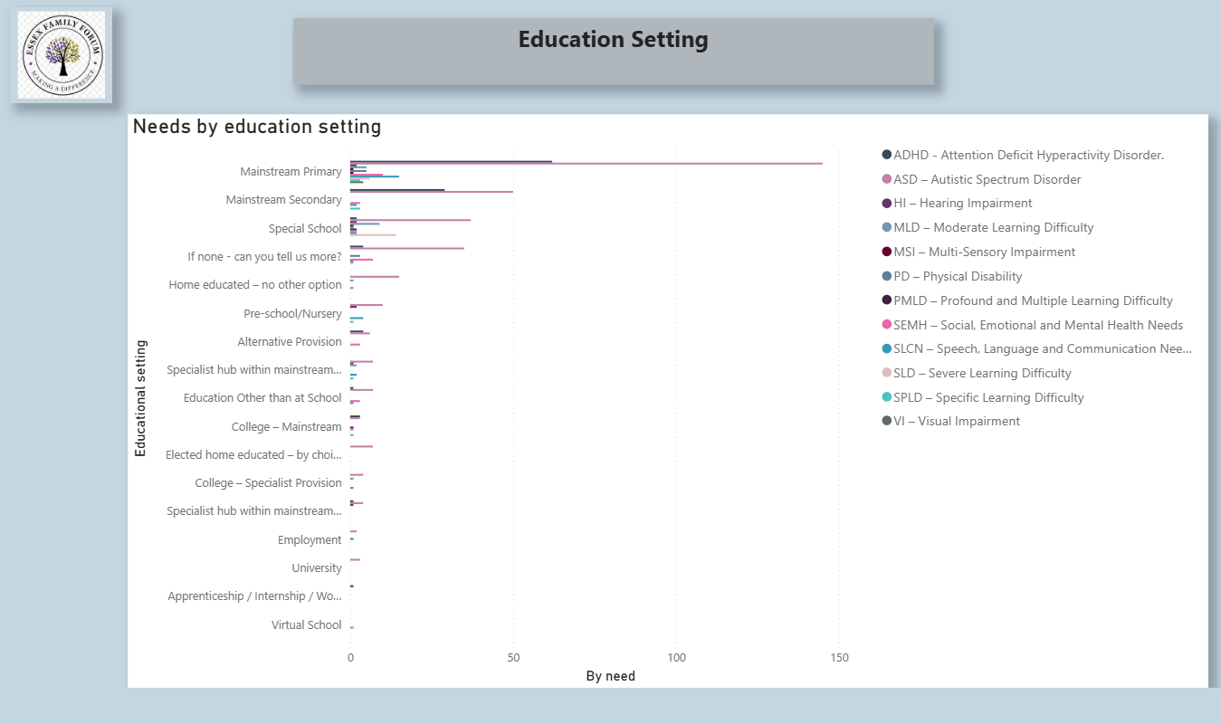

Slide 8
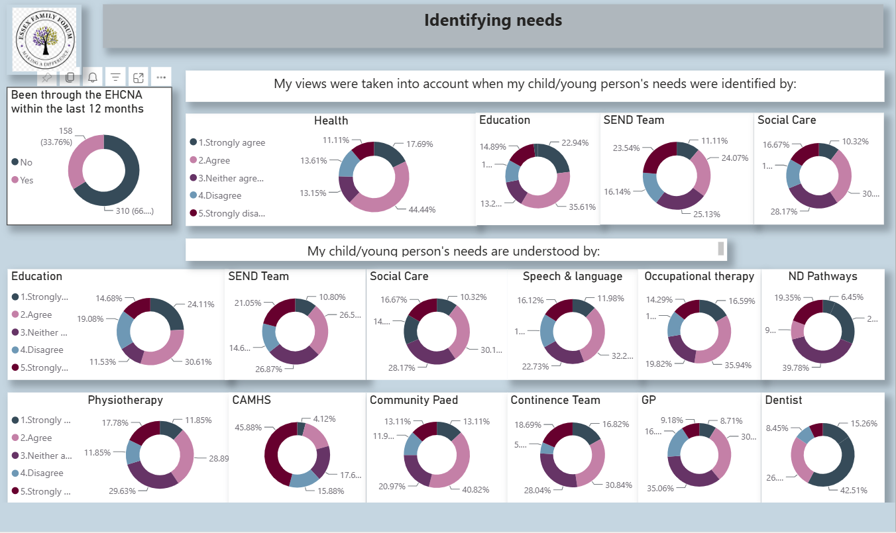

Slide 9
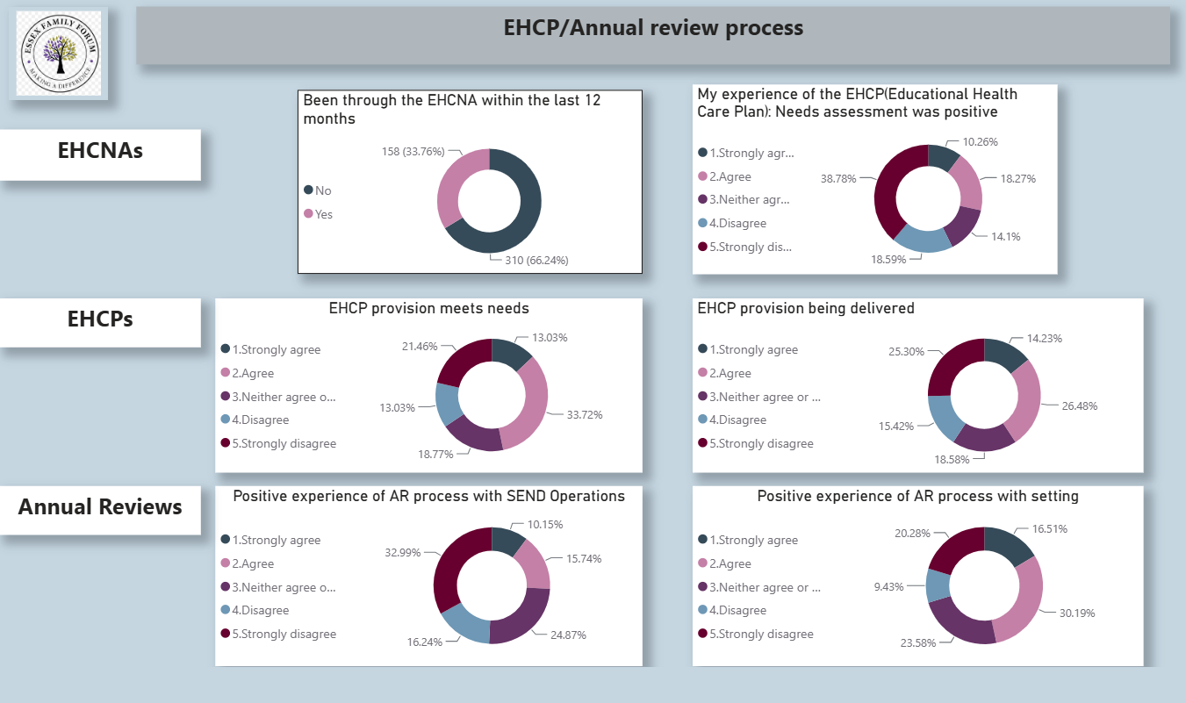

Slide 10
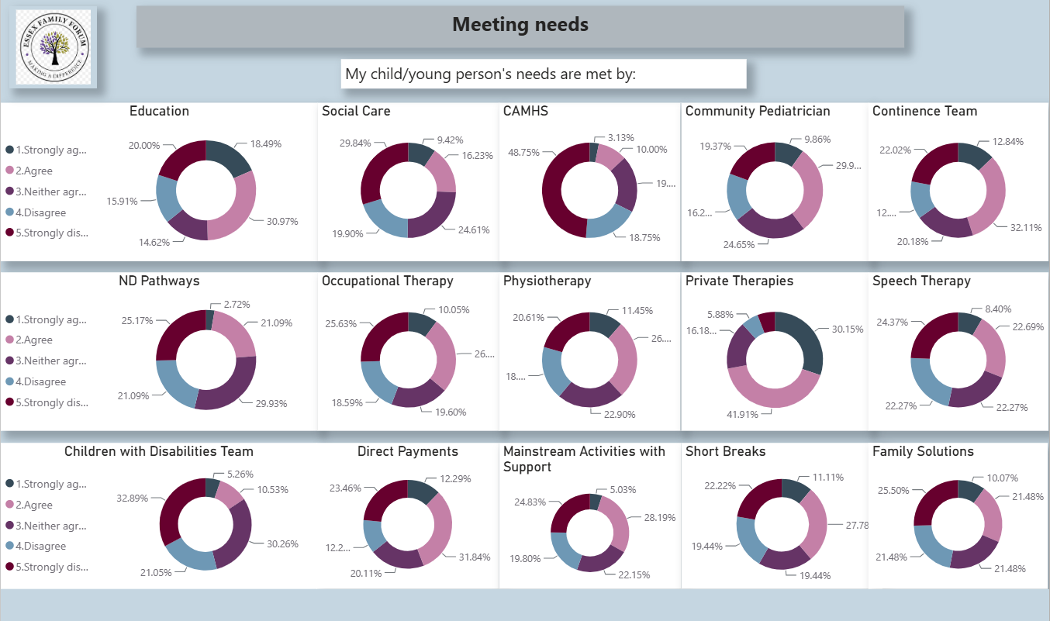

Slide 11
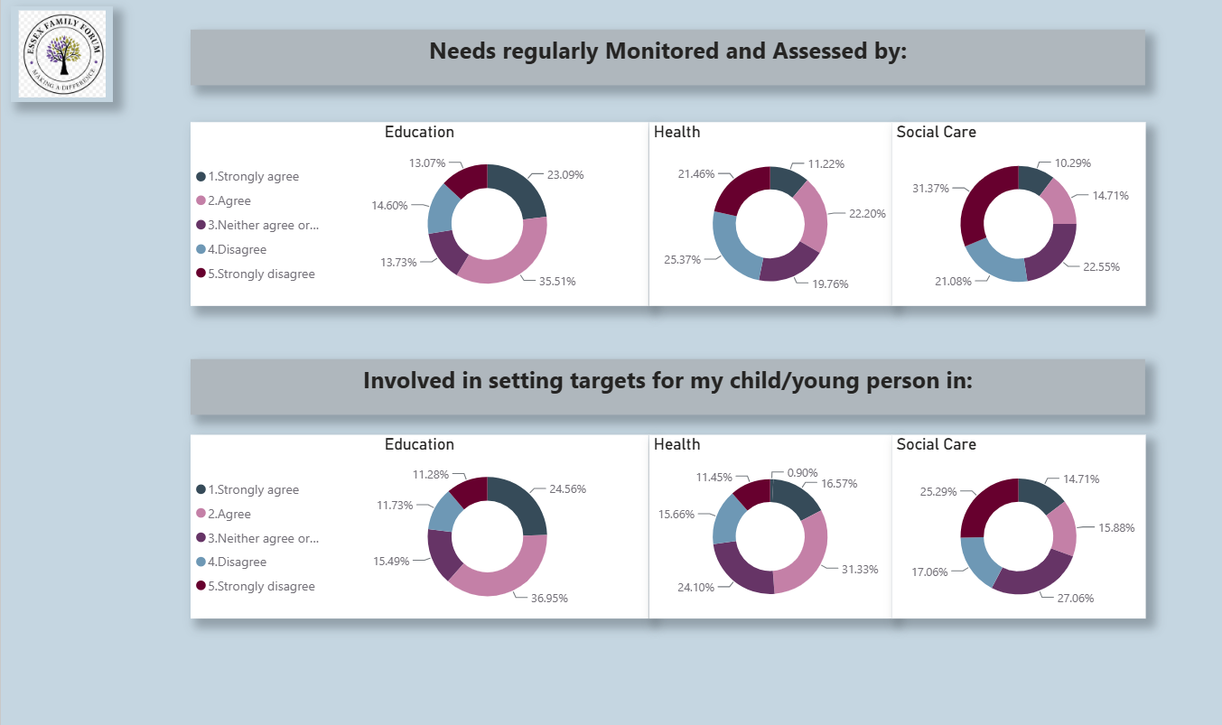

Slide 12
