Slide 1

This presentation reflects the experiences of families accessing Short Breaks, Direct Payments and SEND-inclusive activities.
Children mainly aged 5–15 years
Most common needs: Autism (ASD), ADHD, SEMH and Speech, Language and communication needs
Majority of participants had children in mainstream settings
Family Impact Survey 2025/26
Short Breaks
Notes:
The 2025 FIS received 665 responses from across Essex
This presentation looks to highlight the responses and data relating to North East Essex.
We received 130 responses from parents/carers from NEE
Respondents were evenly split between Tendring and Colchester
The majority of children and young people represented were aged 5-15
35% Female, 63% Male split remaining classified as other
Of those children that were represented in the survey 50 had an EHCP (50) 39 registered being on SEND support (for example One Plans) and 23 were undergoing assessment.

Slide 2
What is working well
Families consistently described Short Breaks, SEND activities and clubs as having a positive impact on children's wellbeing, confidence, independence and social opportunities.
Parents also highlighted the importance of respite, peer friendships and opportunities to participate in activities that are accessible and inclusive.
"We can't praise Short Breaks enough for what they offer with Butterflies."
"West Essex Inclusion Project - SEN swimming lessons and family swim has been excellent for my daughter. We also have found Short Breaks Account really helpful."

Slide 3
Key systemic challenges
Whilst families value Short Breaks, many said access can be limited, with activities filling quickly or not being available locally.
Families in some areas reported having to travel significant distances, whilst others felt there were insufficient options for children with more complex needs.
"Appropriate SEND clubs are just not available."
"No SEND clubs or support in Uttlesford... we have to drive 45 minutes plus to get to any of the SEND clubs if we're lucky enough to get a place."

Slide 4
Quadrant Variation
Families across Essex valued provision where available, but access appeared more variable depending on location.
Similarities Across All Quadrants
Families highly value SEND-specific clubs and activities.
Short Breaks improve wellbeing for both CYP and families.
Parents want more opportunities for social inclusion and independence.
Differences Between Quadrants
Families in rural and more isolated parts of Essex were more likely to report limited local provision.
Some families described needing to travel significant distances to access activities.
Availability of SEND clubs, leisure opportunities and respite appeared to vary between localities.

Slide 5
Next Steps
Our Priorities for Improvement:
Increase the availability of Short Breaks and SEND activities.
Improve access in rural and underserved areas.
Expand provision for children with more complex needs.
Increase respite opportunities for families.
Improve awareness of available activities and support.
Ensure sufficient capacity so families can access places when needed.

Slide 6
Appendix- Data from FIS 2025
The Below is the data that was used, along with individual comments to construct the summary report above.

Slide 7
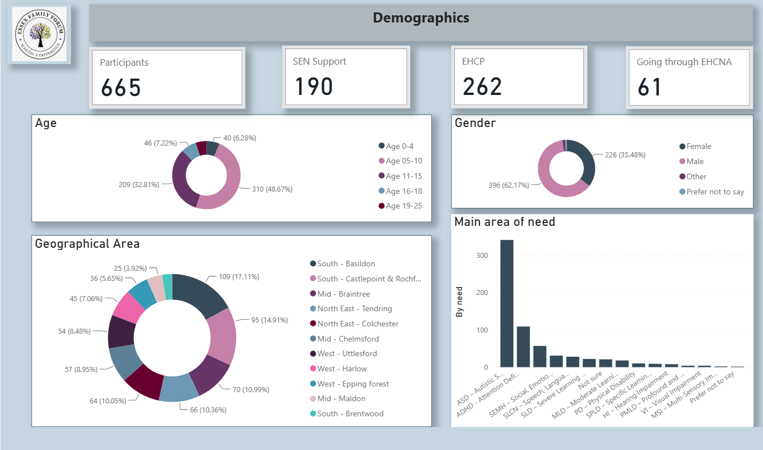

Slide 8
