Slide 1

Analysis is based on families who reported experience of Social Care services, including Children with Disabilities Teams and Family Solutions.
Children mainly aged 5–15 years
Most common needs: Autism (ASD), ADHD, SEMH and Speech, Language and communication needs
Participants had children in 69% specialist provision. And 31% mainstream settings.
Family Impact Survey 2025/26
Social Care
Notes:
The 2025 FIS received 665 responses from across Essex
This presentation looks to highlight the responses and data relating to North East Essex.
We received 130 responses from parents/carers from NEE
Respondents were evenly split between Tendring and Colchester
The majority of children and young people represented were aged 5-15
35% Female, 63% Male split remaining classified as other
Of those children that were represented in the survey 50 had an EHCP (50) 39 registered being on SEND support (for example One Plans) and 23 were undergoing assessment.

Slide 2
What is working well
When families were able to access Social Care support, positive experiences were often linked to individual practitioners who listened, understood needs and helped families access practical support.
Families particularly valued consistent relationships with social workers and support from Children with Disabilities Teams.
"Children with disabilities team have been incredibly helpful. Our social worker has been a consistent support and helped my son get the support he needs."
"Our Social Worker has been marvellous and such a huge provider of support, planning advice for adulthood and knowing when things need to be done!"

Slide 3
Key systemic challenges
Many families described difficulties accessing Social Care support, unclear eligibility criteria and feeling that they had to repeatedly fight for help.
A number of families felt their child fell between services, whilst others reported long delays, poor communication and limited understanding of SEND needs.
"We had to battle with social care for support to be given."
"Social care have been awful. Constantly told by social care that we don't meet criteria for safeguarding team yet also my son isn't disabled enough for disability team support."

Slide 4
Quadrant Variation
Positive and negative experiences were reported across Essex, with similar themes emerging regardless of location.
Similarities Across All Quadrants
Families struggling to understand eligibility criteria.
Difficulty accessing support before reaching crisis point.
Concerns about communication and responsiveness.
Lack of coordinated support across services.
Families reporting they needed to repeatedly advocate for help.
Areas Where Local Differences May Exist
Some families reported limited access to local short breaks, clubs and support services, particularly in less populated areas.
Availability of community-based support opportunities appeared to vary between localities.

Slide 5
Next Steps
Our Priorities for Improvement:
Improve access to Social Care support before families reach crisis point.
Increase clarity around eligibility and thresholds.
Strengthen communication and responsiveness.
Improve understanding of SEND and neurodiversity.
Increase access to short breaks and family support.
Provide more joined-up, family-centred support across services.

Slide 6
Appendix- Data from FIS 2025
The Below is the data that was used, along with individual comments to construct the summary report above.

Slide 7
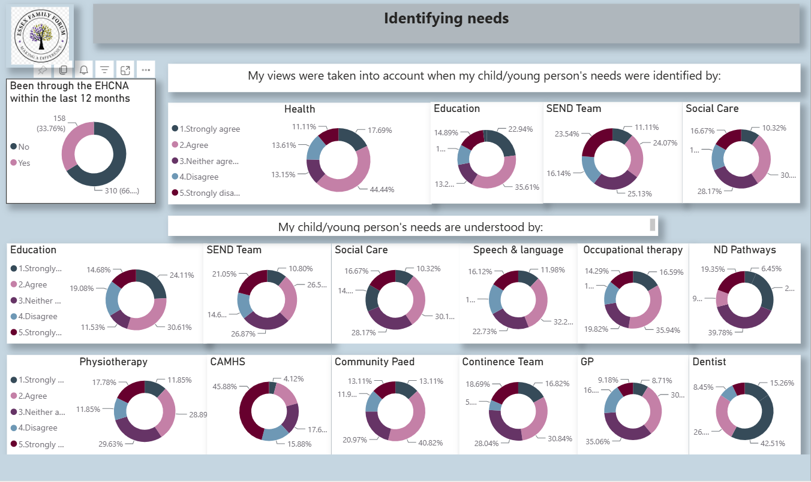

Slide 8
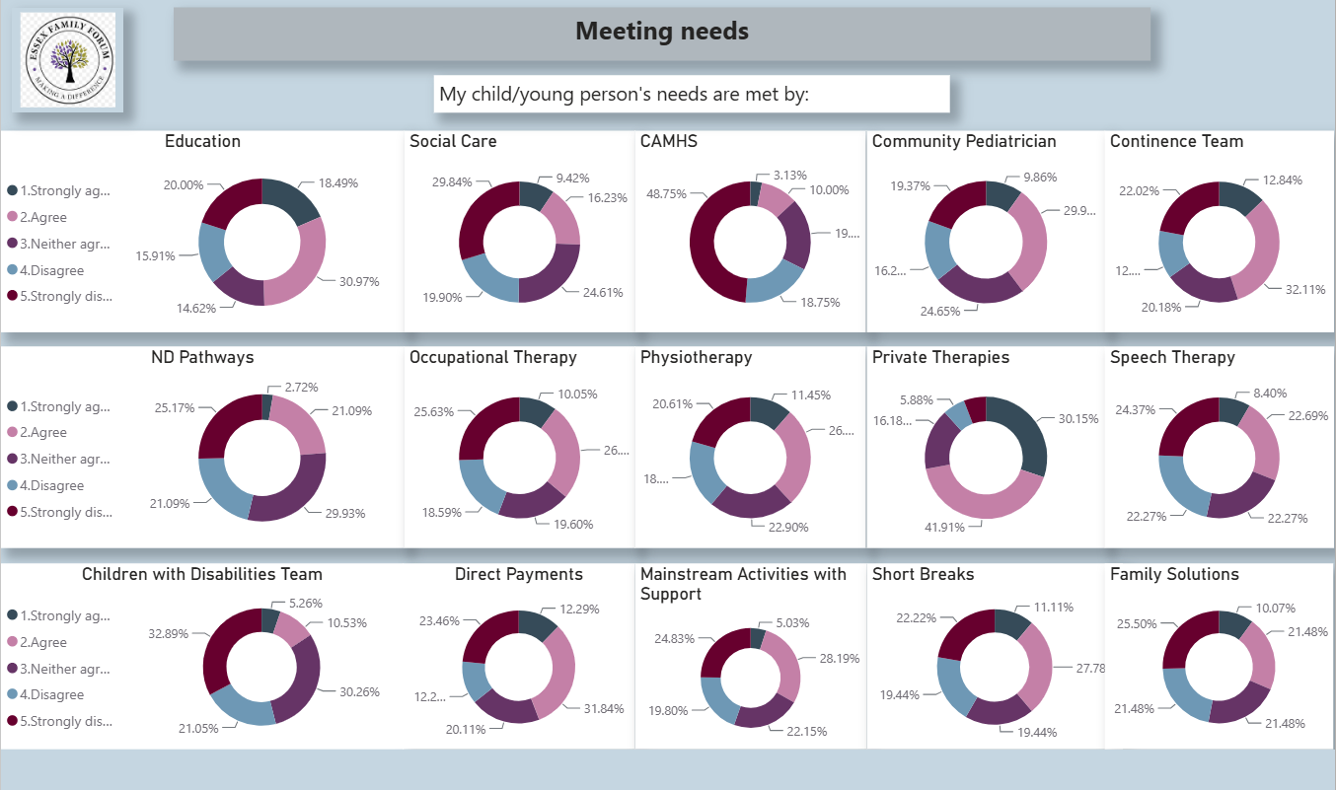

Slide 9
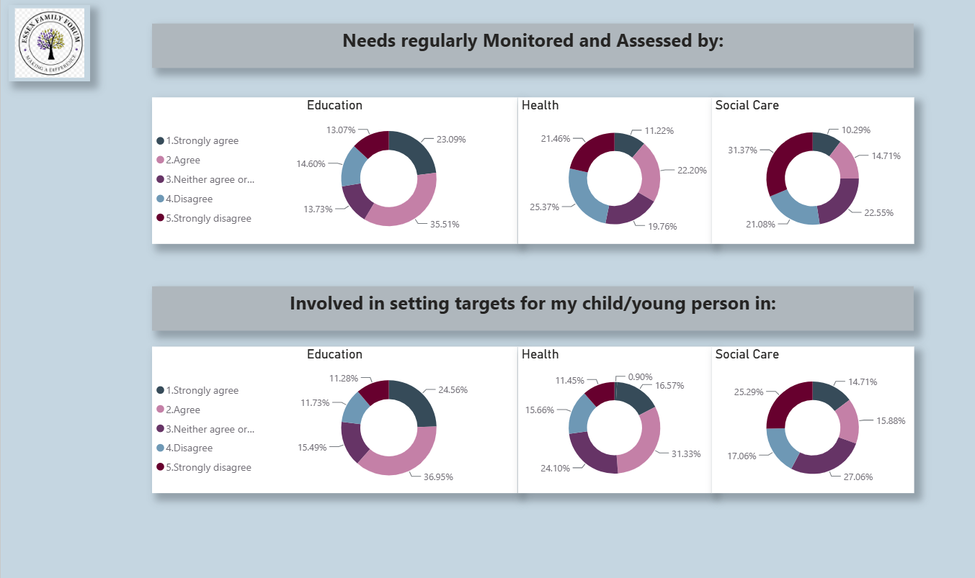

Slide 10
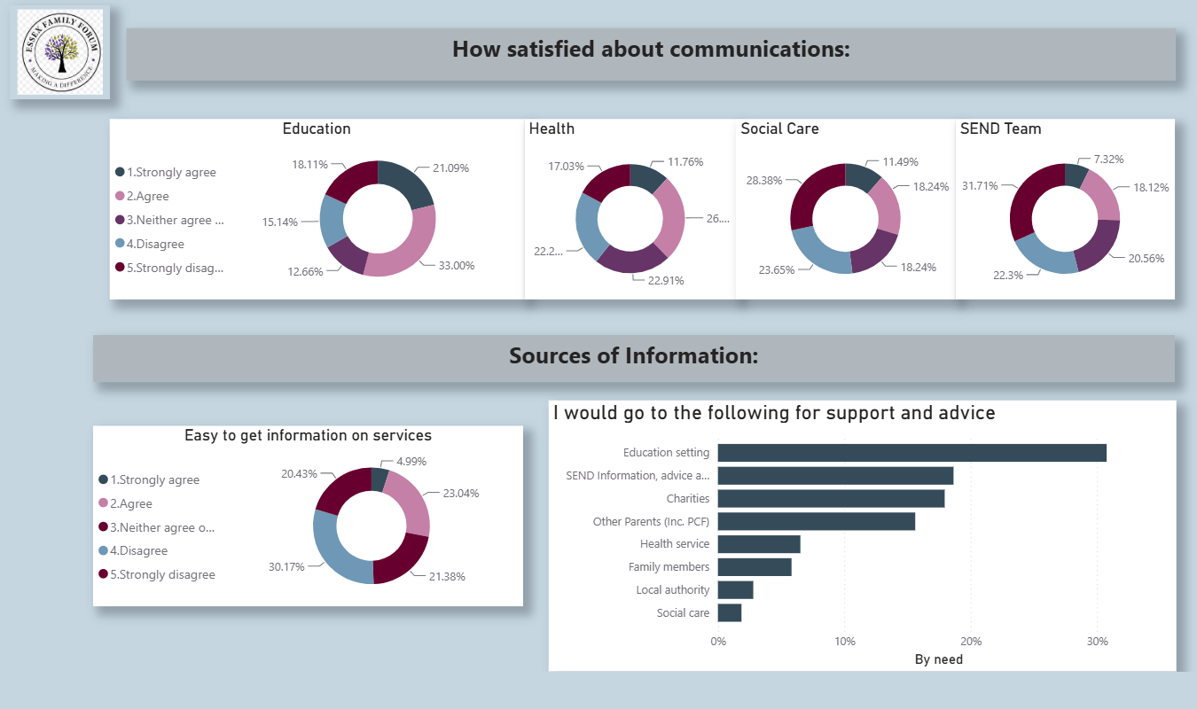

Slide 11
