Slide 1

665 parent carers responded across Essex
Children mainly aged 5–15 years
Most common needs: Autism (ASD), ADHD, SEMH and Speech, Language and communication needs
Majority of participants had children in mainstream settings
Family Impact Survey 2025/26 Therapies
Notes:
The 2025 FIS received 665 responses from across Essex
This presentation looks to highlight the responses and data relating to North East Essex.
We received 130 responses from parents/carers from NEE
Respondents were evenly split between Tendring and Colchester
The majority of children and young people represented were aged 5-15
35% Female, 63% Male split remaining classified as other
Of those children that were represented in the survey 50 had an EHCP (50) 39 registered being on SEND support (for example One Plans) and 23 were undergoing assessment.

Slide 2
What is working well
Families recognise and value individual therapists who listen, adapt their approach and build positive relationships with children and parents.
Positive experiences are associated with regular communication, continuity of support, practical interventions that make a difference to everyday life, and therapy professionals who understand the child's needs.
Overall, families report that success is often linked to dedicated practitioners rather than the wider system.
"OT has been brilliant and keeps me updated every session."
"NHS physio has been excellent and listens."

Slide 3
Key systemic challenges
Families consistently describe a pattern of assessment without ongoing intervention, long waiting times, short therapy blocks, lack of follow-up support, and difficulty accessing therapies despite identified need.
Concerns are particularly strong around Speech and Language Therapy, implementation of EHCP provision, children being discharged without meaningful progress, and increasing reliance on privately funded therapy to access support.
"They assess, agree needs, then say they can't provide anything."
"SaLT is in Section F but it is not being delivered."

Slide 4
Quadrant Variation
The themes reported by families appear remarkably consistent across all quadrants.
Similarities Across All Quadrants
Long waiting times for therapy support.
Assessment and report writing often not followed by intervention.
Concerns about delivery of EHCP therapy provision.
Stronger experiences linked to individual professionals than wider systems.
Growth in families funding private therapy themselves.
Particular concerns regarding Speech and Language Therapy access and continuity.
Minor Variations Noted
Access issues were more commonly referenced where services, activities or specialist provision required significant travel.
Families' positive experiences tended to centre on specific services, schools or individual practitioners rather than geographical location.
No quadrant emerged as consistently better or worse in the available evidence.

Slide 5
Next Steps
What we would like the SEND partnership to focus on:
Move from assessment to intervention - Review the "assess-report-discharge" model and increase access to ongoing therapeutic support.
Improve Speech & Language Therapy pathways - Reduce waiting times, increase therapy intensity where needed, and ensure progression between sessions.
Ensure EHCP therapy provision is delivered - Establish monitoring arrangements to ensure Section F therapies are implemented consistently.
Develop flexible delivery models - Adapt therapy approaches for children who mask, experience anxiety, or present with PDA and other engagement differences.
Strengthen transition arrangements - Ensure therapy support continues through key educational transitions and into adulthood where required.
Reduce reliance on private provision - Review gaps that lead families to self-fund therapy and identify opportunities to improve equitable access to statutory services.

Slide 6
Appendix- Data from FIS 2025
The Below is the data that was used, along with individual comments to construct the summary report above.

Slide 7
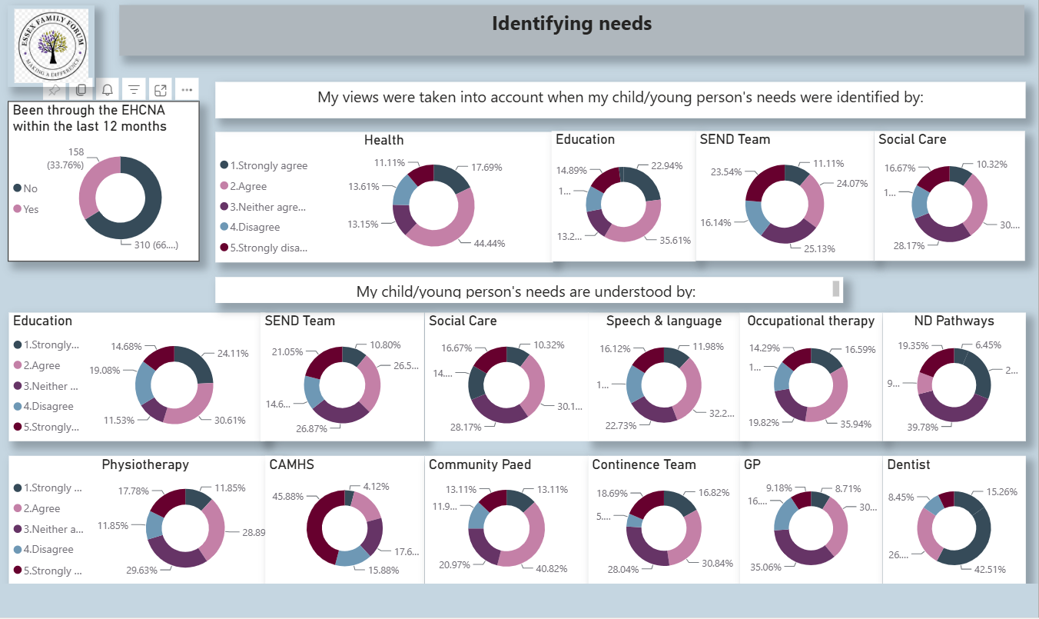

Slide 8
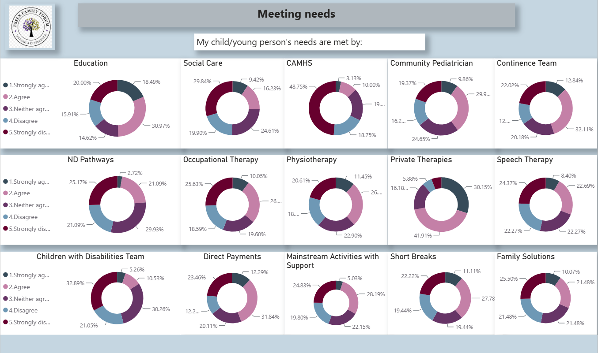

Slide 9
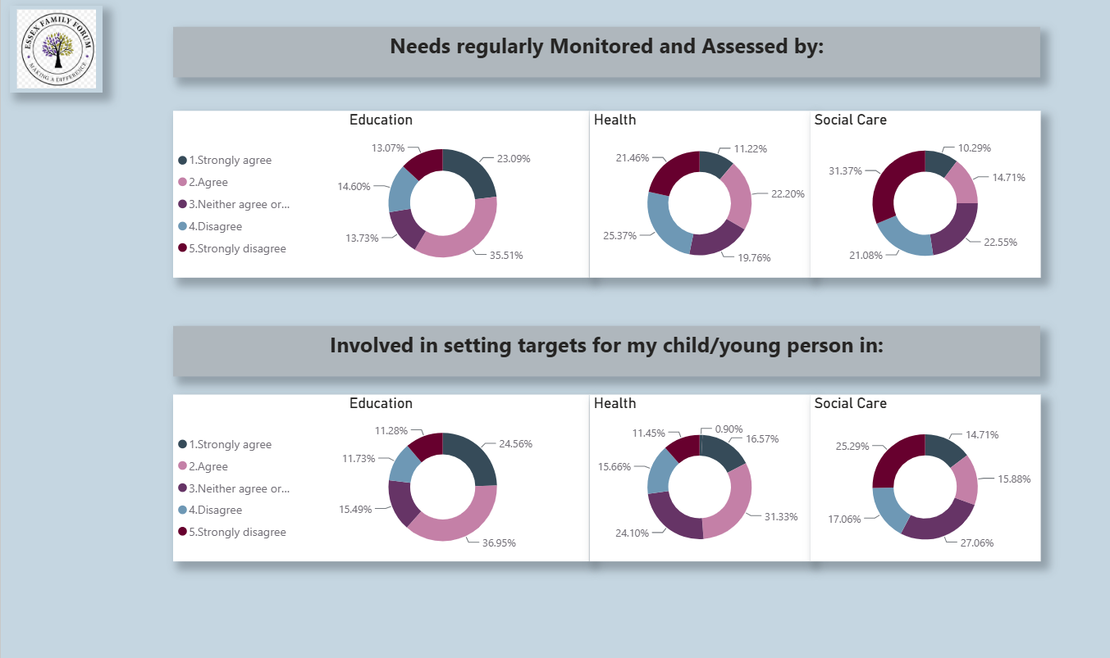

Slide 10
