Slide 1

Children mainly aged 5–15 years
Most common needs: Autism (ASD), ADHD, SEMH and Speech, Language and communication needs
Participants had children in 60% Special provision. 40% Mainstream settings.
This analysis reflects the experiences of families who accessed and responded to questions about SEND transport provision.
Family Impact Survey 2025/26
Transport
Notes:
The 2025 FIS received 665 responses from across Essex
This presentation looks to highlight the responses and data relating to North East Essex.
We received 130 responses from parents/carers from NEE
Respondents were evenly split between Tendring and Colchester
The majority of children and young people represented were aged 5-15
35% Female, 63% Male split remaining classified as other
Of those children that were represented in the survey 50 had an EHCP (50) 39 registered being on SEND support (for example One Plans) and 23 were undergoing assessment.

Slide 2
What is working well
Families who have a reliable and consistent transport arrangement report that transport enables their child to access education safely and reduces stress for the whole family.
Positive experiences are linked to continuity of drivers, predictable routines, and transport services that understand and accommodate SEND needs.
"Consistent transport service."
"Travel training service was really good."

Slide 3
Key systemic challenges
The most common transport concerns relate to inconsistency, communication failures, and decisions that do not appear to take individual SEND needs into account.
Families describe frequent driver changes, uncertainty about arrangements, transport eligibility disputes, and concerns that cost considerations can outweigh a child's specific needs.
"Awful experience, constant change of drivers, late for school / getting home."
"24/7 are absolutely shocking and do not care about the children or their staff. They chop and change routes, don't communicate well with us and its disgusting how they think its acceptable."

Slide 4
Quadrant Variation
Concerns were raised by families from across Essex and themes were remarkably consistent.
Similarities Across All Quadrants
Communication issues.
Delays and uncertainty when arrangements change.
Difficulty understanding transport eligibility decisions.
Anxiety created by changing drivers and routes.
Families wanting greater SEND awareness and consistency from providers.
Areas Where Geography Appears Relevant
Some families in more rural areas reported having to travel considerable distances to access appropriate provision or services.
Transport eligibility concerns were often linked to school placement decisions and availability of suitable local provision.

Slide 5
Next Steps
Our Priorities for Improvement:
Improve consistency of drivers and transport arrangements.
Strengthen communication with families about changes and delays.
Review transport eligibility to ensure SEND needs are fully considered.
Increase SEND training for drivers and passenger assistants.
Improve safety and personalised support for individual children.
Create a clear feedback and escalation process for families.

Slide 6
Appendix- Data from FIS 2025
The Below is the data that was used, along with individual comments to construct the summary report above.

Slide 7
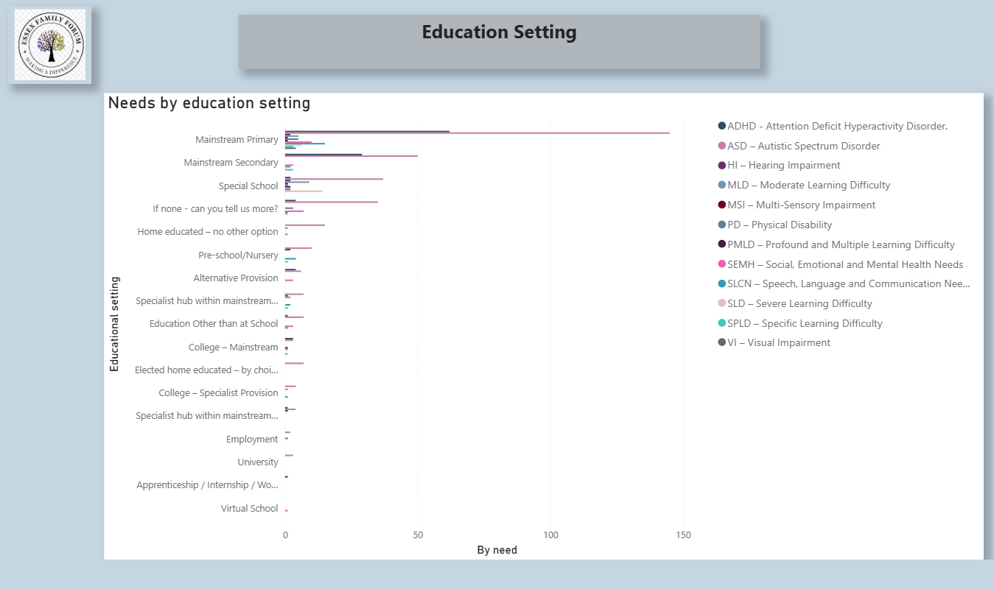

Slide 8
