Slide 1

152 parent carers responded across Mid Essex
Children mainly aged 5–15 years
Most common needs: Autism (ASD), ADHD, SEMH and Speech, Language and communication needs
Majority of participants had children in mainstream settings
Family Impact Survey 2025/26 Mid Essex
Notes:
The 2025 FIS received 665 responses from across Essex
This presentation looks to highlight the responses and data relating to North East Essex.
We received 130 responses from parents/carers from NEE
Respondents were evenly split between Tendring and Colchester
The majority of children and young people represented were aged 5-15
35% Female, 63% Male split remaining classified as other
Of those children that were represented in the survey 50 had an EHCP (50) 39 registered being on SEND support (for example One Plans) and 23 were undergoing assessment.

Slide 2
What is working well
Families in Mid Essex highlighted positive experiences where schools, SEND charities and individual professionals worked collaboratively to understand and support children and young people. The strongest feedback related to supportive schools, SENDIASS, local support groups, SEND roadshows and professionals who listened and advocated for families
"All my sons education settings have been very supportive and informative."
"My local parents association Send4all has been an absolute lifesaver."

Slide 3
Key systemic challenges
Families reported long waits, poor communication and difficulties accessing support as the biggest challenges. Concerns were raised regarding CAMHS, EHCP processes, access to therapies, social care support and delays in assessments and diagnosis. Many families described having to repeatedly fight for support and information
"Delays, poor communication."
"It is a constant struggle trying to get any help for my child."

Slide 4
Quadrant Variation
Families across Mid Essex reported similar experiences, with strengths found in schools and community support, but challenges remaining around communication, access to services and timeliness of support.
Emerging Local Themes
Families in more rural areas reported fewer local services and opportunities.
Some families highlighted limited support provision outside larger towns.
Concerns regarding transport reliability and access to specialist services requiring significant travel.

Slide 5
Next Steps
What we would like the SEND partnership to focus on:
Improve communication across SEND services and pathways.
Reduce waiting times for diagnosis, assessments and therapies.
Strengthen access to CAMHS and mental health support.
Improve timeliness and quality of EHCP processes.
Increase awareness of available support and services.
Improve access to local support, activities and specialist provision.

Slide 6
Appendix- Data from FIS 2025
The Below is the data that was used, along with individual comments to construct the summary report above.

Slide 7
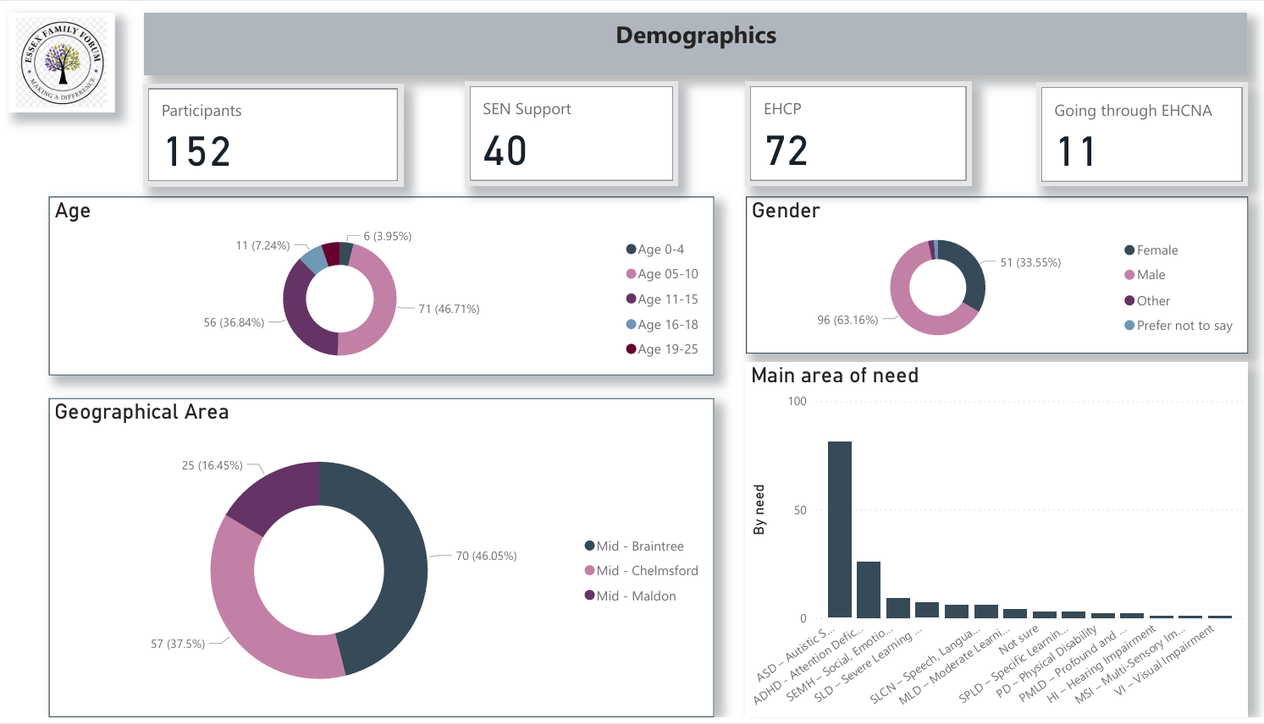

Slide 8
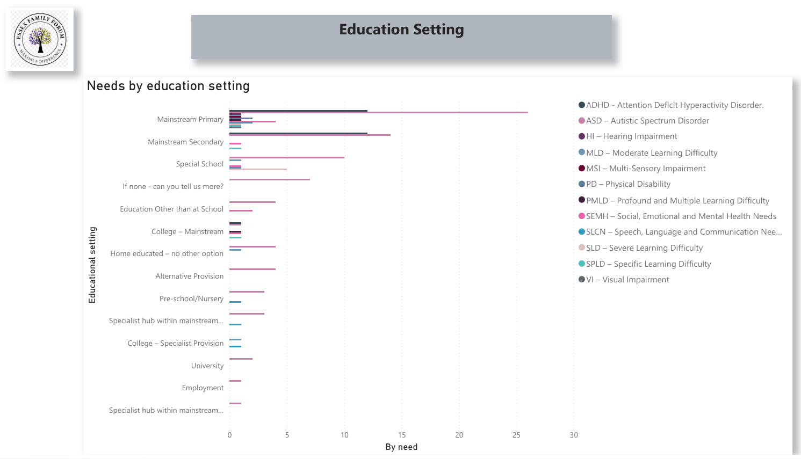

Slide 9
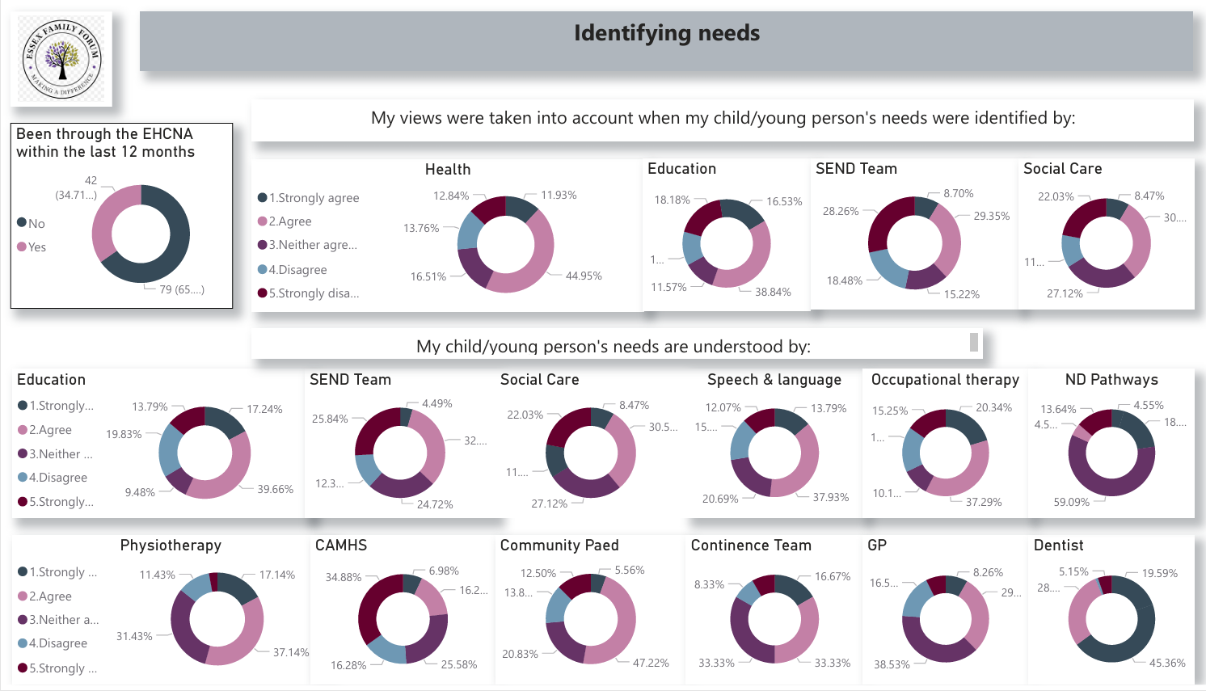

Slide 10
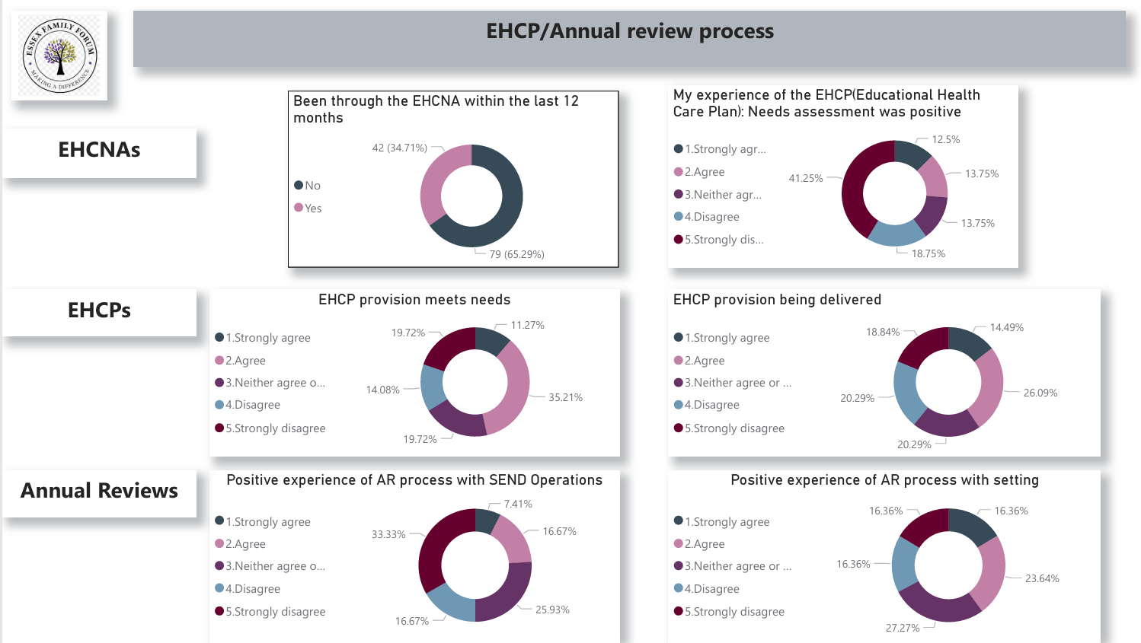

Slide 11
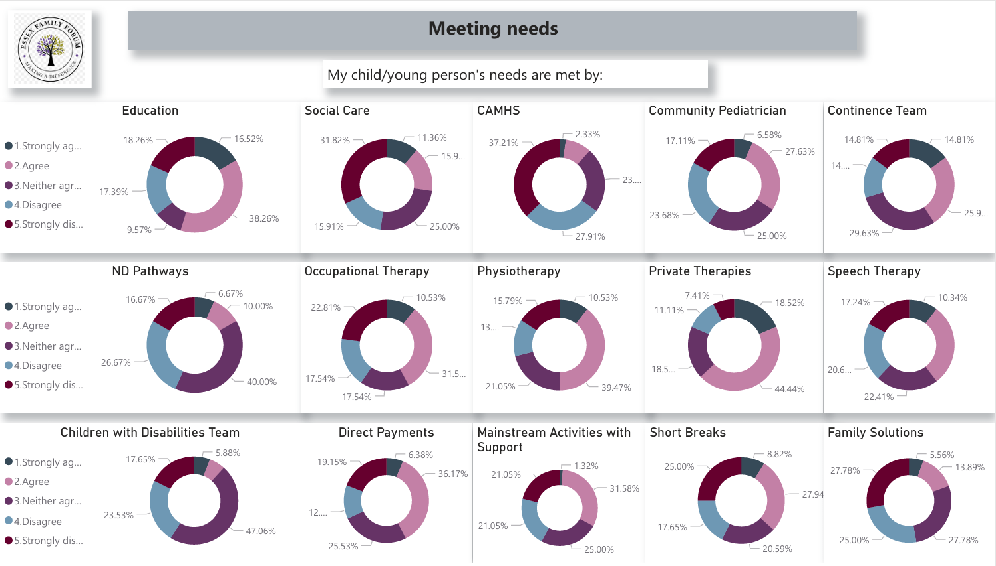

Slide 12
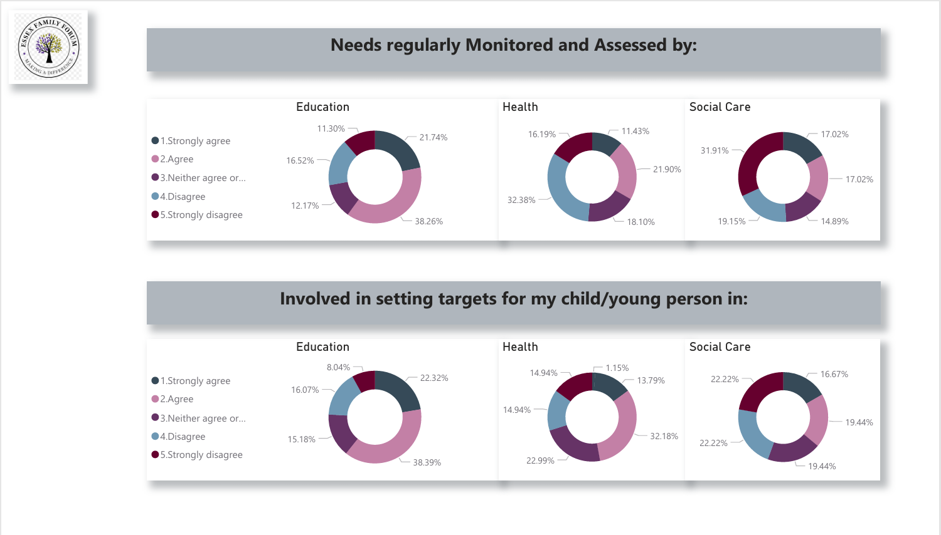

Slide 13
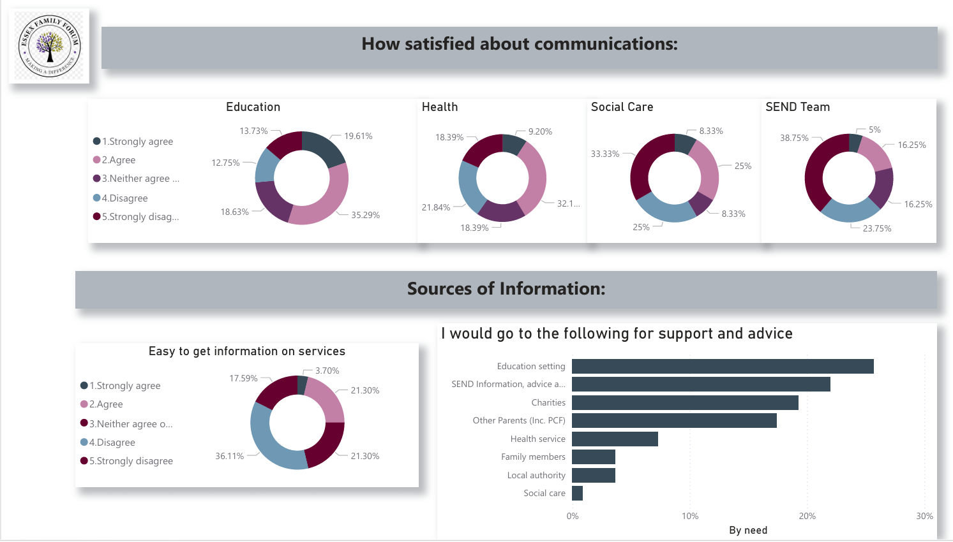

Slide 14
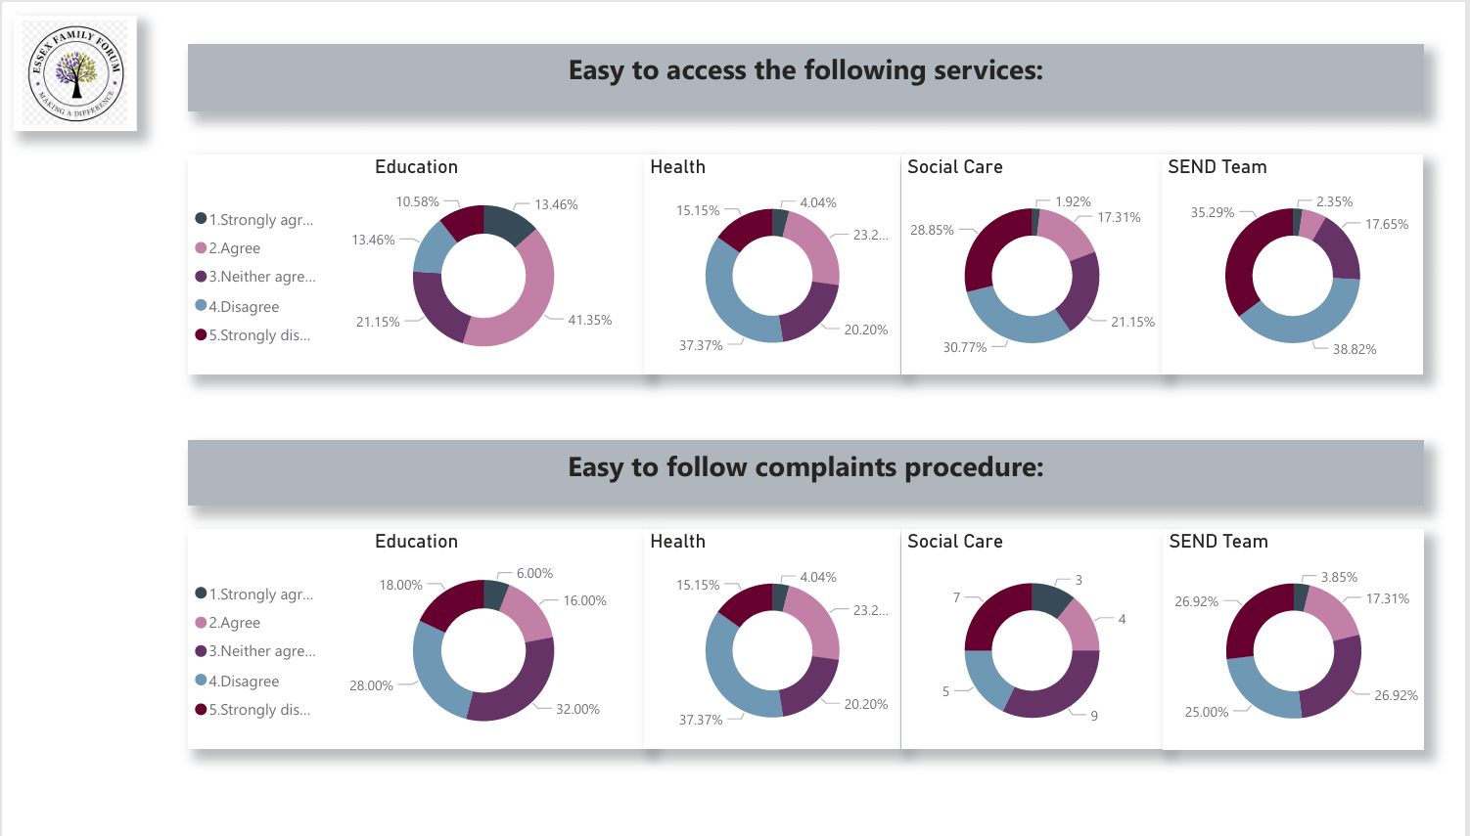

Slide 15
