Slide 1

130 parent carers responded across Essex
Children mainly aged 5–15 years
Most common needs: Autism (ASD), ADHD, SEMH and Speech, Language and communication needs
Majority of participants had children in mainstream settings
Family Impact Survey 2025/26 North East Essex
Notes:
The 2025 FIS received 665 responses from across Essex
This presentation looks to highlight the responses and data relating to North East Essex.
We received 130 responses from parents/carers from NEE
Respondents were evenly split between Tendring and Colchester
The majority of children and young people represented were aged 5-15
35% Female, 63% Male split remaining classified as other
Of those children that were represented in the survey 50 had an EHCP (50) 39 registered being on SEND support (for example One Plans) and 23 were undergoing assessment.

Slide 2
What is working well
Families in North East Essex highlighted the positive impact of supportive schools, SENDIASS, charities, parent support groups and individual professionals who listened and worked collaboratively with families. Positive feedback often centred on families feeling heard, receiving effective signposting, and children benefiting from the right support and educational provision.
"Engagement facilitator really listened to us as parents. Felt heard and supported."
"Health visitor has been fantastic and supported our referral. No one else took us seriously."

Slide 3
Key systemic challenges
Families described significant challenges around communication, delays, EHCP processes and access to support. Many reported having to repeatedly fight for help, concerns about legal compliance within SEND processes, difficulties accessing mental health support and frustrations regarding unmet needs.
"Always a fight to get the needs for the child met."
"Absolutely disgraceful service... no communication, no honesty, no regard for the law."

Slide 4
Quadrant Variation
Families across North East Essex reported that outcomes improve when services listen, communicate clearly and work collaboratively, but significant concerns remain around timeliness, consistency and access to support.
Emerging Local Themes
Families reported shortages of specialist placements and suitable alternative provision.
Several comments highlighted difficulties securing provision that fully met needs.
Transport concerns focused on consistency, communication and accessibility.

Slide 5
Next Steps
What we would like the SEND partnership to focus on:
Improve communication across SEND services and pathways.
Reduce waiting times for EHCPs, assessments and support services.
Strengthen access to CAMHS and mental health support.
Improve consistency and delivery of EHCP provision.
Increase confidence in Preparing for Adulthood pathways.
Improve access to appropriate educational placements and support.

Slide 6
Appendix- Data from FIS 2025
The Below is the data that was used, along with individual comments to construct the summary report above.

Slide 7
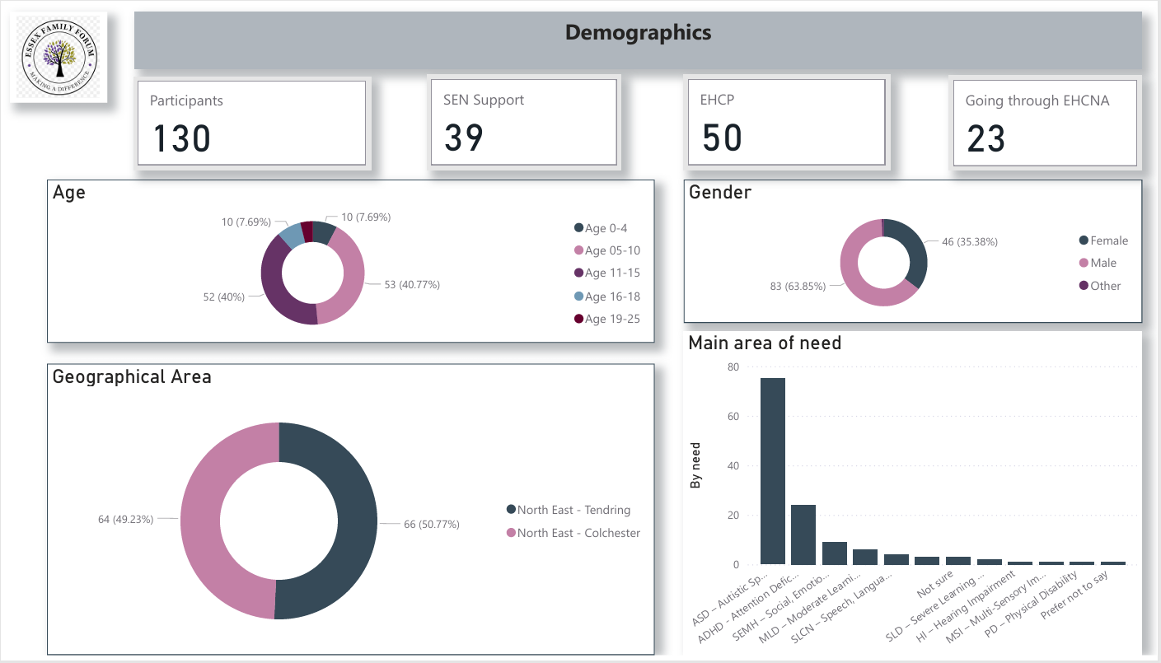

Slide 8
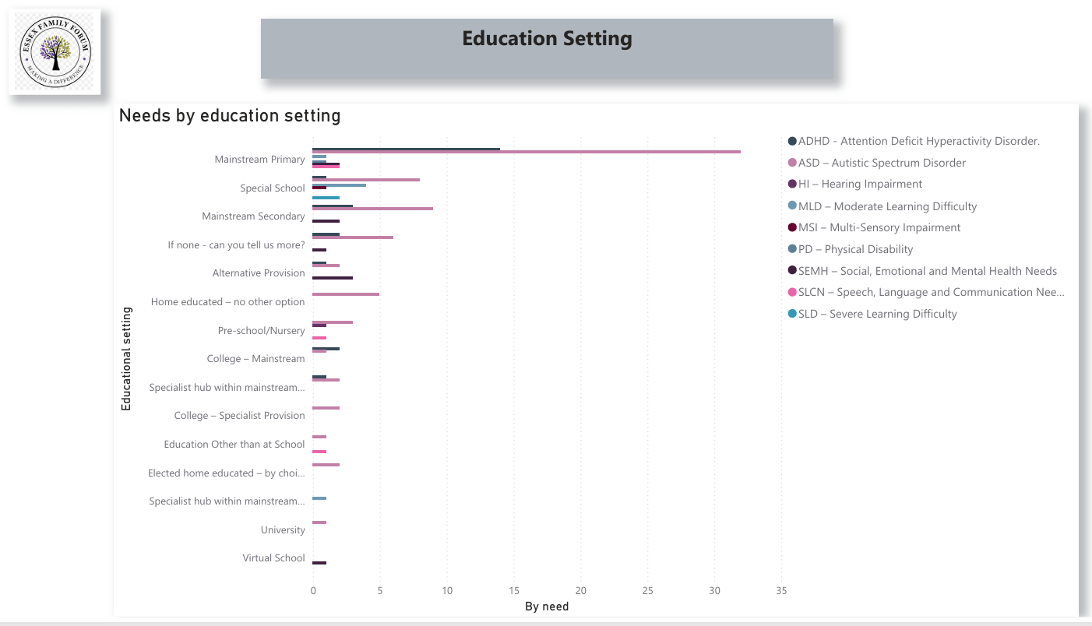

Slide 9
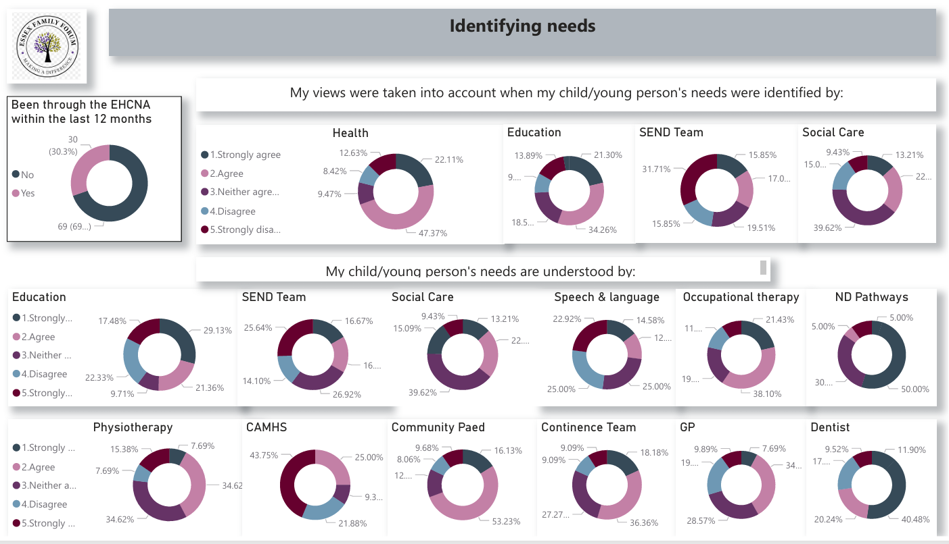

Slide 10
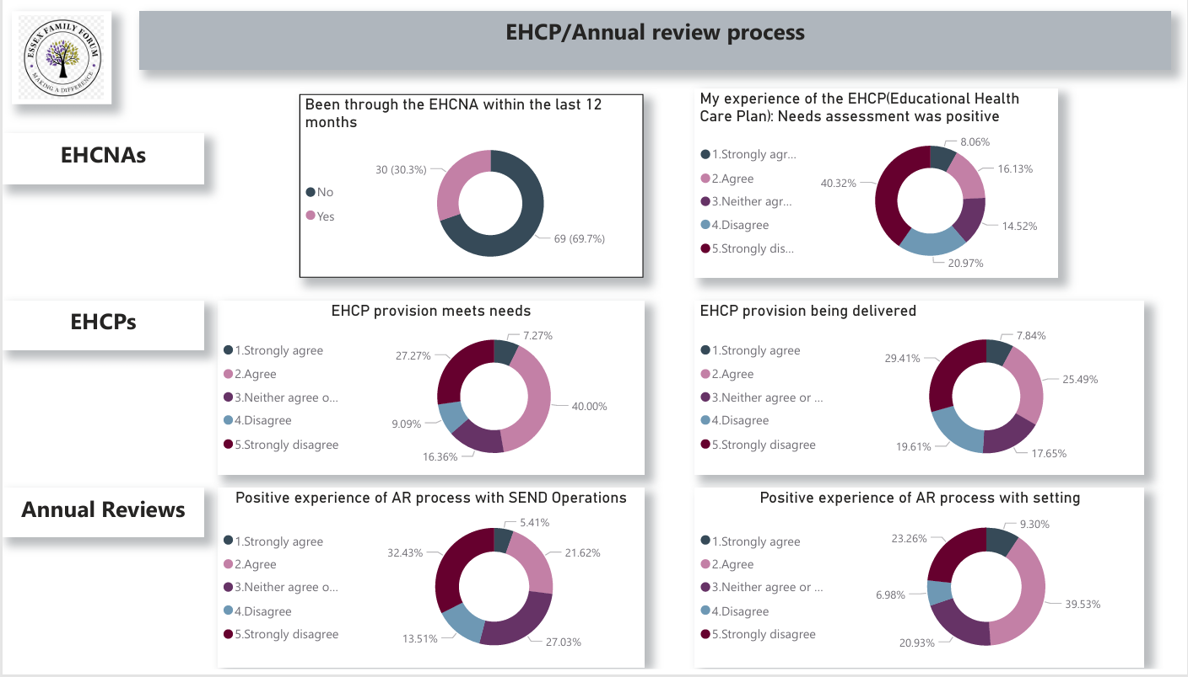

Slide 11
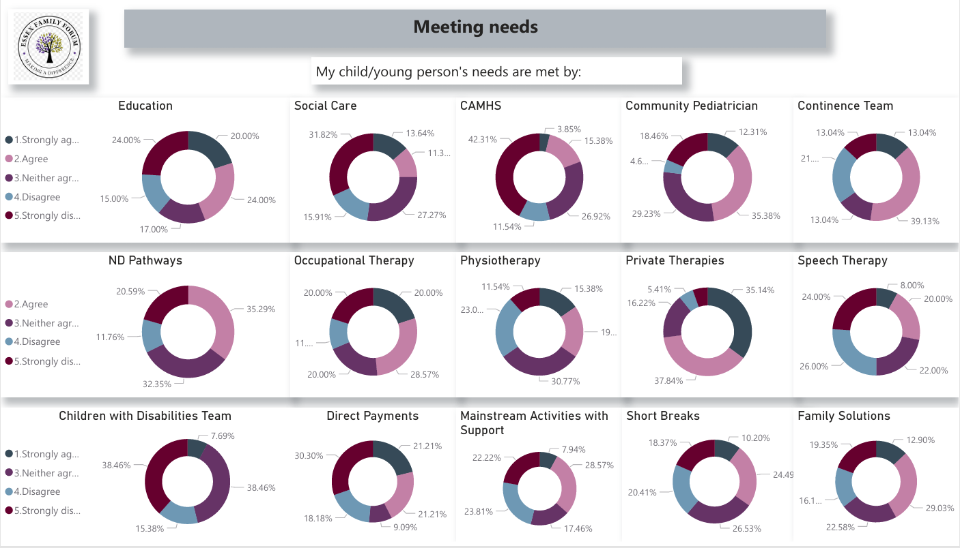

Slide 12
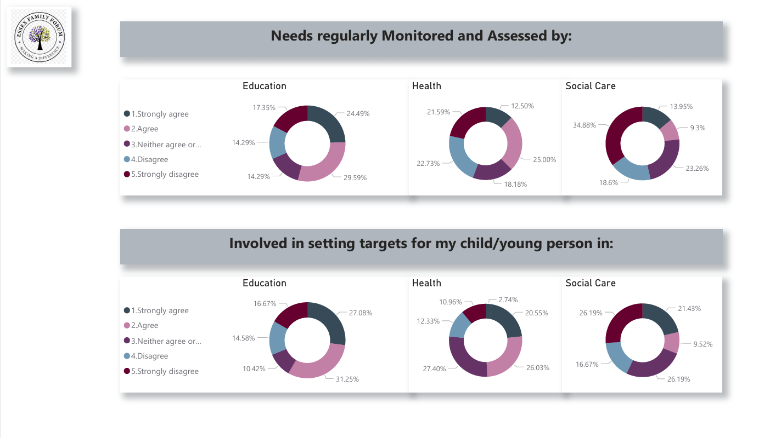

Slide 13
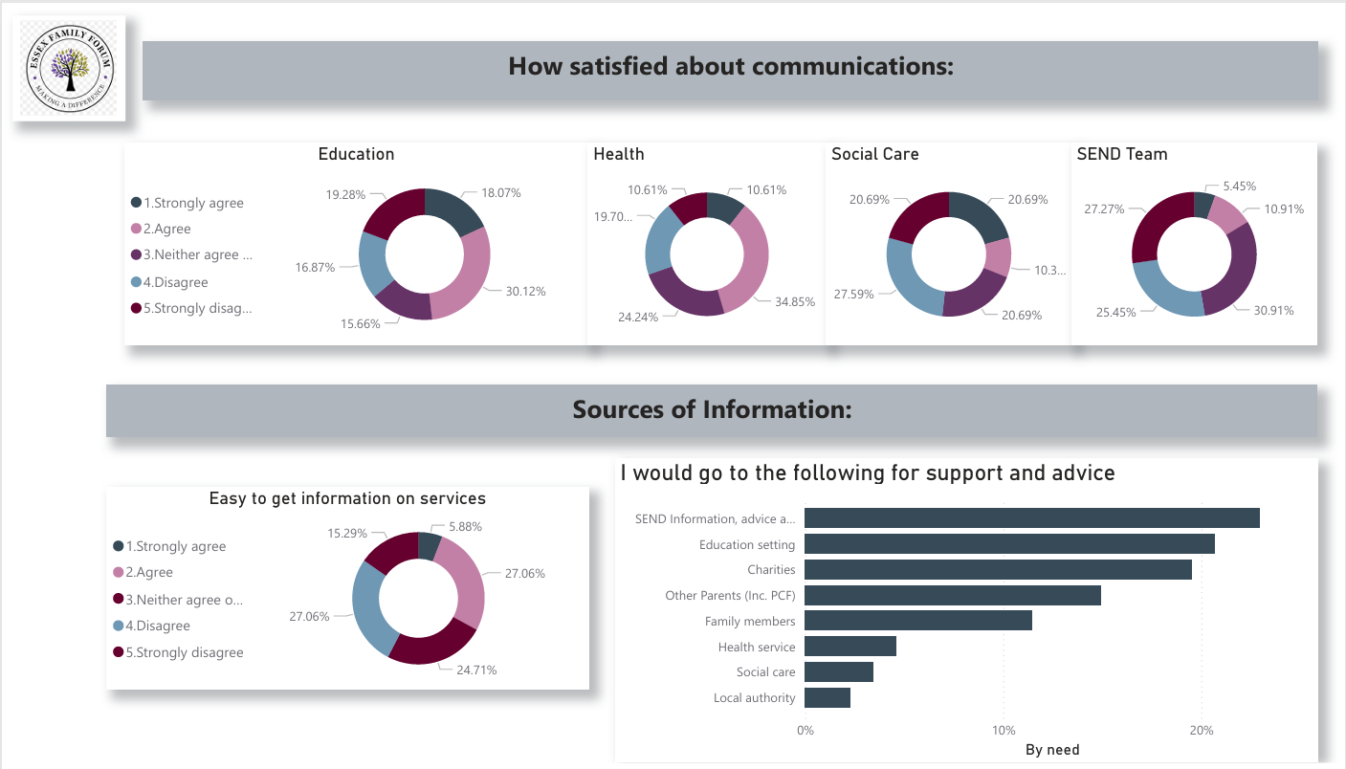

Slide 14
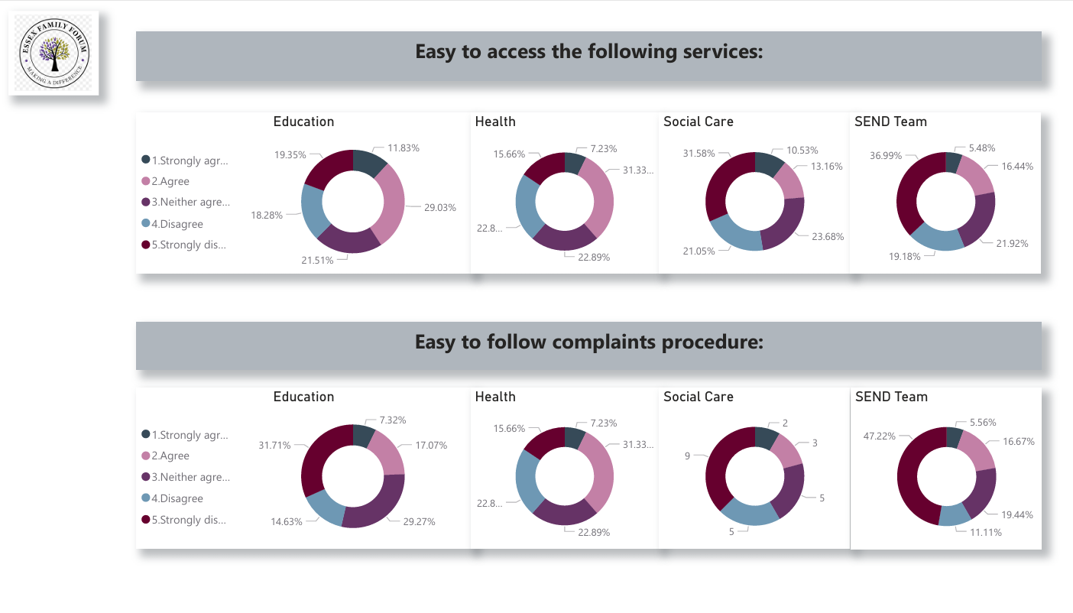

Slide 15
