Slide 1

220 parent carers responded across South Essex
Children mainly aged 5–15 years
Most common needs: Autism (ASD), ADHD, SEMH and Speech, Language and communication needs
Majority of participants had children in mainstream settings
Family Impact Survey 2025/26 Summary
Notes:
The 2025 FIS received 665 responses from across Essex
This presentation looks to highlight the responses and data relating to North East Essex.
We received 130 responses from parents/carers from NEE
Respondents were evenly split between Tendring and Colchester
The majority of children and young people represented were aged 5-15
35% Female, 63% Male split remaining classified as other
Of those children that were represented in the survey 50 had an EHCP (50) 39 registered being on SEND support (for example One Plans) and 23 were undergoing assessment.

Slide 2
What is working well
Families in South Essex highlighted the positive impact of supportive schools, SEND charities, support groups and individual professionals who listened and understood their child's needs. Positive experiences were most commonly linked to children being in the right educational setting, strong relationships with school staff, and support from organisations such as SNAP, Families in Focus and local support groups.
"Education are addressing some of the needs and implementing the right support."
"Charities like SNAP are amazing. So caring and helpful."

Slide 3
Key systemic challenges
Whilst many families praised individual professionals, families consistently reported difficulties navigating the wider SEND system. Long waiting times, poor communication, challenges accessing assessments and mental health support, and delays in EHCP processes were recurring themes. Many parents described feeling exhausted from having to repeatedly advocate for support.
"The constant battle has left me in poor health physically, mentally and emotionally, just exhausted."
"You have to be prepared to wait YEARS for anything."

Slide 4
Quadrant Variation
Across South Essex, families consistently praised individual professionals and schools, but reported challenges with system-wide communication, timeliness and access to support.
Emerging Local Themes
Transport concerns were raised frequently, particularly around driver changes, reliability and eligibility decisions.
Several families reported challenges accessing specialist provision and suitable school placements.
Transition to adulthood generated significant concern, with many families expressing uncertainty about future support.

Slide 5
Next Steps
What we would like the SEND partnership to focus on:
Improve communication across SEND services and pathways.
Reduce waiting times for assessments, diagnosis and intervention.
Strengthen access to mental health support, particularly CAMHS.
Improve timeliness and consistency of EHCP processes.
Increase confidence in Preparing for Adulthood pathways and support.
Improve access to suitable educational provision and transport.

Slide 6
Appendix- Data from FIS 2025
The Below is the data that was used, along with individual comments to construct the summary report above.

Slide 7
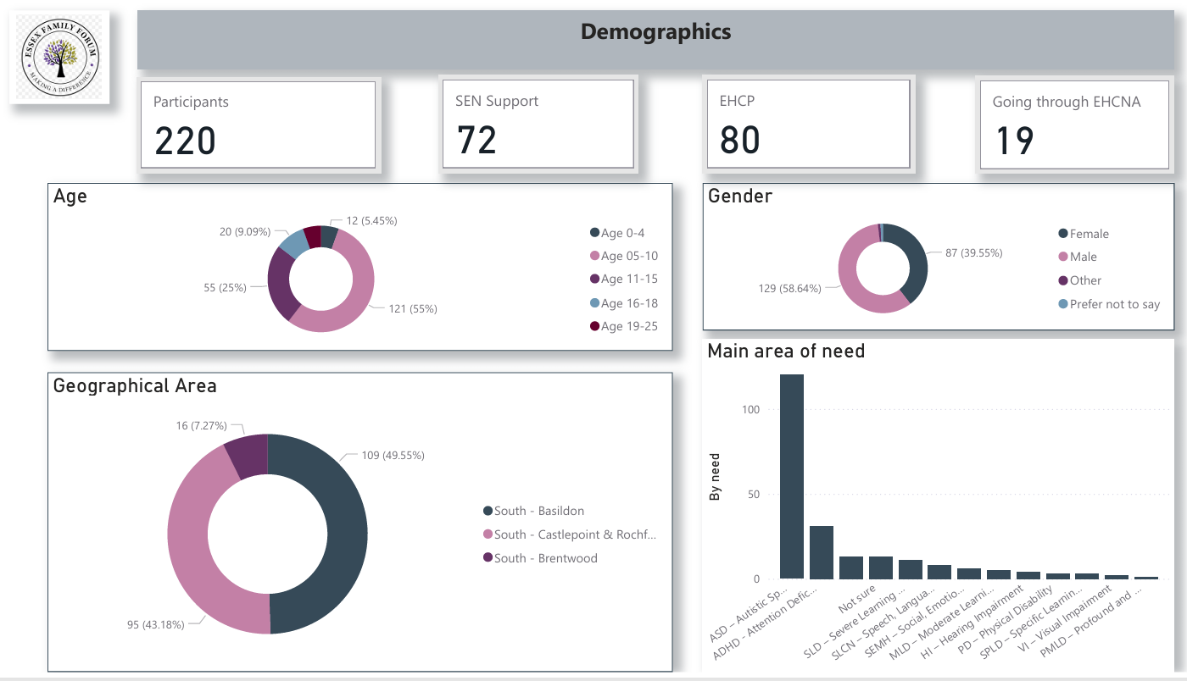

Slide 8
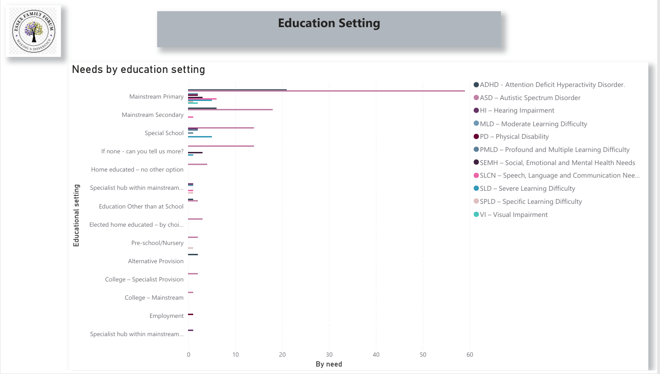

Slide 9
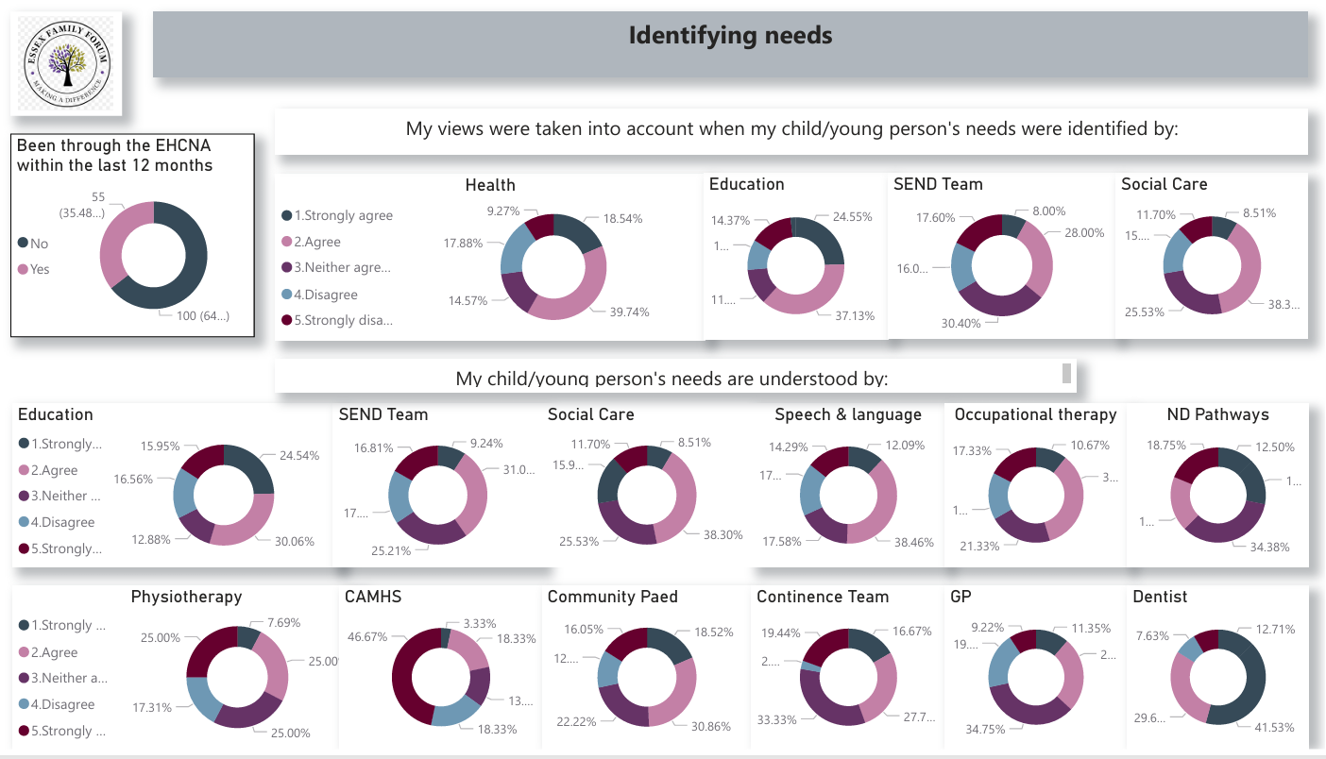

Slide 10
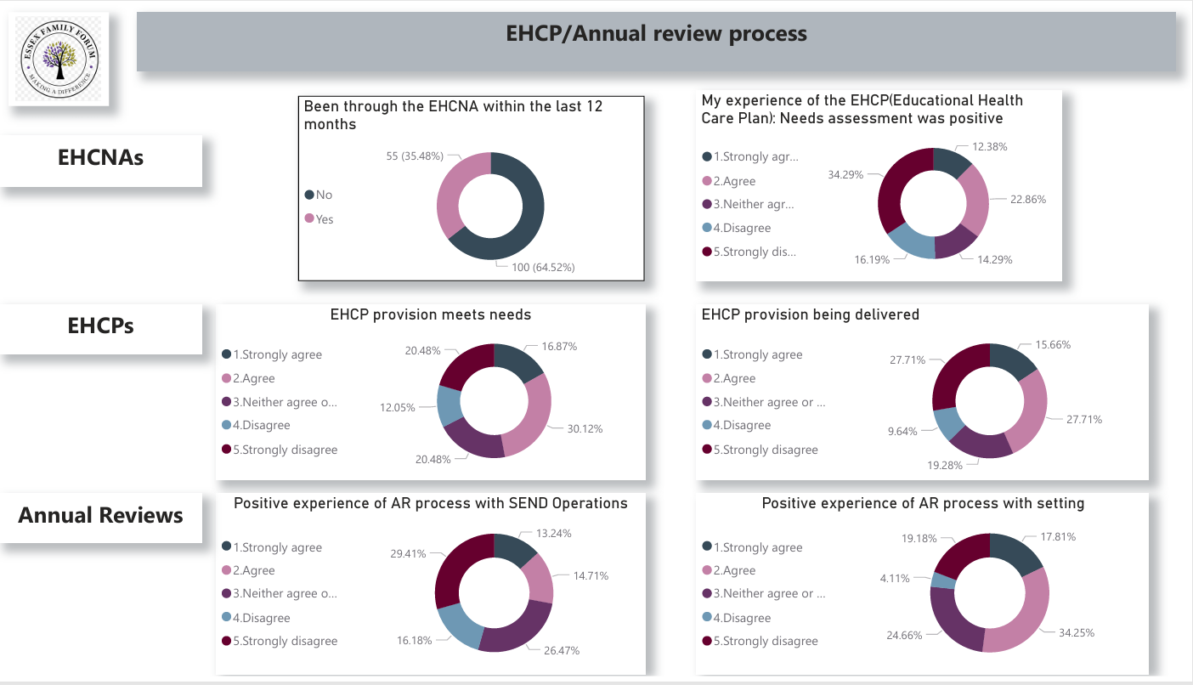

Slide 11
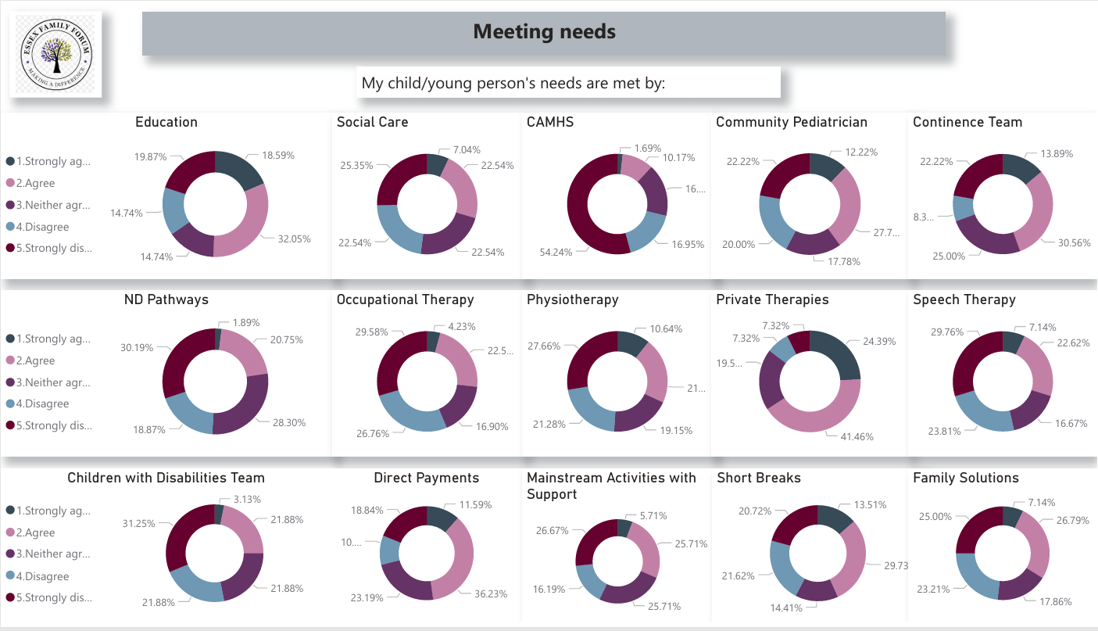

Slide 12
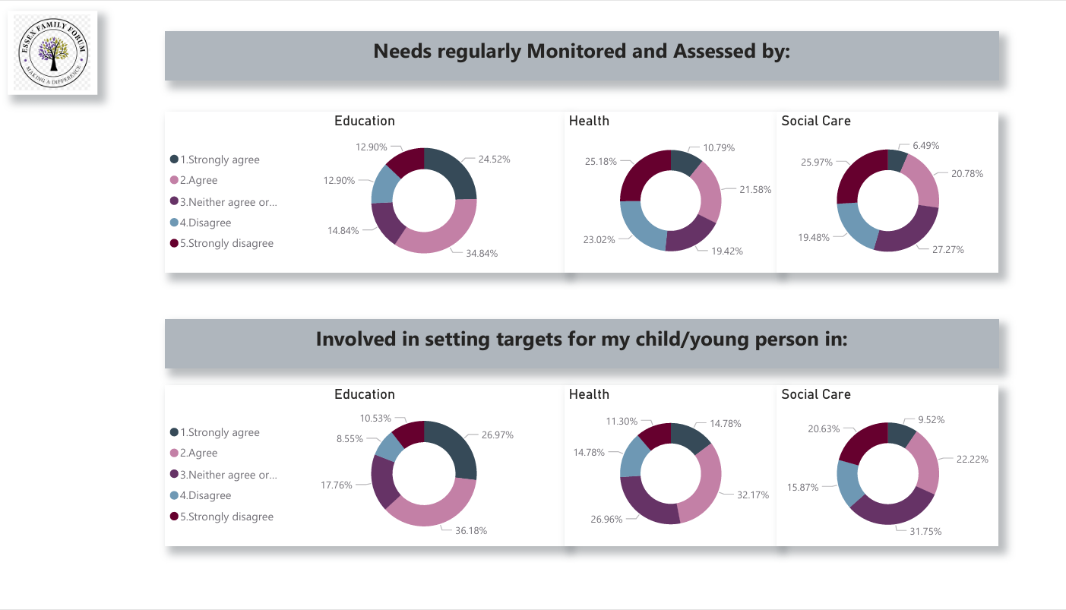

Slide 13
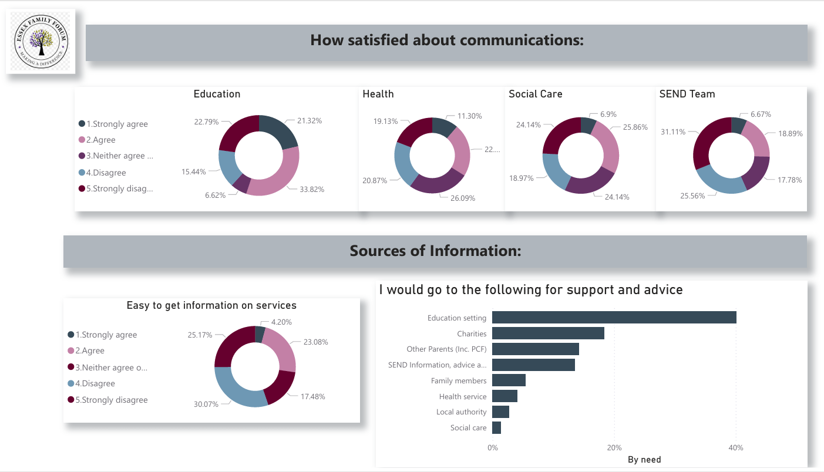

Slide 14
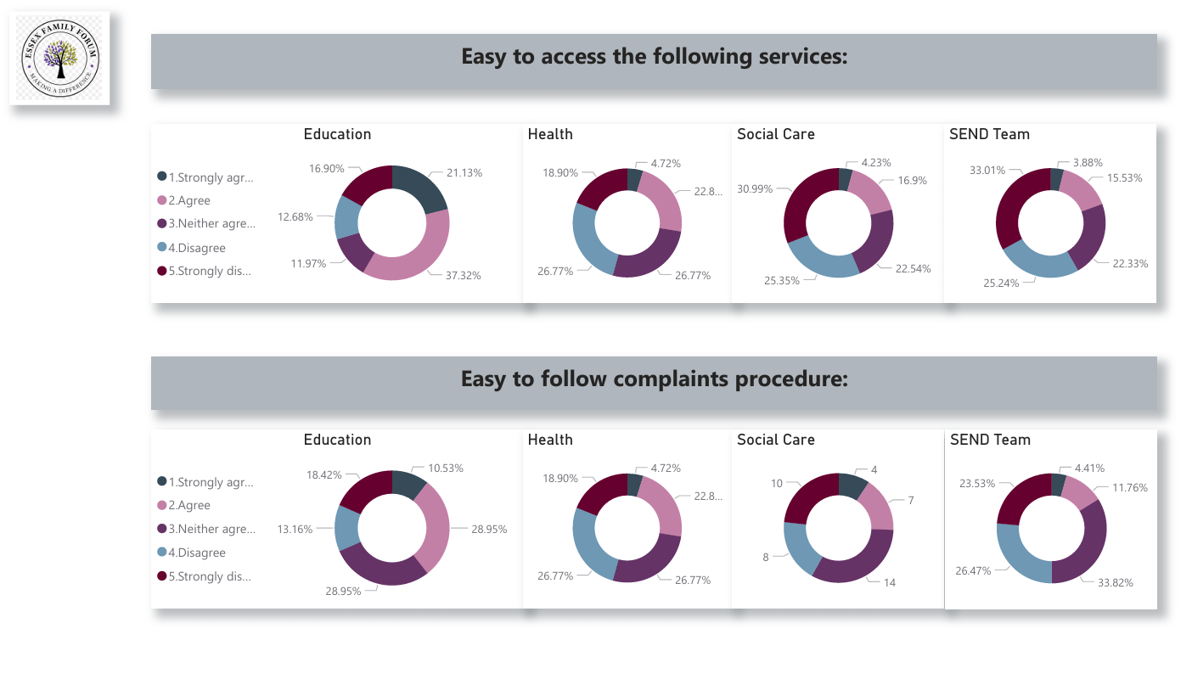

Slide 15
