Slide 1

135 parent carers responded across West Essex
Children mainly aged 5–15 years
Most common needs: Autism (ASD), ADHD, SEMH and Speech, Language and communication needs
Majority of participants had children in mainstream settings
Family Impact Survey 2025/26 West Essex
Notes:
The 2025 FIS received 665 responses from across Essex
This presentation looks to highlight the responses and data relating to North East Essex.
We received 130 responses from parents/carers from NEE
Respondents were evenly split between Tendring and Colchester
The majority of children and young people represented were aged 5-15
35% Female, 63% Male split remaining classified as other
Of those children that were represented in the survey 50 had an EHCP (50) 39 registered being on SEND support (for example One Plans) and 23 were undergoing assessment.

Slide 2
What is working well
Families in West Essex highlighted the positive impact of supportive schools, charities and individual professionals who understand SEND and work collaboratively with families. The strongest feedback related to children thriving in the right educational setting, supportive SEND organisations such as Families in Focus, and professionals who listen and take action.
"Education meets my sons needs and getting a place in the right setting has seen him thrive."
"Families in Focus have been a huge support throughout."

Slide 3
Key systemic challenges
While families valued individual professionals, many described the wider SEND system as difficult to navigate. Consistent concerns included long waiting times, poor communication, difficulties accessing services, EHCP delays, challenges accessing mental health support and families feeling they had to repeatedly chase for help.
"Awful, lack of or no communication, painful, emotional, frustrating, system is not working."
"Any actual help that my child should receive I have had to request and fight for."

Slide 4
Quadrant Variation
Families' experiences are shaped less by location and more by how accessible, responsive and coordinated services feel once they enter the SEND system.
Emerging Local Themes
Families in more rural areas reported concerns about distance and accessibility of services.
Several comments highlighted that support and activities were concentrated in larger towns and less available in fringe or border communities.

Slide 5
Next Steps
What we would like the SEND partnership to focus on:
Improve communication across SEND services.
Reduce waiting times for assessments and interventions.
Strengthen access to mental health support.
Improve timeliness and quality of EHCP processes.
Increase access to local support and activities.
Ensure services take a more joined-up, family-centred approach.

Slide 6
Appendix- Data from FIS 2025
The Below is the data that was used, along with individual comments to construct the summary report above.

Slide 7
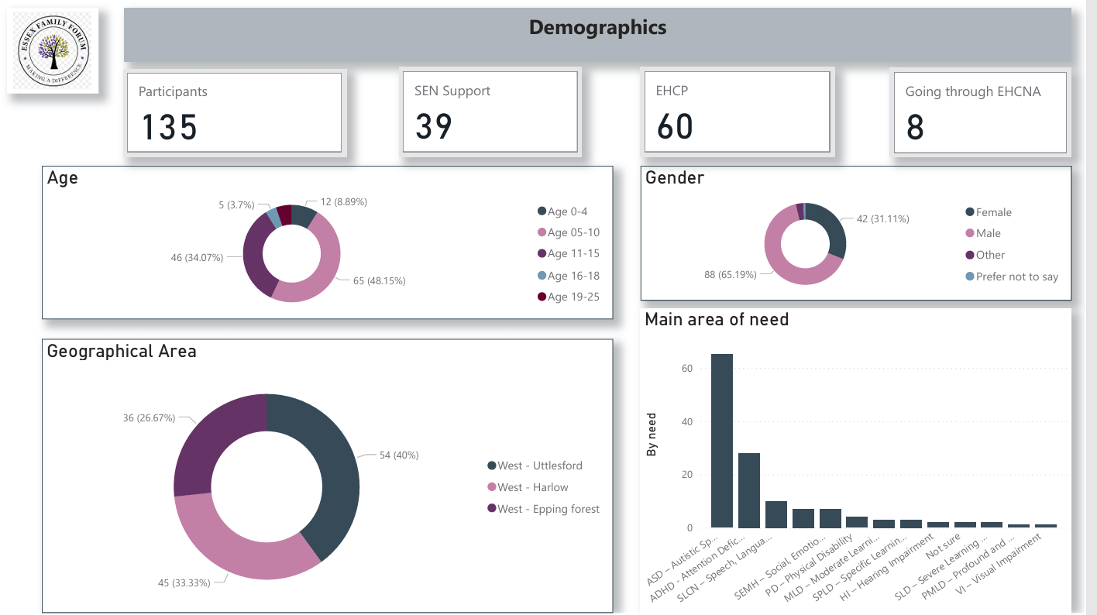

Slide 8
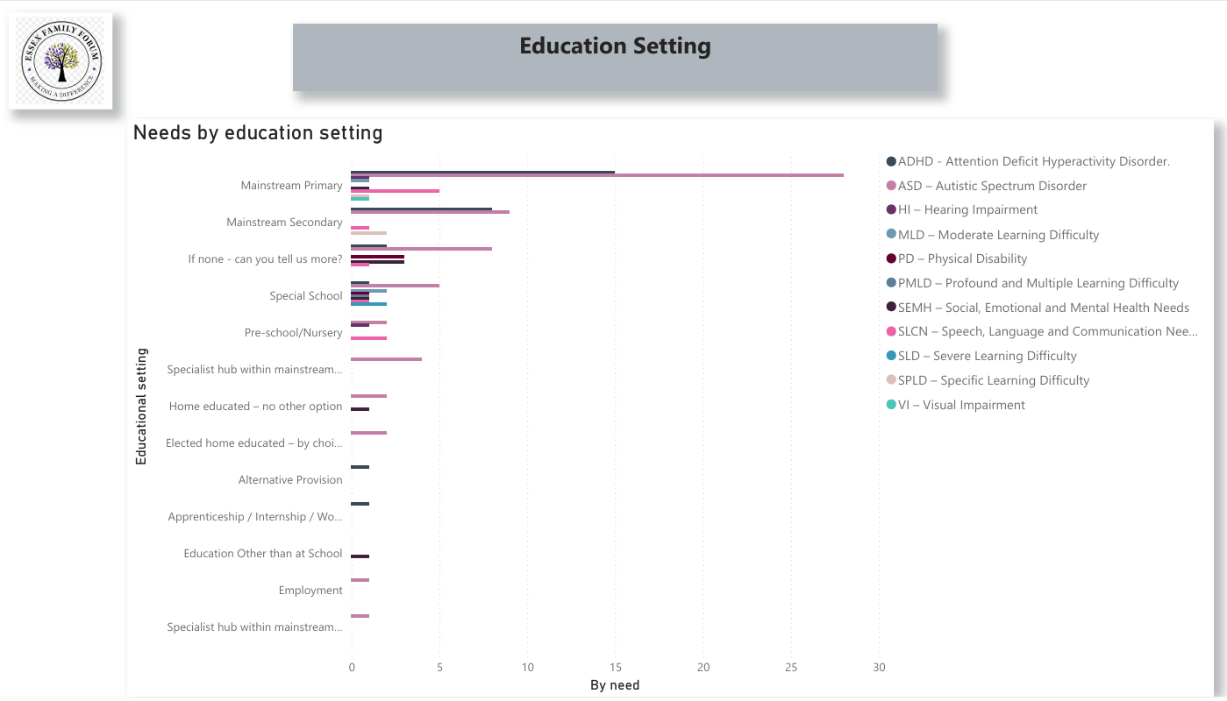

Slide 9
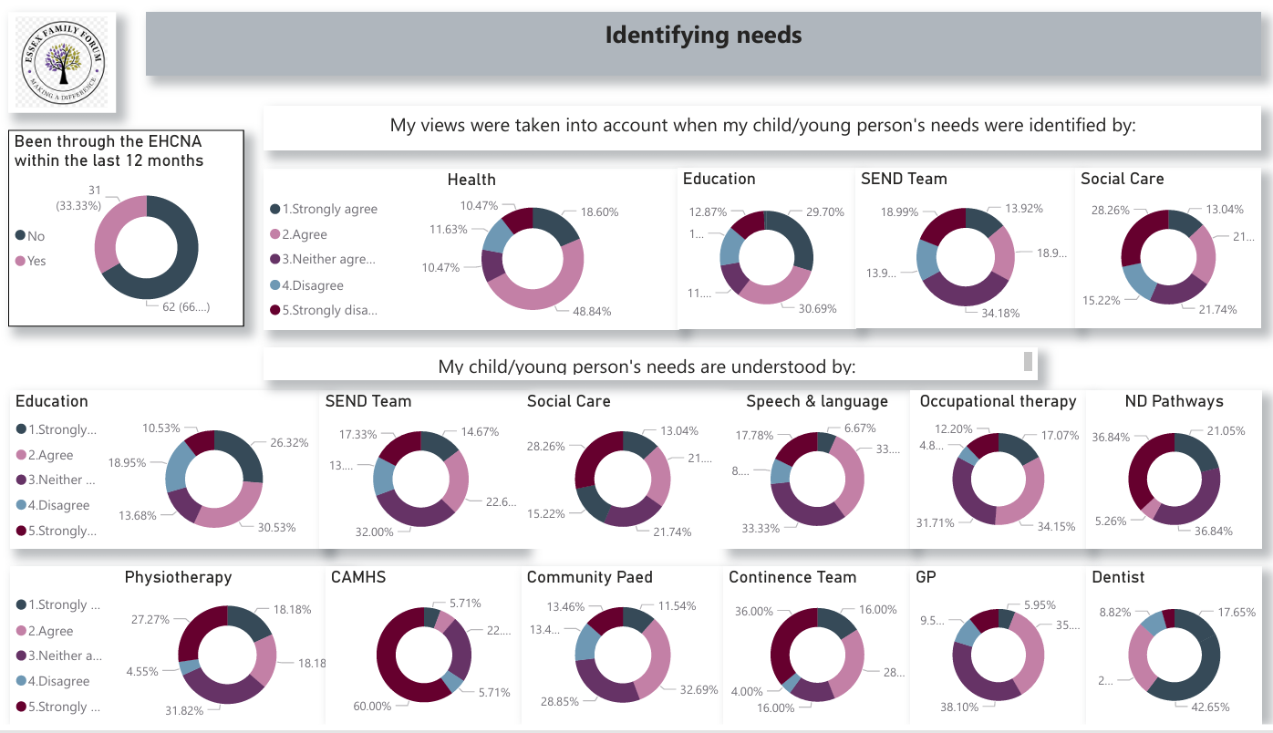

Slide 10
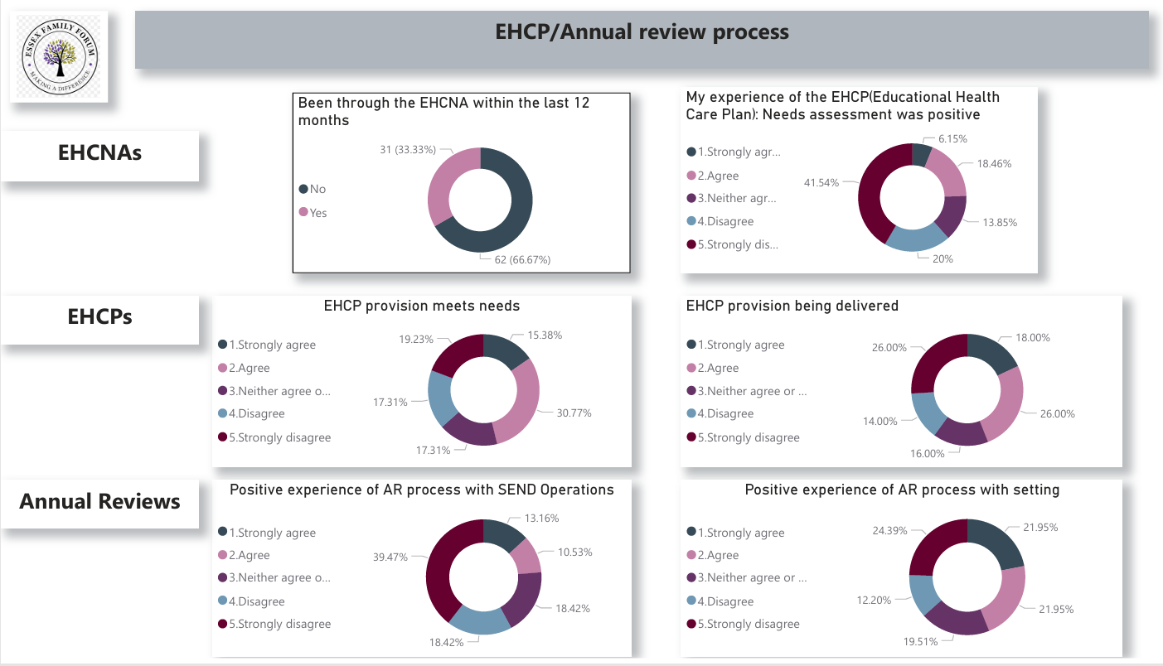

Slide 11
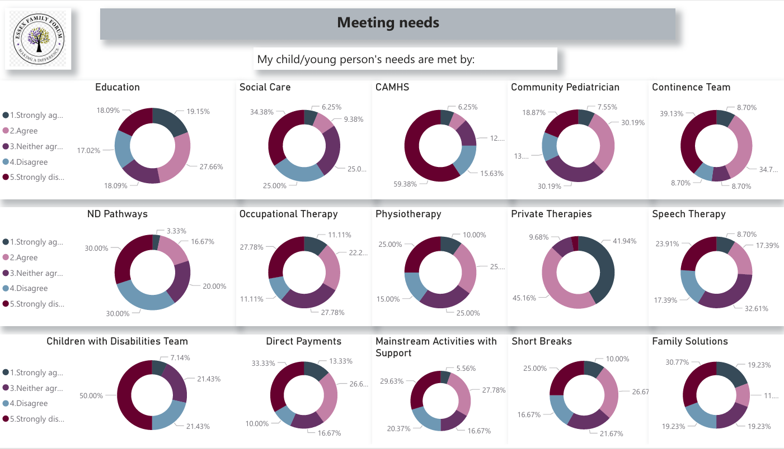

Slide 12
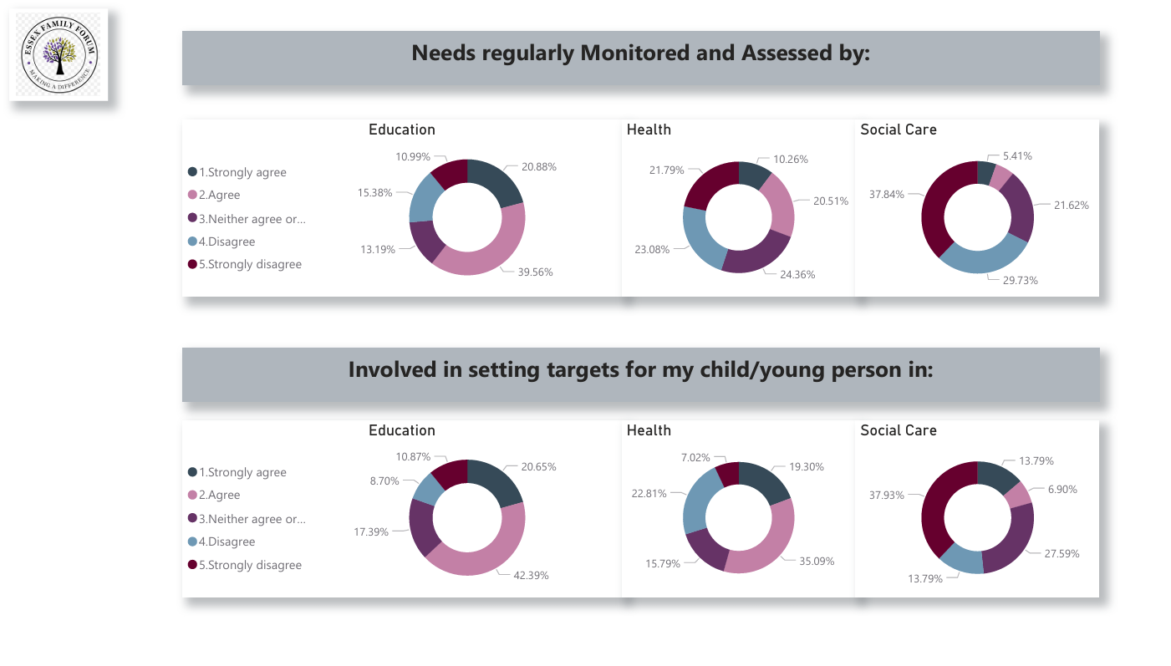

Slide 13
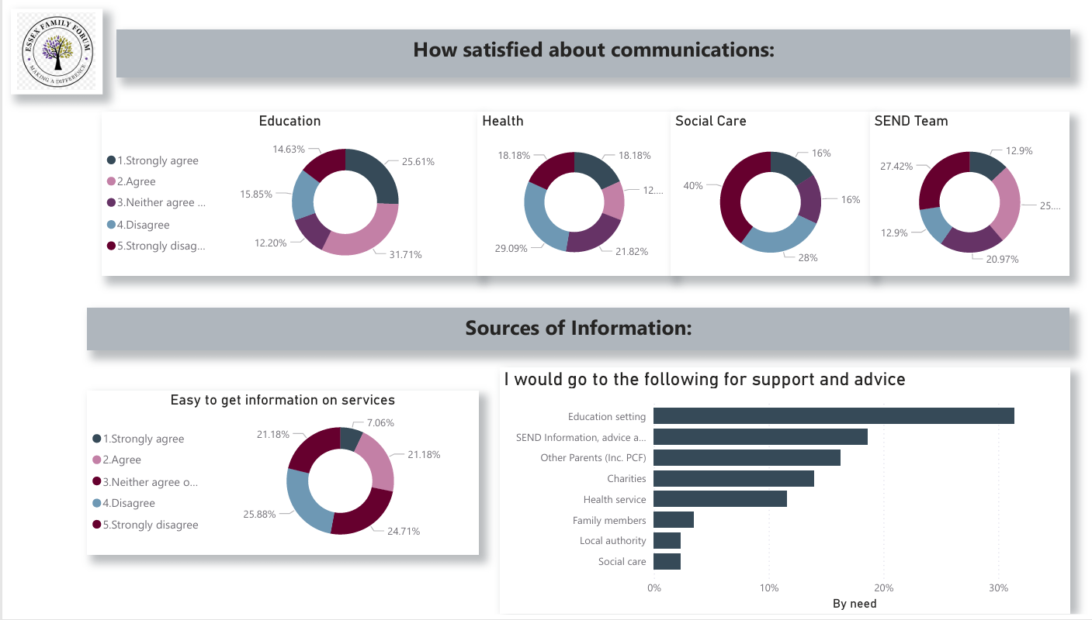

Slide 14
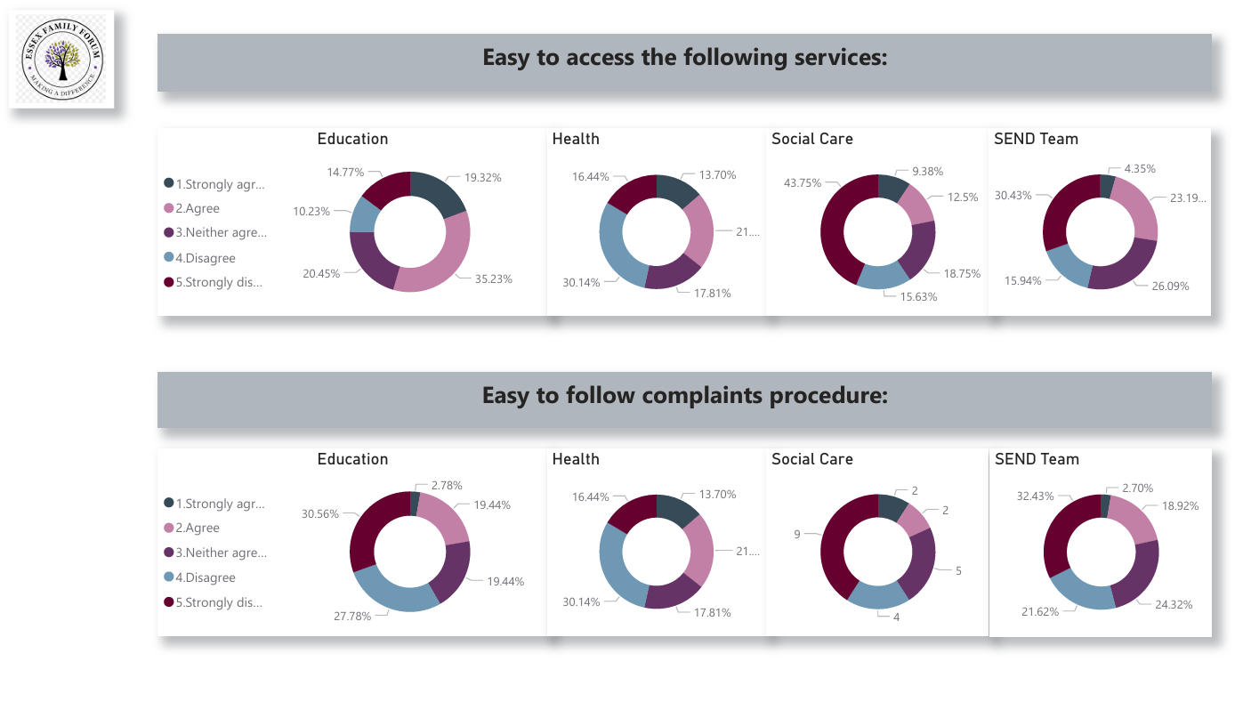

Slide 15
